Slide 1



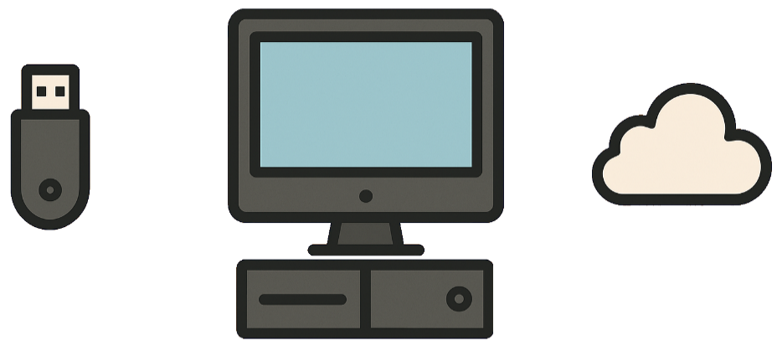
Starter – Revision
Subject: Computing Science
Level: S1
Topics: Computing Science - Basics
      Hardware
      Processor
      Binary
      Backing Storage

Slide 2
Bitmap Graphics
Computing Science

Slide 3

Learning Targets
I can define the term bitmap graphic
I can define the term pixel
I can define the term resolution
I can explain how resolution affects image quality
I can identify the resolution of a bitmap graphic
I can create a bitmap graphic

Slide 4

What is a graphic?
A graphic is any picture or image you see on a screen

Slide 5


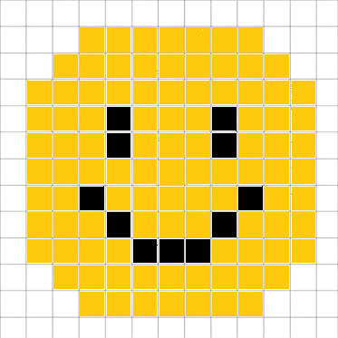
What is a bitmap graphic?
Computers can display images using a grid.
Each square on the grid is called a pixel.
A bitmap graphic is a grid of pixels.

Slide 6
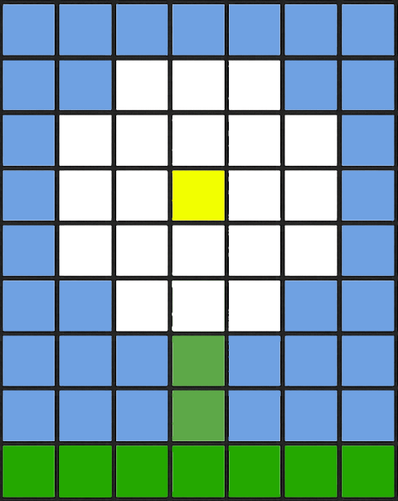
Resolution
The resolution of a graphic is the number of pixels used to create it
It is written as width x height
The resolution of this image is
x
7
7
9
9

Slide 7
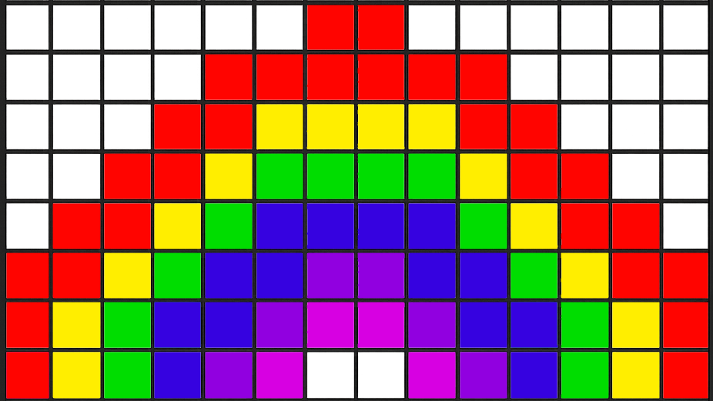
Identify the resolution of this graphic
14 x 8

Slide 8
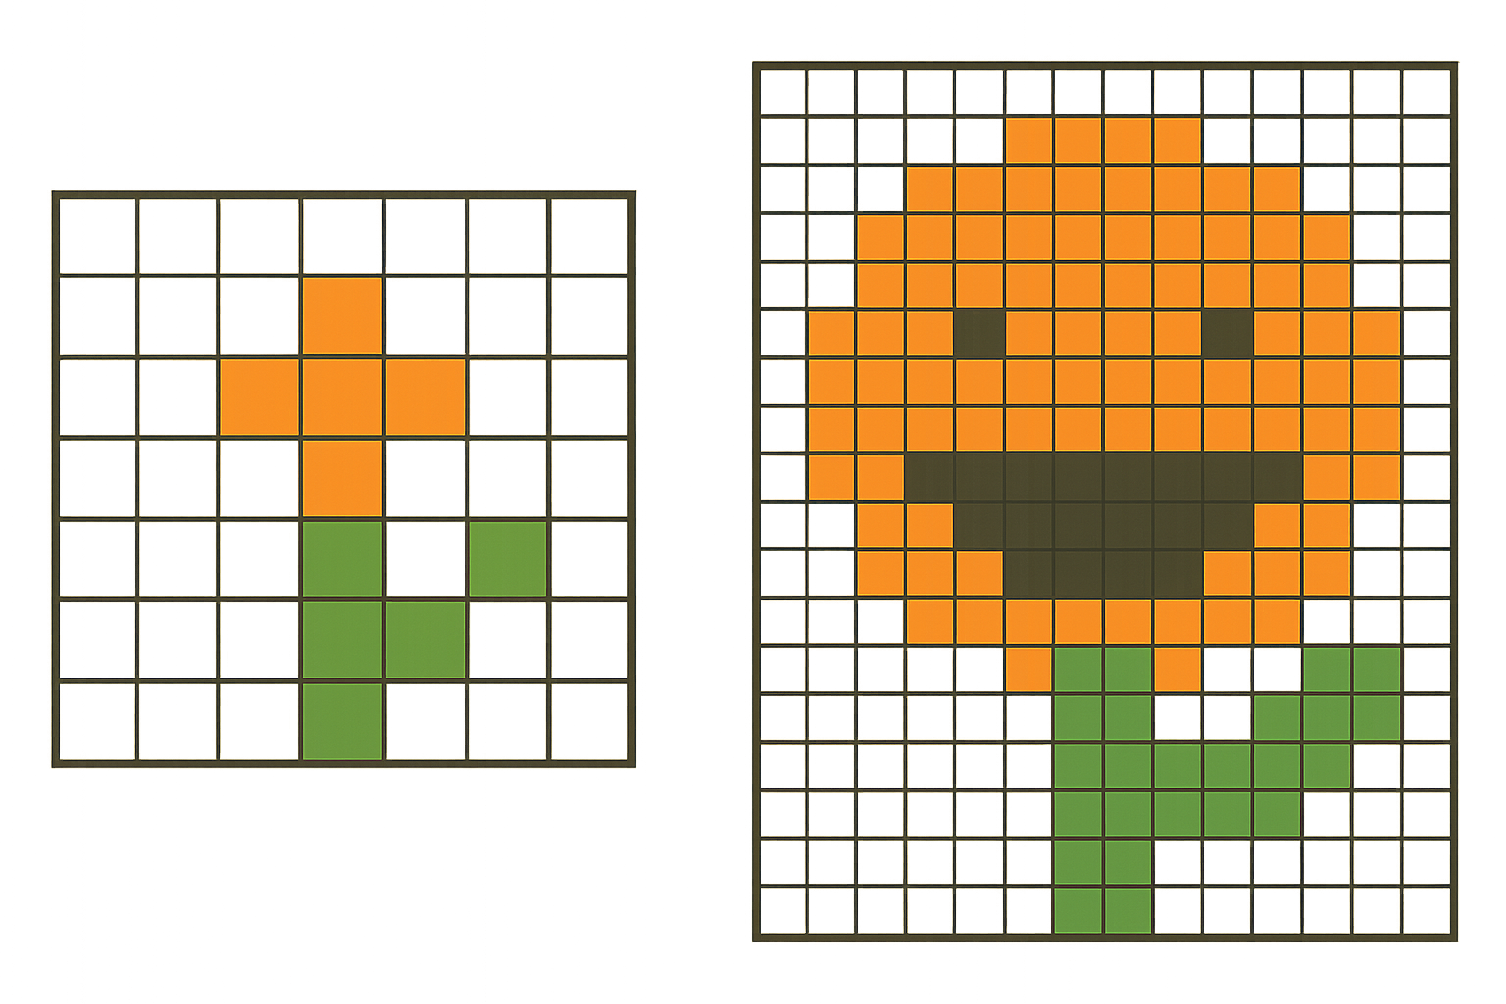
How does resolution affect quality?
Higher resolution bitmaps contain more pixels, resulting in greater image detail.
Lower resolution bitmaps contain fewer pixels, resulting in less image detail.

Slide 9
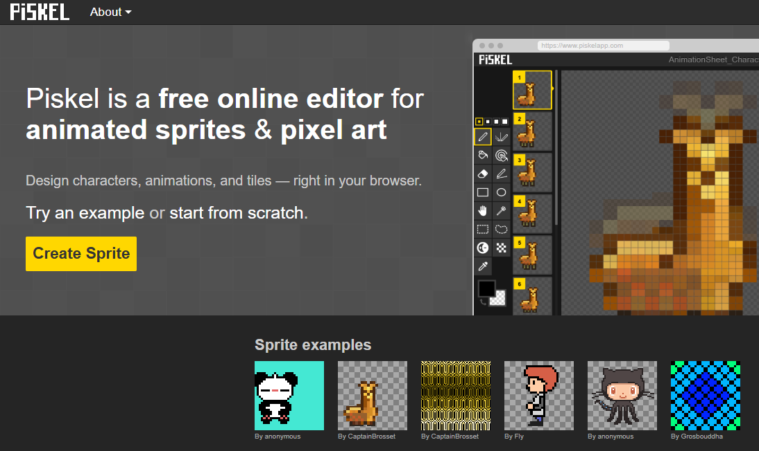
Creating bitmap graphics with piskelapp.com
Click ‘Create Sprite’
*A sprite is another name for a bitmap graphic
Notes:
Either use this presentation or demo how to make a graphic on piskelapp.com

Slide 10
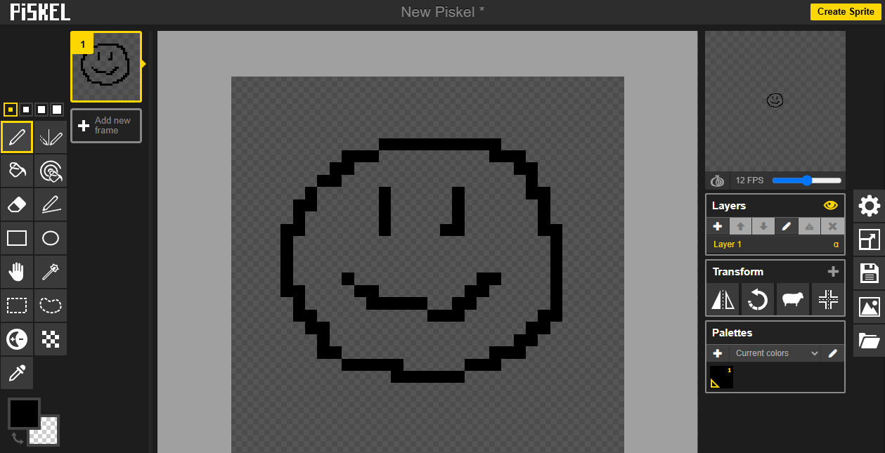
Draw your bitmap
Use the pen tool to change the colours of the pixels
Use colour tool to change the colour of the pen

Slide 11
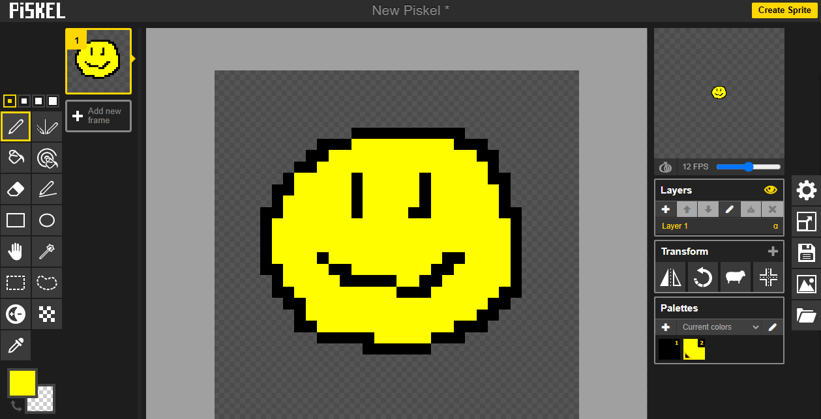
Click ‘Export’

Slide 12
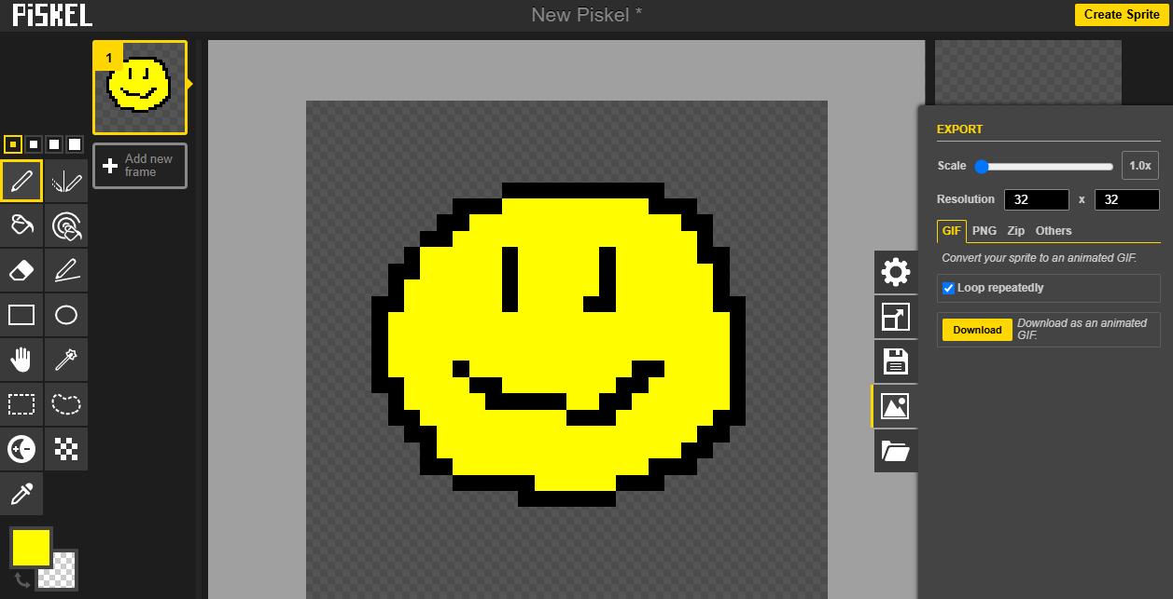
Click ‘PNG’
*A PNG is a type of bitmap

Slide 13
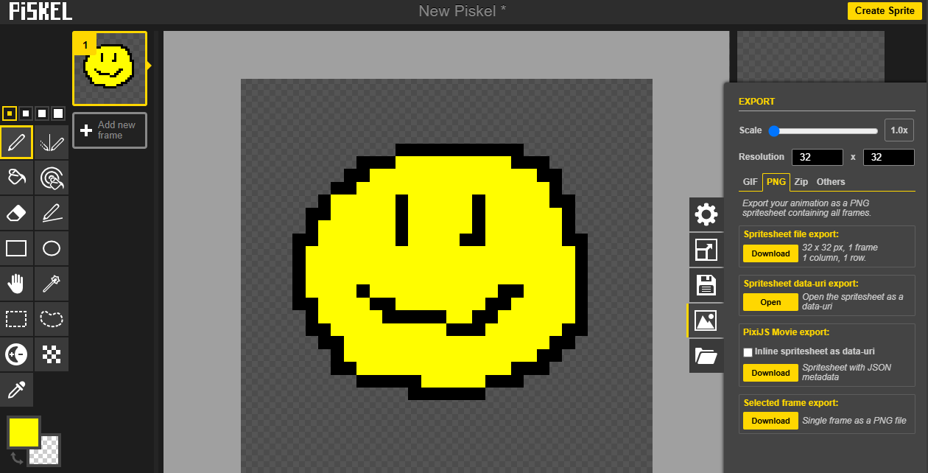
Click ‘Selected frame export’

Slide 14

Task 1
Take a Test
Task 2
Workbook
Subject: Computing Science
Level: S1
Topic: Computing Science - Basics
      Bitmap Graphics
Download and complete the
Workbook
SuperStudyParty.com
S1 - S3
Computing Science - Basics
Bitmap Graphics

