Slide 1
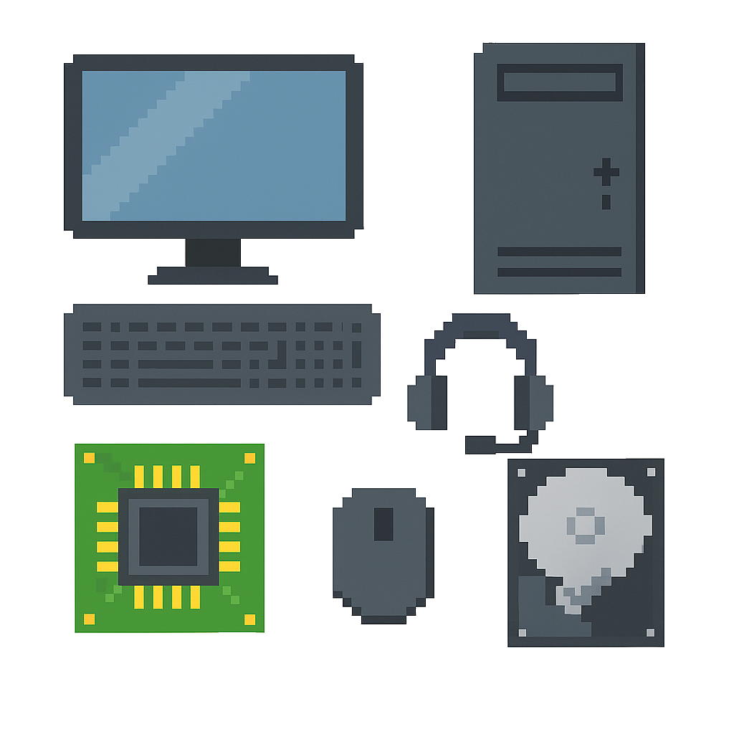

Starter
SPOT 8 DIFFERENCES

Slide 2
CPU
(Central Processing Unit)
NPA Computing Technologies
Level 4

Slide 3

Learning Targets
I can state the purpose of the CPU.
I can state two ways to measure CPU performance.

Slide 4
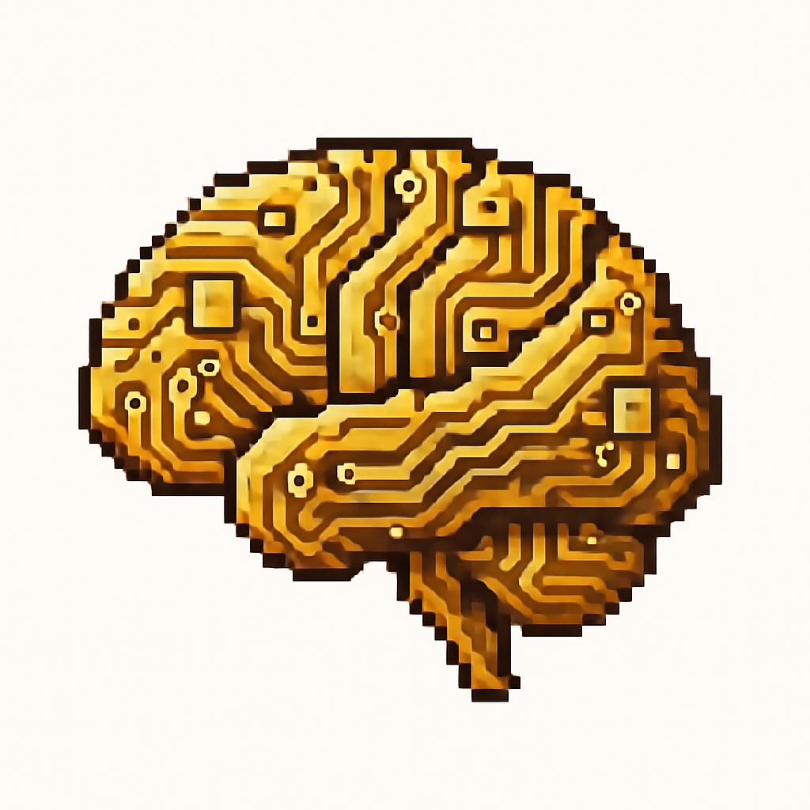
What is the CPU?
The CPU is the “brain” of the computer
It processes instructions and performs calculations
Handles tasks like running programs and managing data

Slide 5
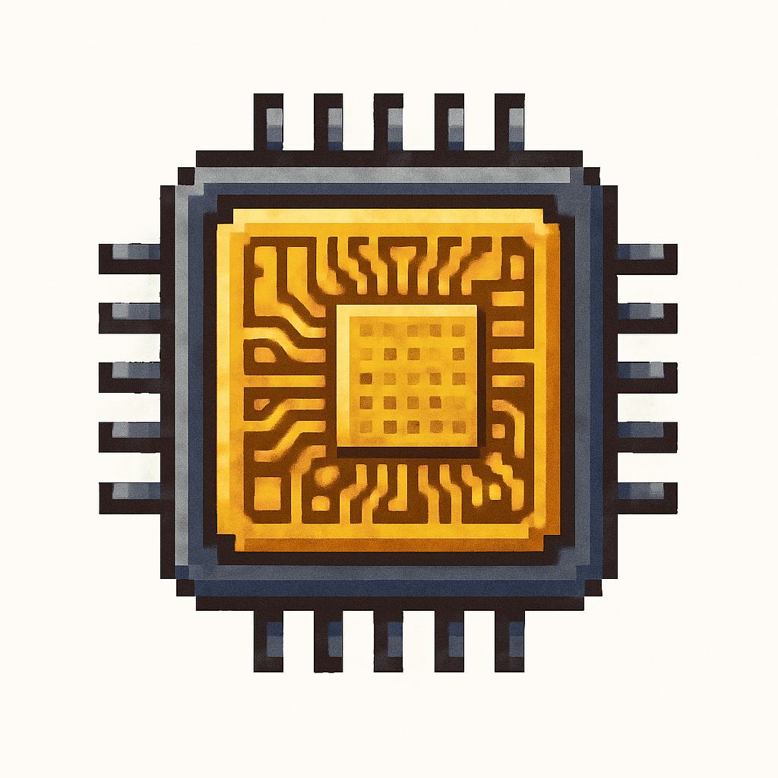
Measuring CPU Performance
Two measures of a CPU’s performance are
Clock Speed
Number of Cores

Slide 6

Clock Speed
Clock speed is measured in Hertz. Usually GHz (gigahertz)
1 GHz = 1,000,000,000 Hz
It shows how many instructions the CPU can process per second.
A higher GHz means faster performance

Slide 7
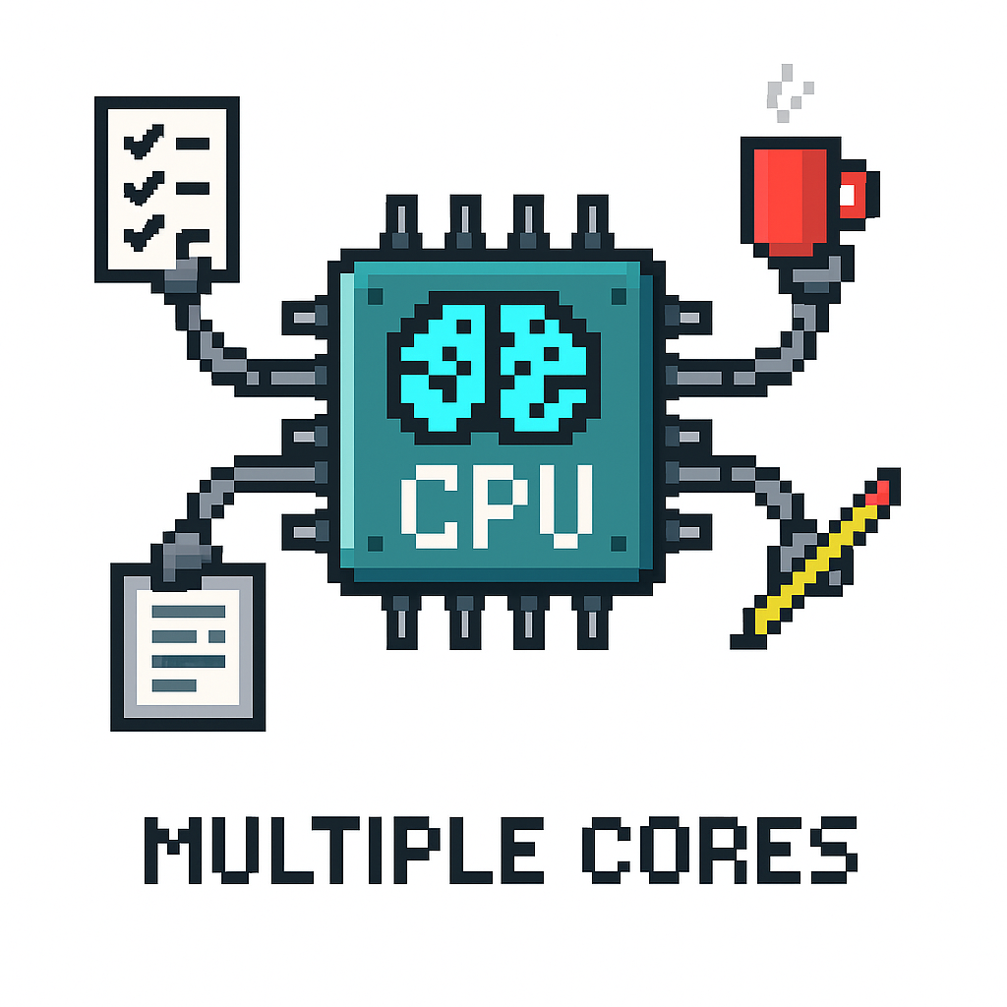
Number of Cores
Modern CPUs have multiple cores (dual-core, quad-core, etc.)
This allows them to process multiple tasks at once.
More cores improve multitasking and speed for complex programs.

Slide 8
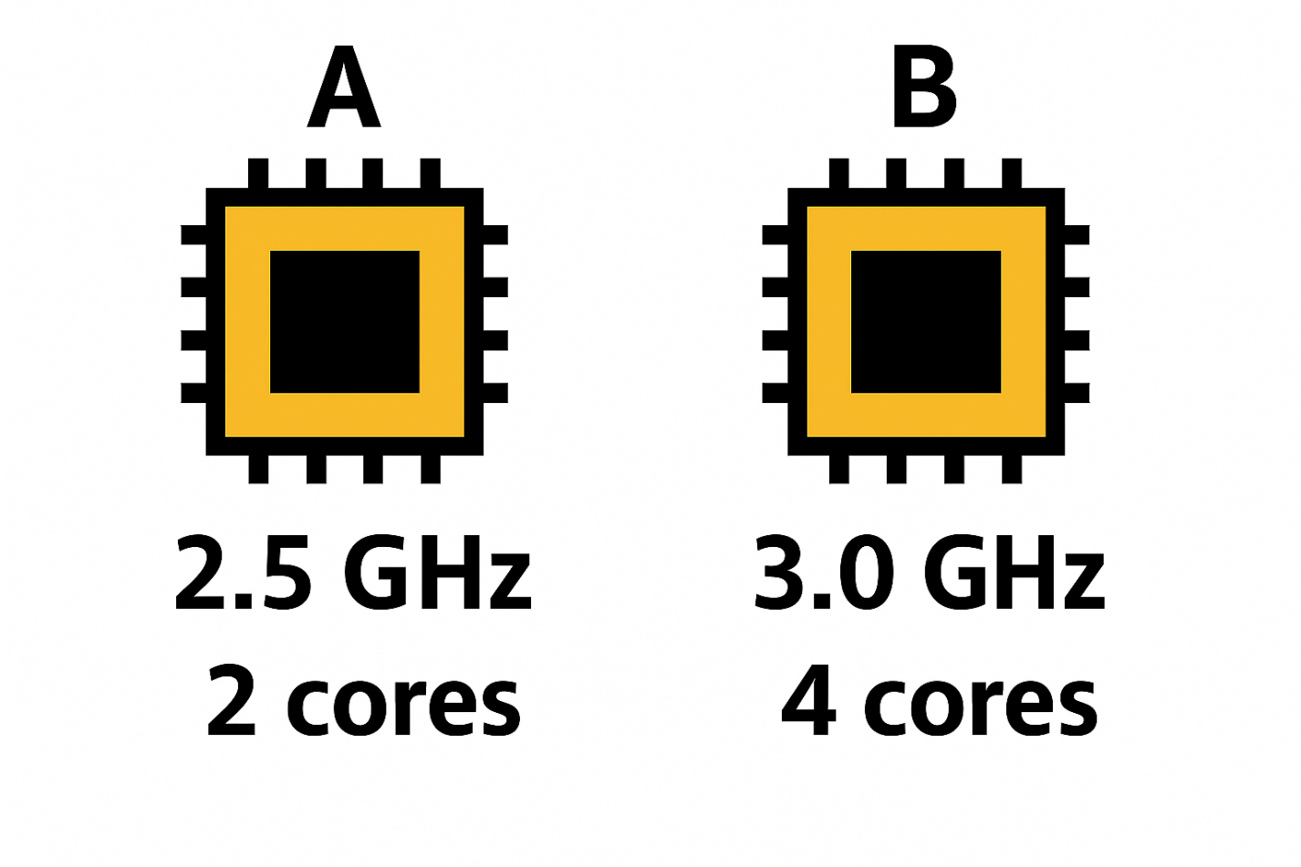
Example
CPU B would have better performance than CPU A
This is because it has a higher clock speed and more cores

Slide 9


Targets
Tasks
I can state the purpose of the CPU.
I can state two ways to measure CPU performance.
CPU Workbook
Superstudyparty.com
  NPA Computing Technologies
  Level 4
  Computing Foundations
  CPU

