Slide 1



Starter Revision
Subject: Computing Technologies
Level: 4
Computing Foundations
Data Types

Slide 2
Variables
NPA Computing Technologies
Level 4

Slide 3
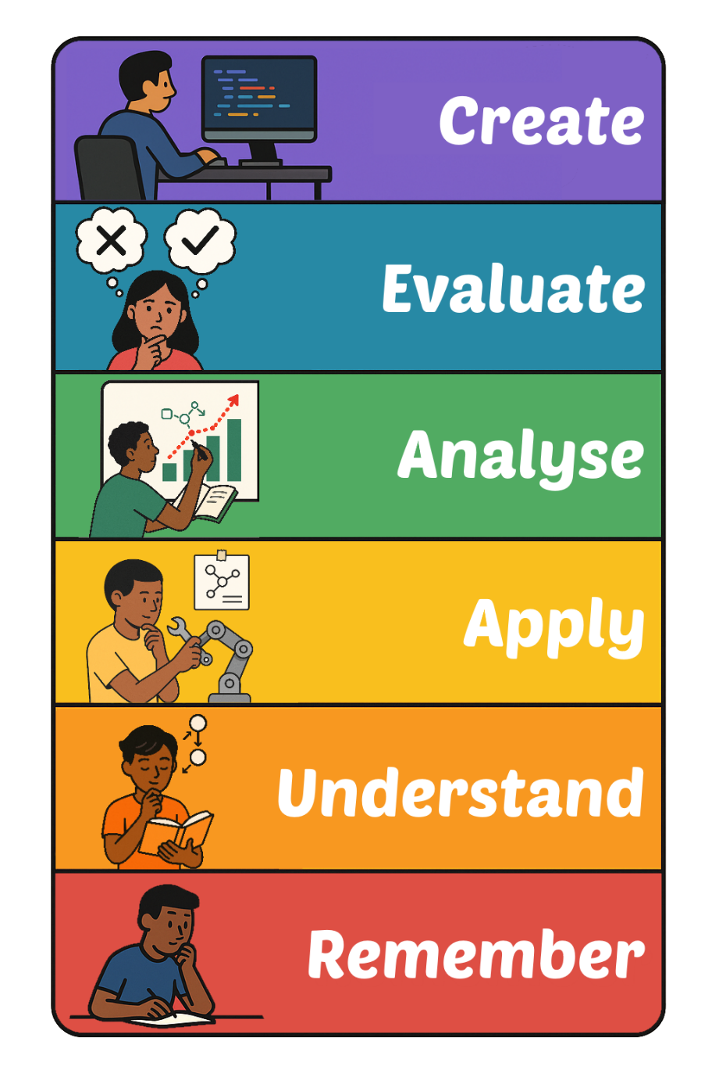
Learning Targets
I can identify variables used in a program.

Slide 4
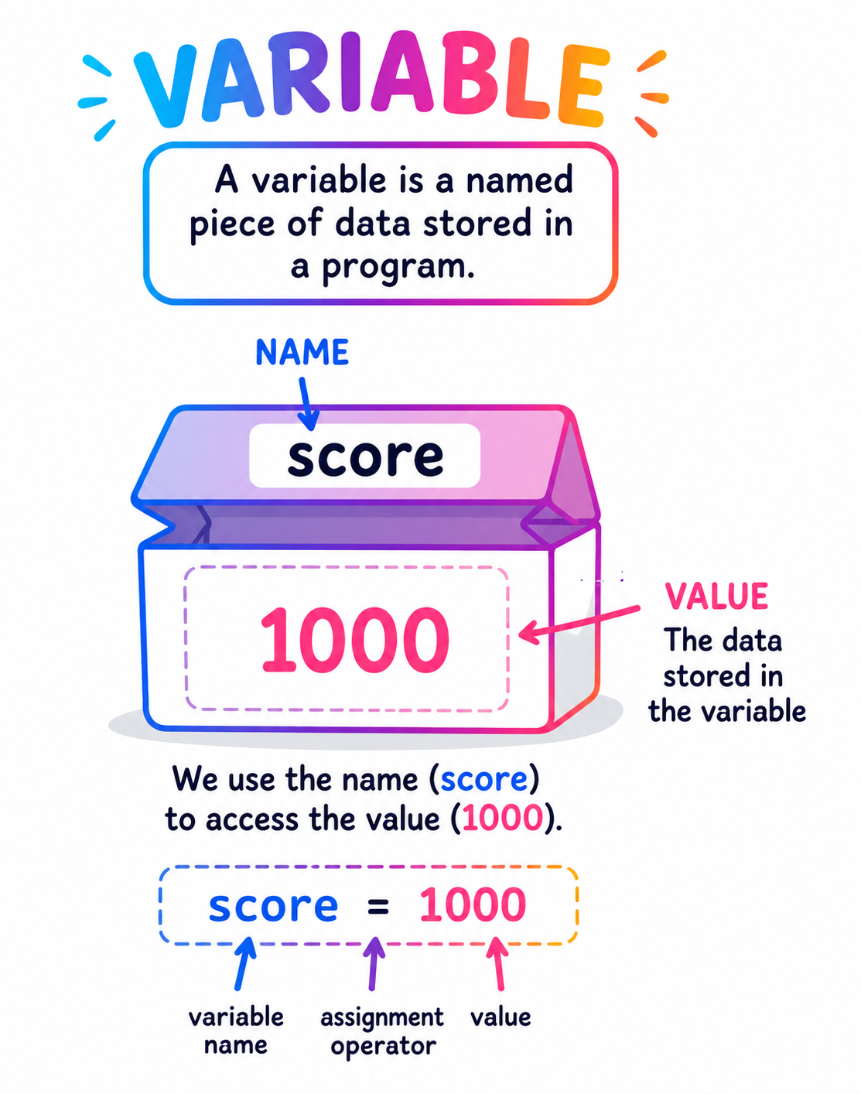
What is a Variable?
A variable is a named location of stored data in a program.
price = 5.99
age = 21
name = “Bill”

Slide 5
Naming Variables
When naming a variable, it is important to make the variable name simple and relative to the data its storing.
Don’t call a variable ‘name’ if it’s storing a person’s age.

Slide 6
Identifying Variables in Code
You don’t need to be a programmer in order to identify variables.
Variables are just named bits of data. Can you spot the named bits of data in the following programs?

Slide 7
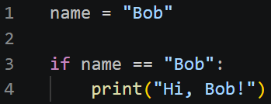
Identify the Variables
Can you identify the variable in the below code?
name

Slide 8
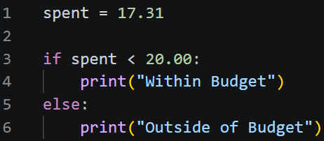
Identify the Variables
Can you identify the variable in the below code?
spent

Slide 9
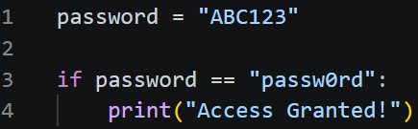
Identify the Variables
Can you identify the variable in the below code?
password

Slide 10
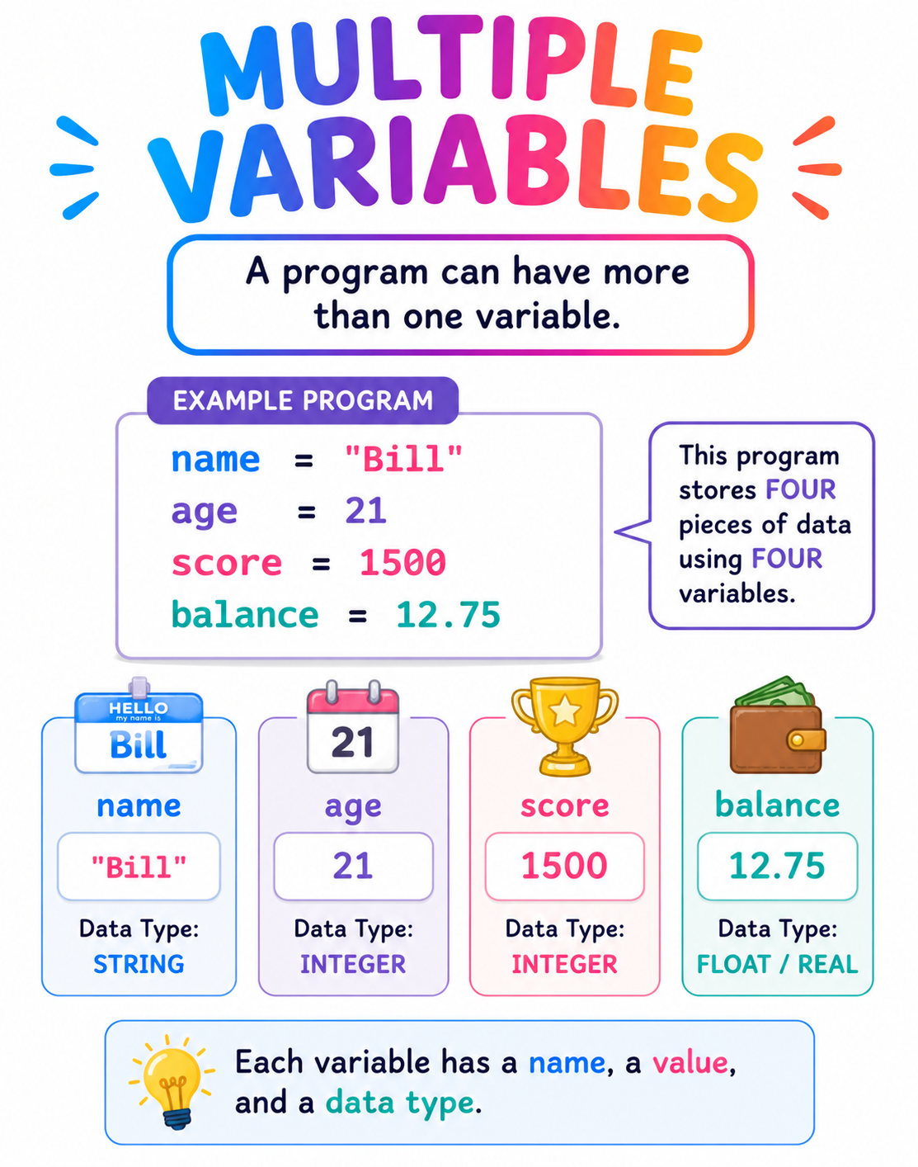
Multiple Variables
Programs will almost always have more than one variable.
This is another reason why you must give variables good, simple names.

Slide 11
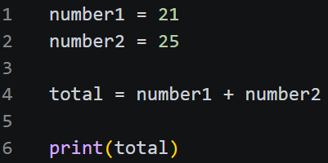
Identify the Variables
Can you identify the variables?
number1
number2
total

Slide 12
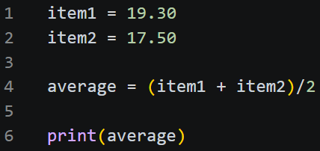
Identify the Variables
Can you identify the variables?
item1
item2
average

Slide 13
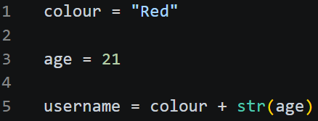
Identify the Variables
Can you identify the variables?
colour
age
username

Slide 14

Targets
Tasks
I can identify variables used in a program.
Variables Workbook
Superstudyparty.com
  NPA Computing Technologies
  Level 4
  Computing Foundations
  Variables

