Slide 1



Starter Revision
Subject: Computing Technologies
Level: 4
Computing Foundations
Data Types
Variables

Slide 2
Outputs
NPA Computing Technologies
Level 4

Slide 3
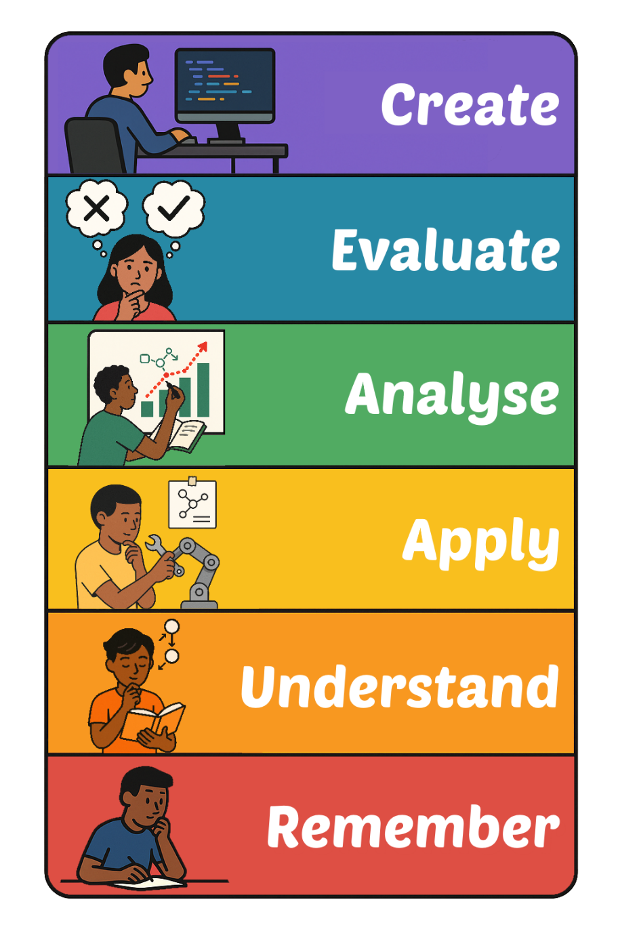
Learning Targets
I can predict the output of a program.

Slide 4

What is an Output?
Outputs are the information a program shows to the user.
Outputs are a way for the program to communicate with the user.

Slide 5


Simple Outputs
The most simple output would be displaying text.
print(“Hello!”)
This line of code displays the word “Hello!” to the user.
Code
Output

Slide 6
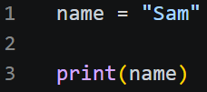

Printing out Variables
The next part is to print the data stored within a variable.
Printing the variable ‘name’ will display the variables value (Sam) to the user.
Code
Output

Slide 7

Printing Maths
It’s possible to perform maths and display the output to the user.
The code will perform the calculation before displaying the answer to the user.
Code
Output

Slide 8
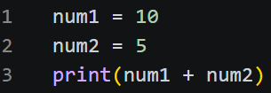
Using variables to do outputs
Most math problems will be completed using variables, and only the total will be displayed to the user.
In this example, two variables are added together and the total is displayed to the user.
Code
Output

Slide 9

Using a Total variable
What if a third variable is used to store the total?
Now the program stores the total as a variable and only displays the total to the user.
Code
Output

Slide 10
Adding to a Variable
In this final example, a variable is used as part of the calculation.
Instead of using two variables, one variable is used, and value of the variable is reset.
Code
Output

Slide 11
Predict the Output
Can you predict the output of the following code?
Bear

Slide 12
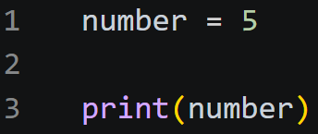
Predict the Output
Can you predict the output of the following code?
5

Slide 13
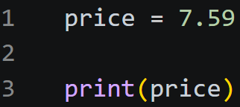
Predict the Output
Can you predict the output of the following code?
7.59

Slide 14
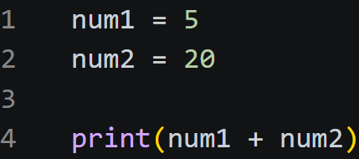
Predict the Output
Can you predict the output of the following code?
25

Slide 15
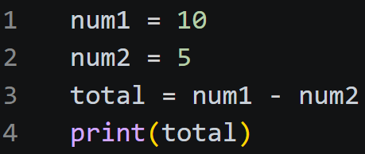
Predict the Output
Can you predict the output of the following code?
5

Slide 16

Targets
Tasks
I can predict the output of a program.
Outputs Workbook
Superstudyparty.com
  NPA Computing Technologies
  Level 4
  Computing Foundations
  Outputs

