Slide 1



Starter Revision
Subject: Computing Technologies
Level: 4
Computing Foundations
Data Types
Variables
Outputs

Slide 2
Calculations
NPA Computing Technologies
Level 4

Slide 3

Learning Targets
I can remember what each mathematical operator does within code.
I can identify the order of operations in calculations.
I can predict the output of a program.

Slide 4
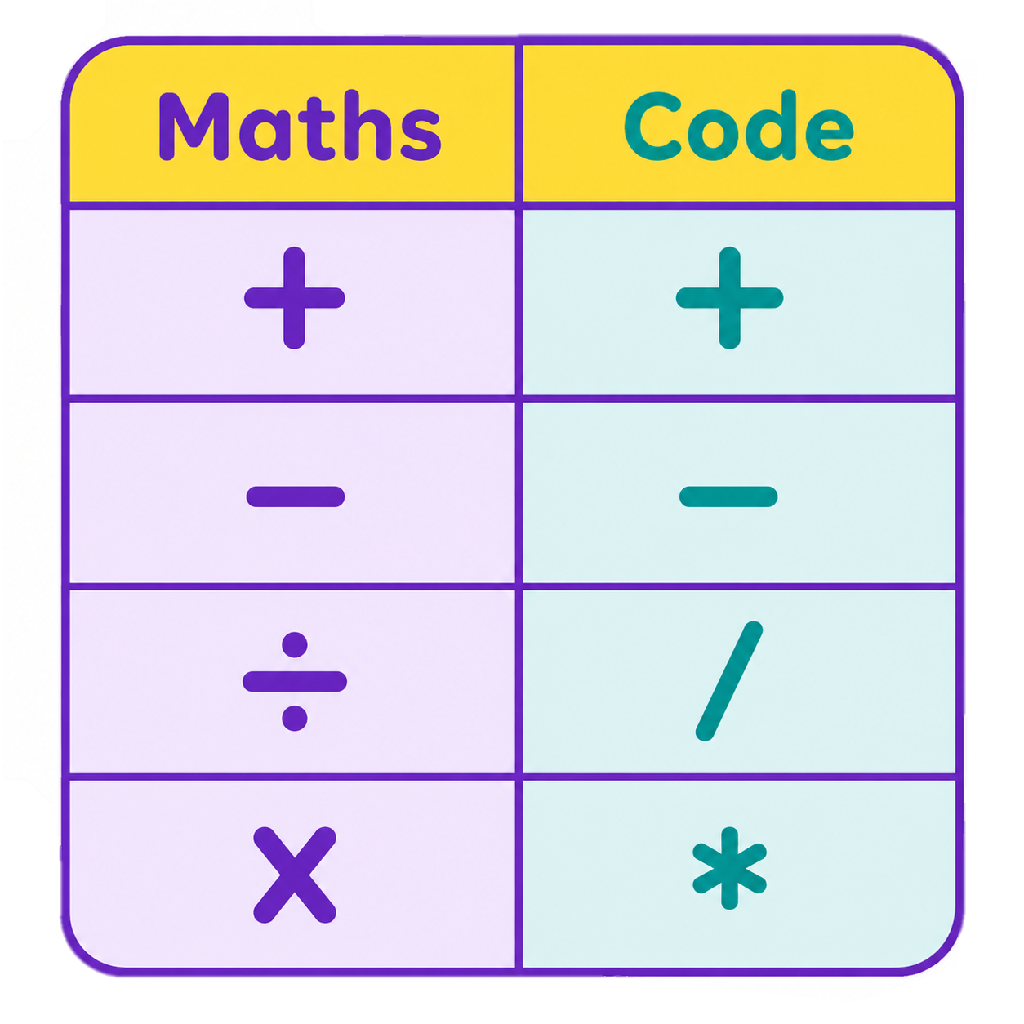
What are Mathematical Operators?
Mathematical Operators are what are used to add, subtract, divide and multiply.
In programming, the logic is the same but the symbols that are used can be different.

Slide 5
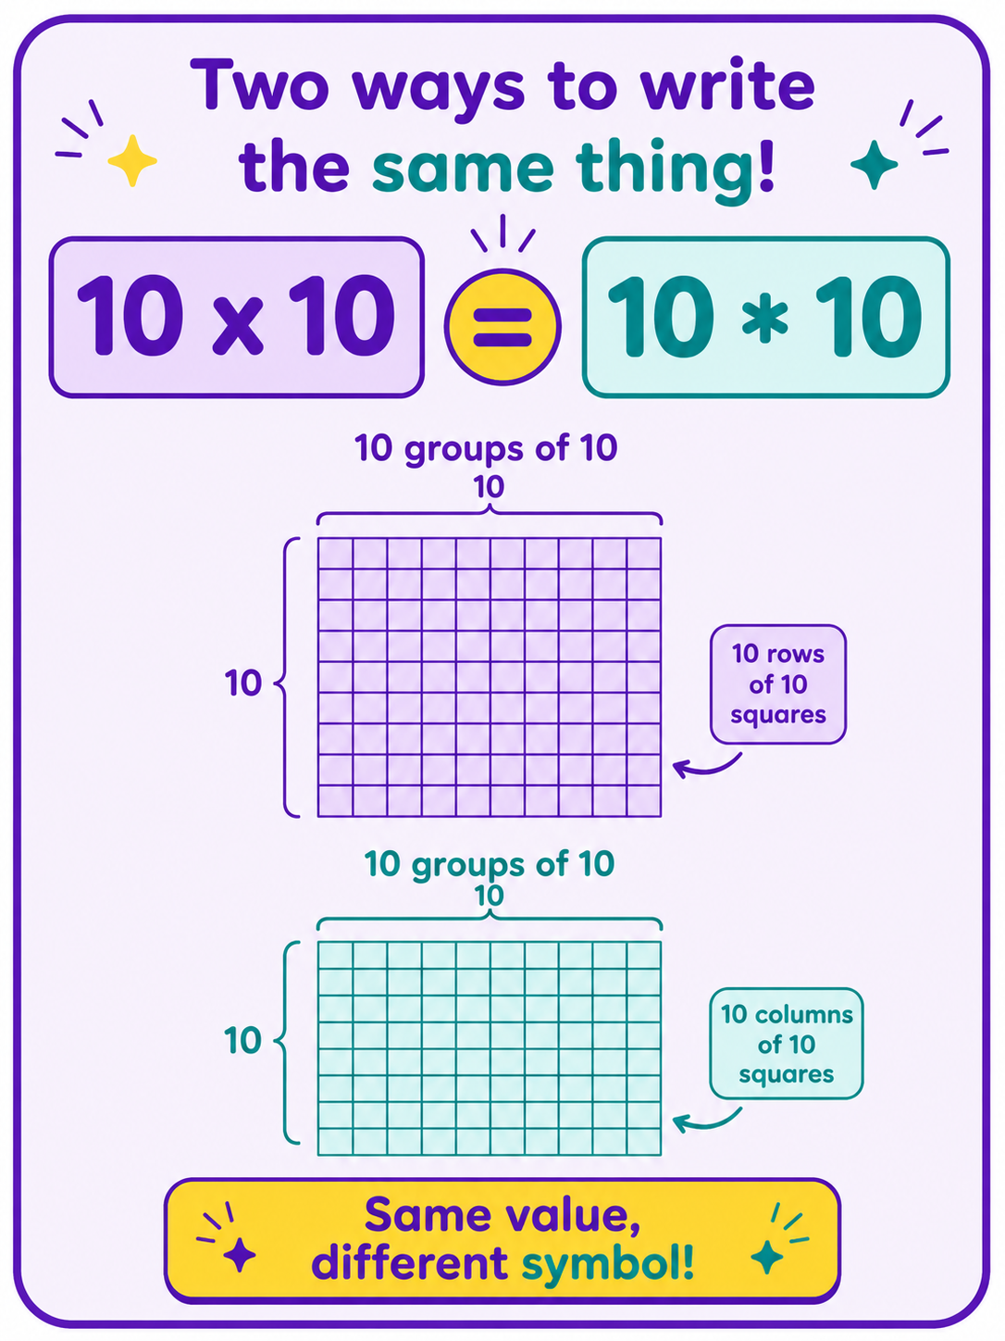
What are Mathematical Operators?
When using mathematical operators within code, the logic is still the same.
2 x 10 is the same as 2 * 10.
6 ÷ 3 is the same as 6 / 3.

Slide 6
Order of Operations
Order of Operations determines the steps you take to calculate an answer.
Solve anything in brackets first
Multiply and Divide
Add and Subtract

Slide 7
Order of Operations
In this example, the brackets must be completed first.
2 + 5 = 7
We can then add the 10 to the answer from the brackets.
Sum
10 + (2 + 5)
Answer
17

Slide 8
Order of Operations
In this example, complete the multiplication first.
2 * 5 = 10
We can then add the 5 to the answer from the multiplication.
Sum
5 + 2 * 5
Answer
15

Slide 9
Order of Operations
In this example, complete the division first.
9 / 3 = 3
We can then add the 1 to the answer from the division.
Sum
1 + 9 / 3
Answer
4

Slide 10

How this looks in code
In code, the process is the exact same.
Instead of an answer, the program will produce an output.
Code
Output
30

Slide 11

How this looks in code
In code, the process is the exact same.
Instead of an answer, the program will produce an output.
Code
Output
7

Slide 12

Targets
Tasks
I can remember what each mathematical operator does within code.
I can identify the order of operations in calculations.
I can predict the output of a program.
Calculations Workbook
Superstudyparty.com
  NPA Computing Technologies
  Level 4
  Computing Foundations
  Calculations

