Slide 1



Starter Revision
Subject: Computing Technologies
Level: 4
Computing Foundations
Data Types
Variables
Inputs and Outputs
Calculations

Slide 2
Networks in Daily Life
NPA Computing Technologies
Level 4

Slide 3
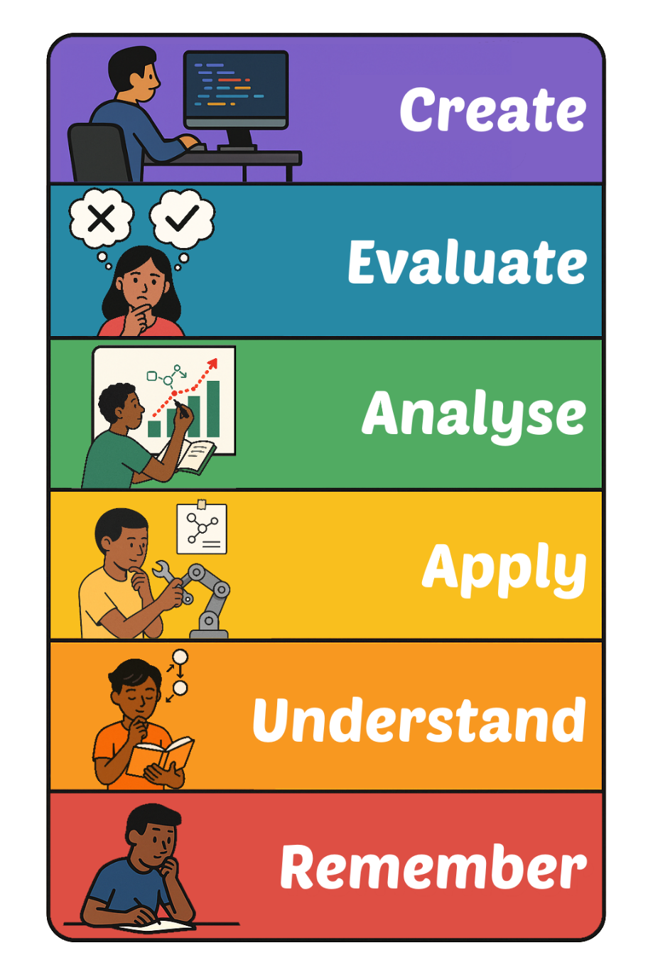
Learning Targets
I can state the importance of networks in daily life.

Slide 4
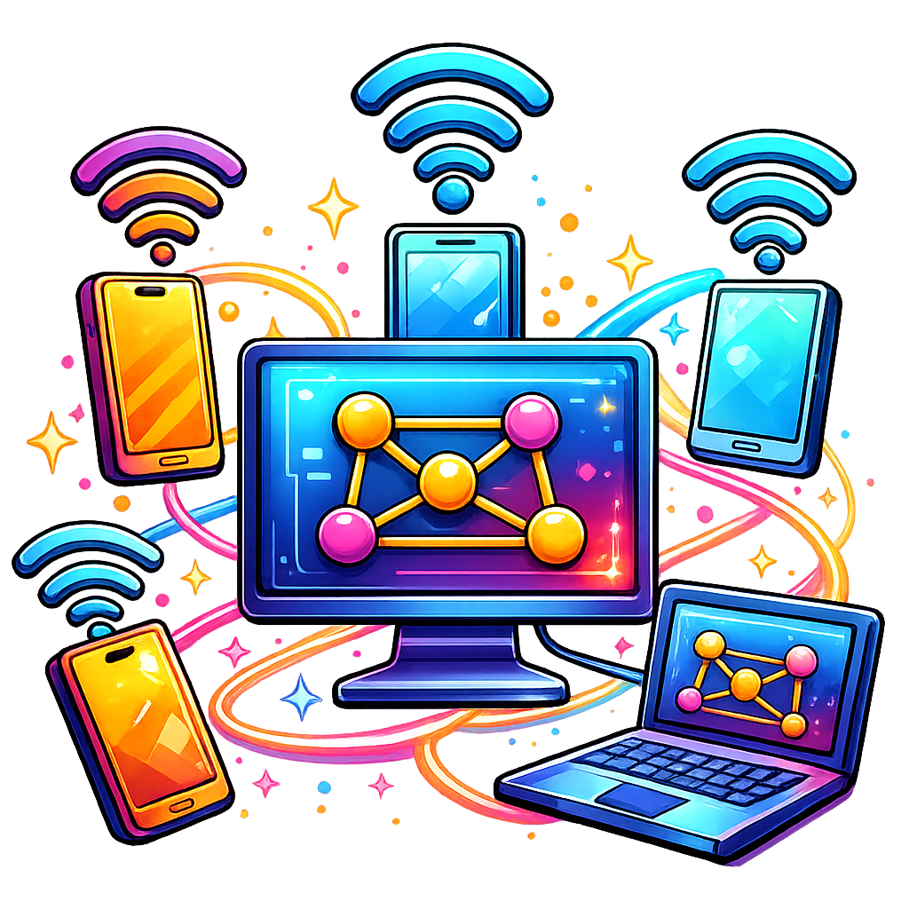
What is a Network?
Networks connect devices to share information and resources.
By connecting devices, we can share data, communicate and access online services.

Slide 5

Communication
Without Networks, we would not be able to communicate as we do.
Networks are required for things like WhatsApp, Zoom, Gmail, Instagram to work.

Slide 6
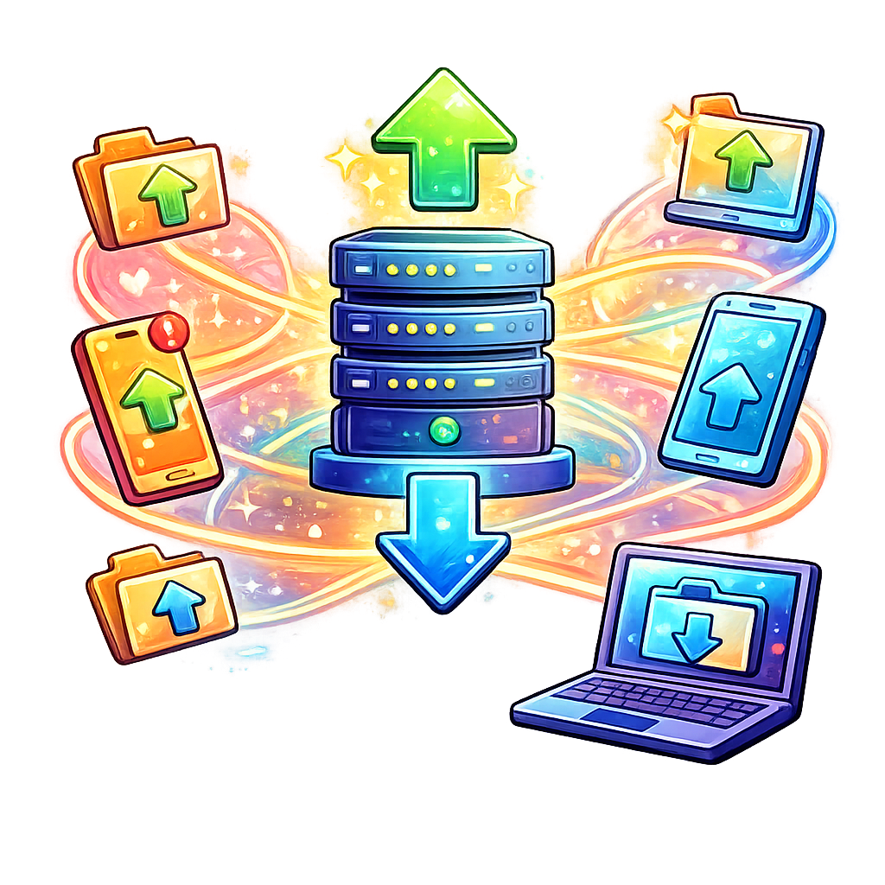
Data Sharing
Businesses use networks to share files through Google Drive and iCloud, both of which require Networks.
Downloading and installing Apps and games require a network to work.

Slide 7
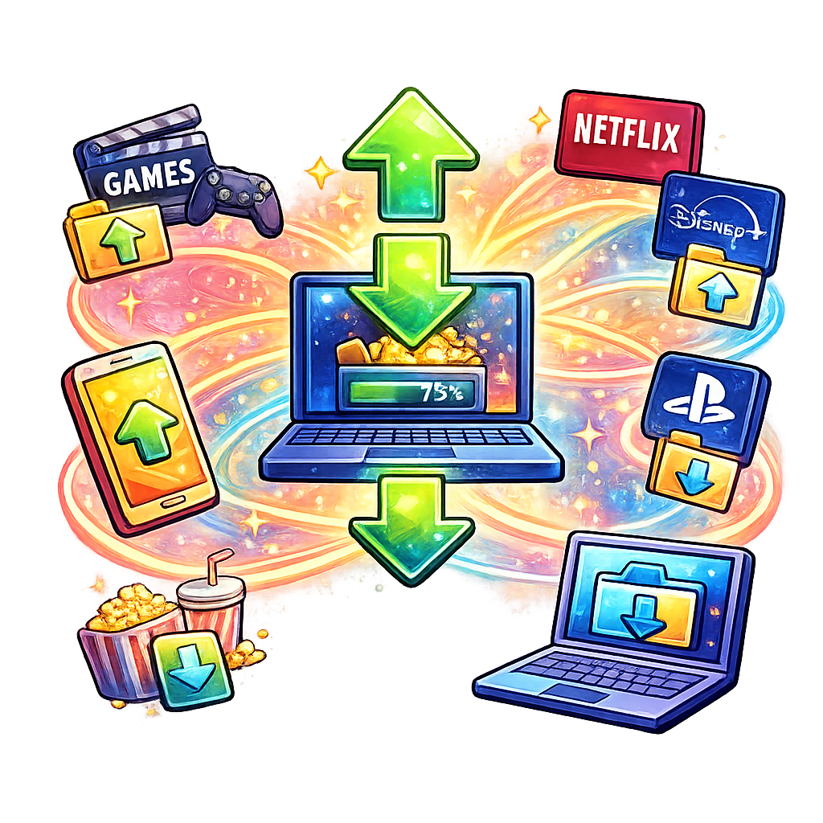
Entertainment
Networks power platforms like Netflix, Disney+, TikTok, Xbox and PlayStation.
Without networks, none of these platforms would work forcing us back to using games on disc and DVDs.

Slide 8
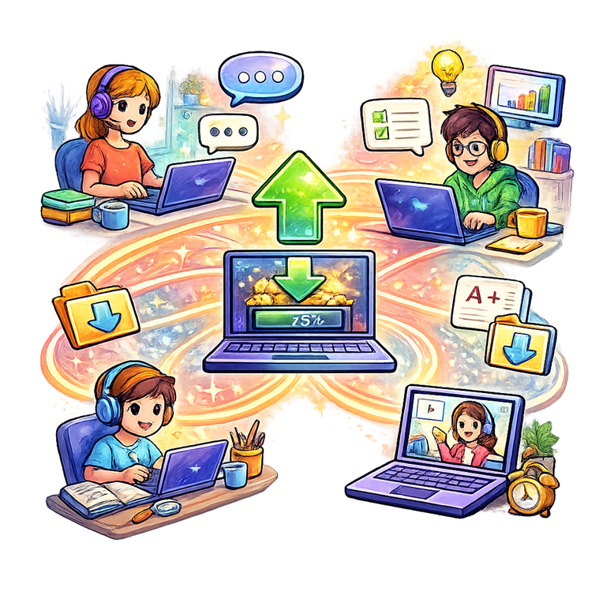
Remote Work and Learning
Networks allow people to attend online meetings in Microsoft Teams, attend classes via Google Classroom and share files and ideas on platforms like Slack.
Networks allow people to work and learn from anywhere.

Slide 9
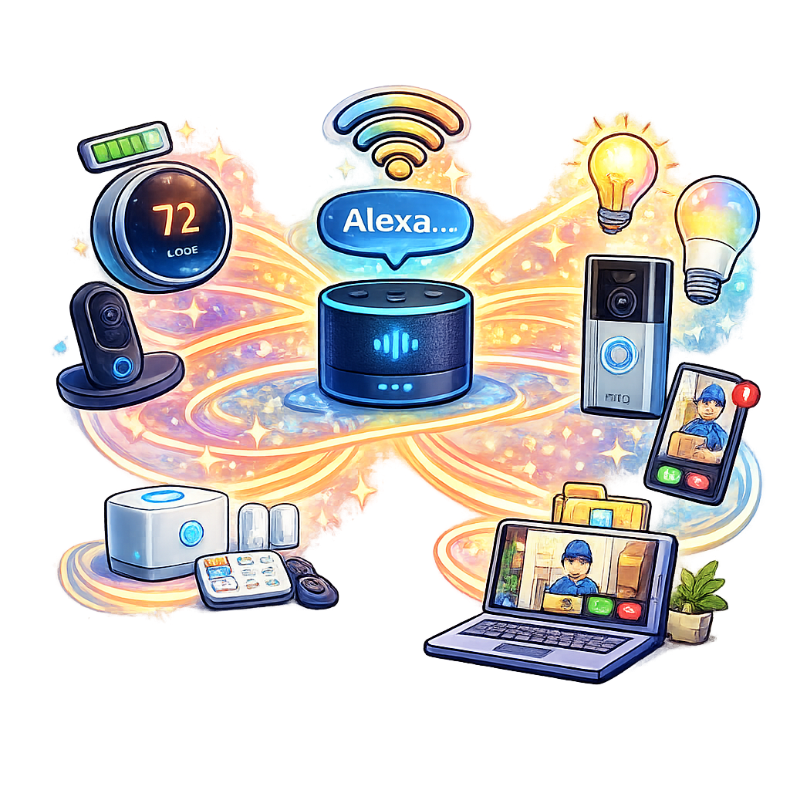
Smart Devices
Networks connect devices like Amazon Alexa for voice-controlled assistance.
Ring doorbells require networks for home security.
Sat Nav systems are heavily reliant on Networks to work.

Slide 10

Data is the Key
All tasks require the sharing of data over a network.

Slide 11

Targets
Tasks
I can state the importance of networks in daily life.
Networks in Daily Life Workbook
Superstudyparty.com
  NPA Computing Technologies
  Level 4
  Computing Foundations
  Networks in Daily Life

