Slide 1



Starter Revision
Subject: Computing Technologies
Level: 4
Computing Foundations
Networks in Daily Life

Slide 2
Types of Networks
NPA Computing Technologies
Level 4

Slide 3

Learning Targets
I can state the four types of network topologies
I can state how a switch is used within a network

Slide 4
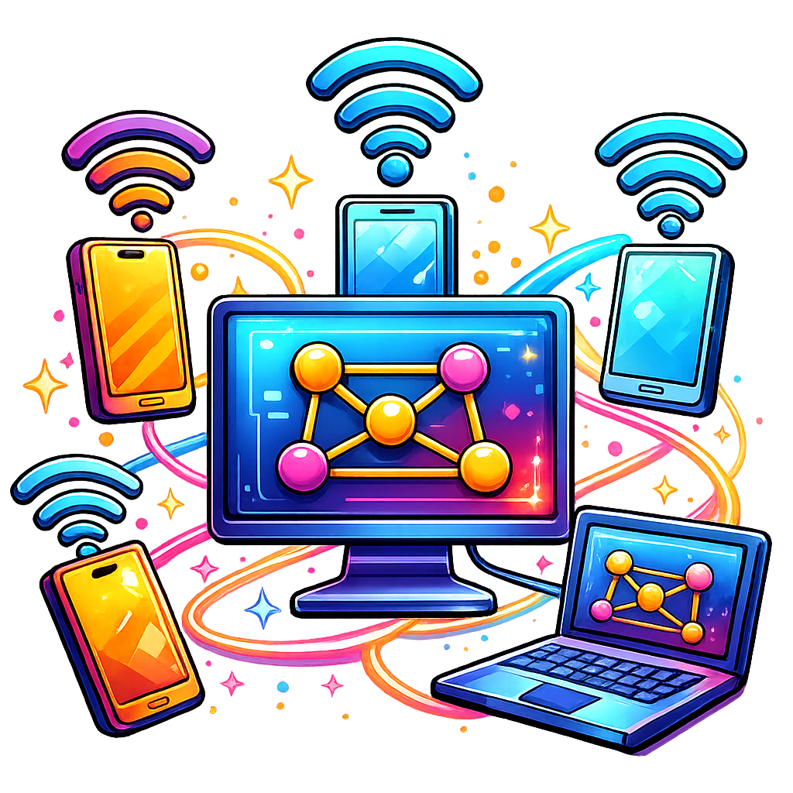
What is a Network?
Networks connect devices to share information and resources.
Networks can be arranged in different structures called topologies.

Slide 5
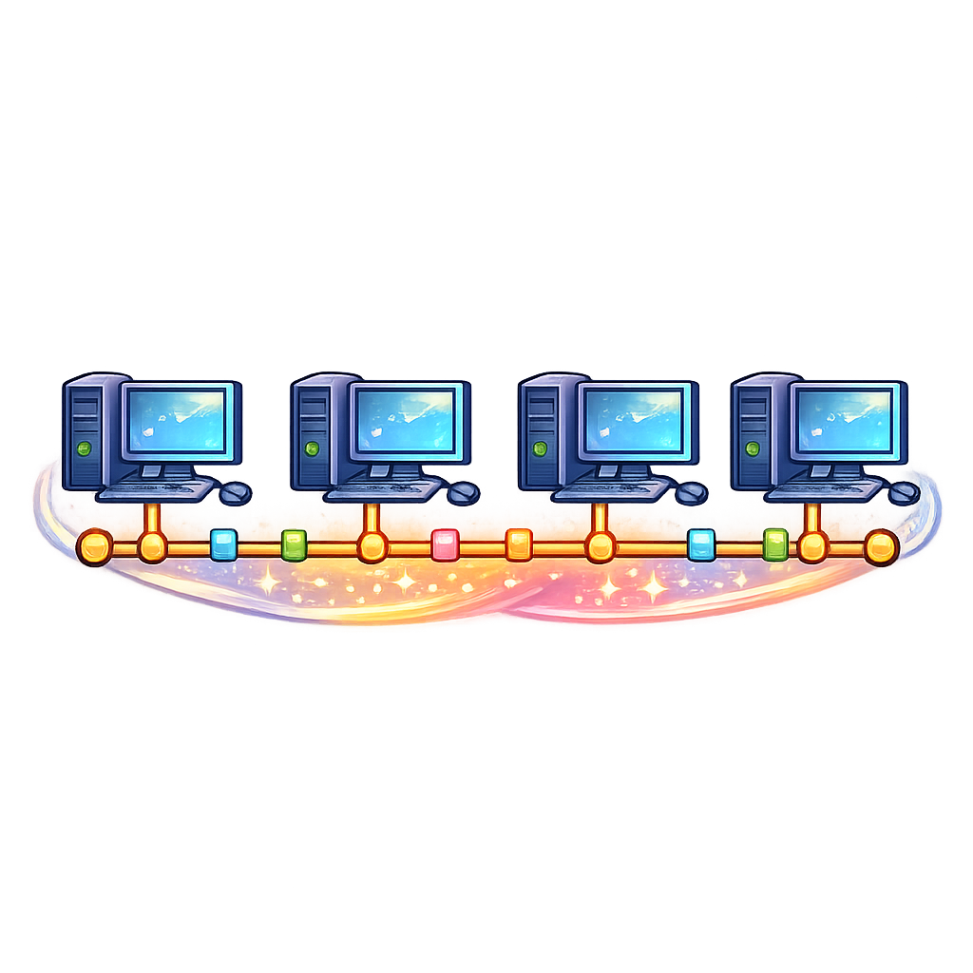
Bus Topology
All Devices are connected on a single cable.
Easy to setup, but if the cable breaks, the whole network breaks.

Slide 6
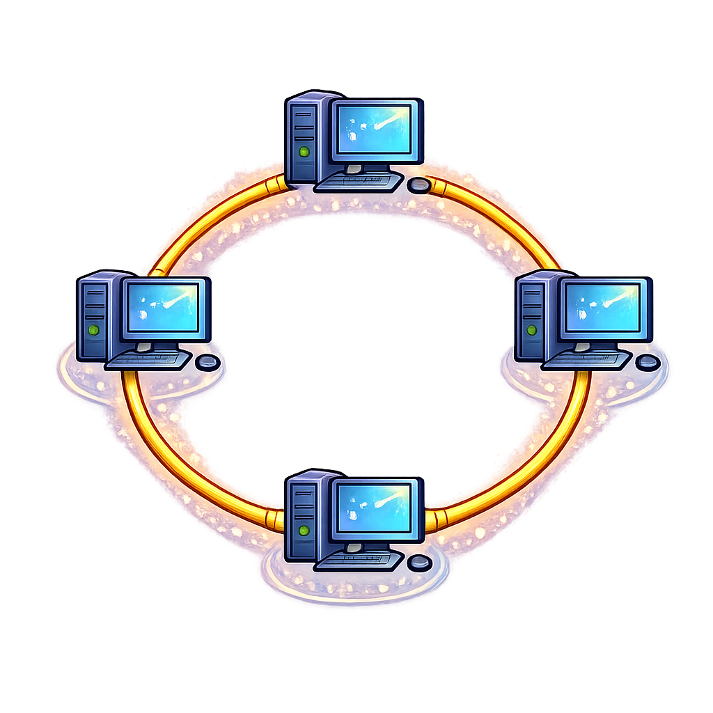
Ring Topology
Devices are connected in a circular loop.
Data travels in one direction, slowing the network if more devices are active.

Slide 7
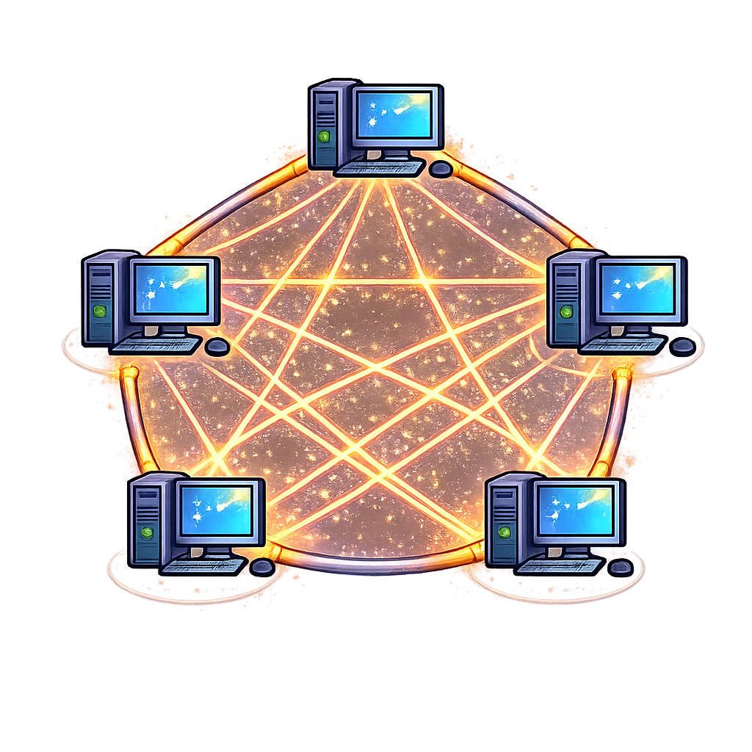
Mesh Topology
Every device is connected to every other device.
Highly reliable but complex and costly to setup.

Slide 8
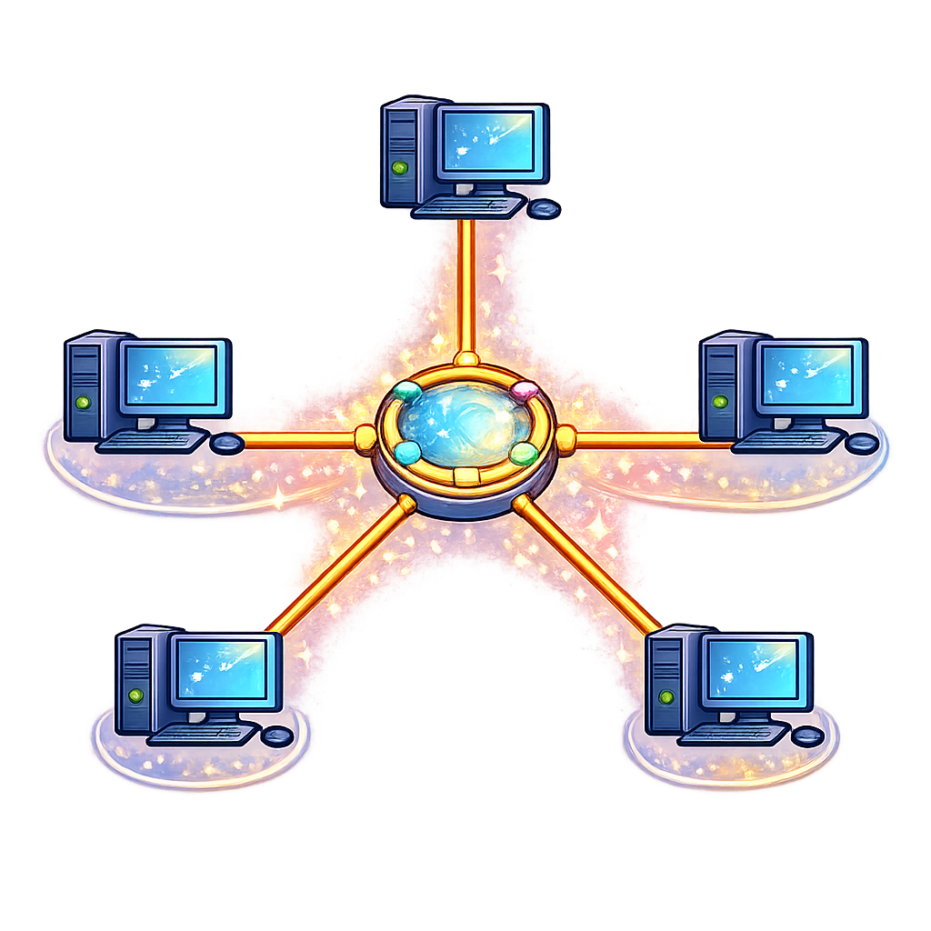
Star Topology
Devices are connected to a central hub or switch.
A switch is a piece of hardware that directs data to the correct devices.
Reliable, as if one cable fails it doesn't affect the others.

Slide 9

Targets
Tasks
I can state the four types of network topologies
I can state how a switch is used within a network
Types of Networks Workbook
Superstudyparty.com
  NPA Computing Technologies
  Level 4
  Computing Foundations
  Types of Networks

