Slide 1


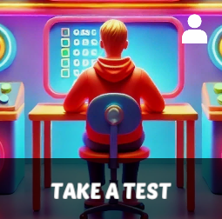
Starter Revision
Subject: Computing Technologies
Level: 4
Computing Foundations
Networks in Daily Life
Types of Networks

Slide 2
Network Security
NPA Computing Technologies
Level 4

Slide 3

Learning Targets
I can state the purpose of network security.
I can state two methods of network security.

Slide 4
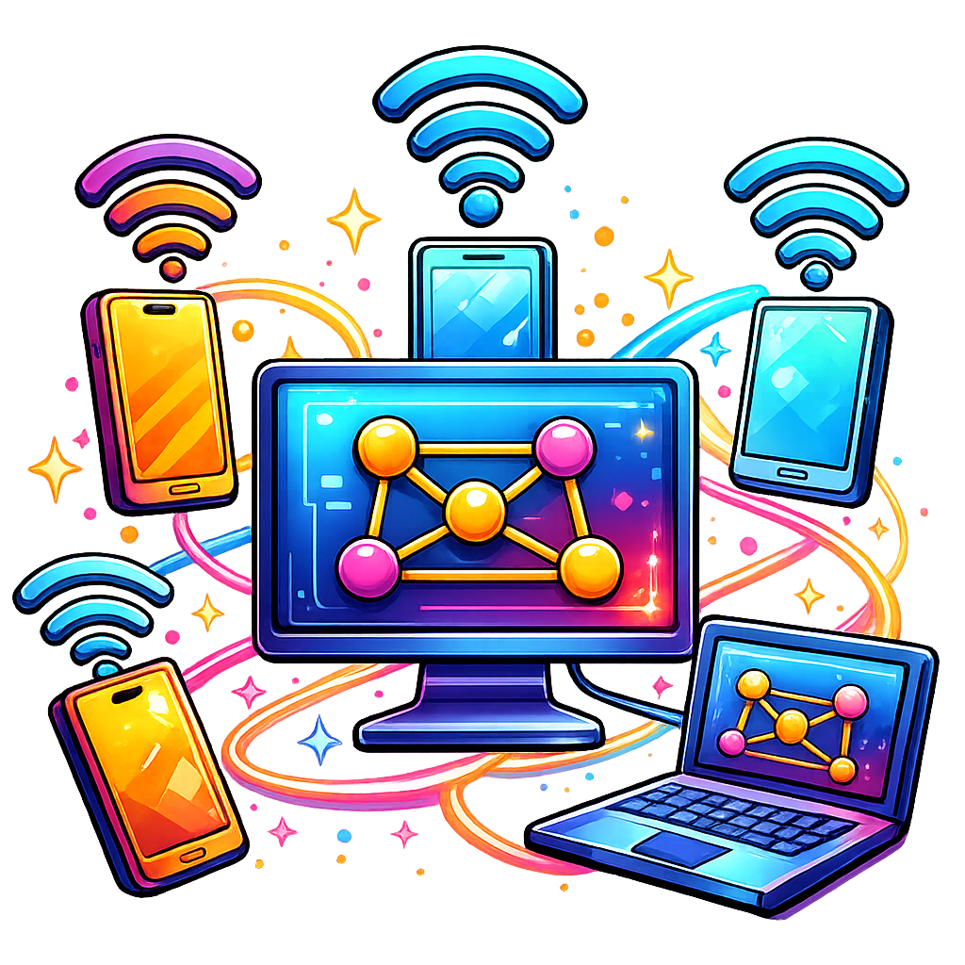
What is Network Security?
Network security protects devices, accounts and data.
By implementing different methods, you can keep a network safe, and in turn, keep users safe.

Slide 5
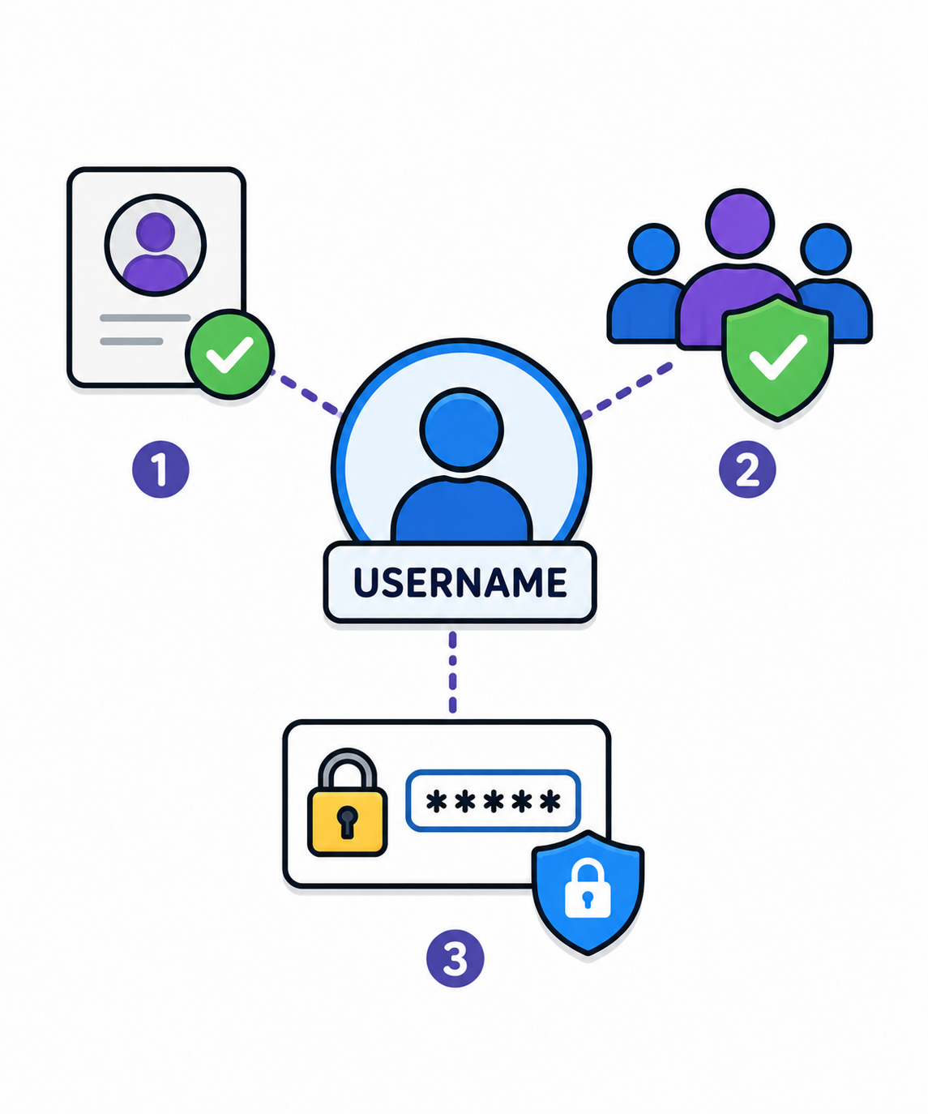
Username
A username is a unique name used to login.
Helps identify authorised users.
Used with passwords for security.

Slide 6
Passwords
Secret code to protect accounts.
Must be strong to stop unauthorised access.
Used in combination with a username.
Tips for Strong Passwords
8–12 characters
Use UPPER and lower case
Add numbers (e.g., 3, 9)
Use symbols (e.g., @, !)
Don’t use easy words or reuse passwords

Slide 7
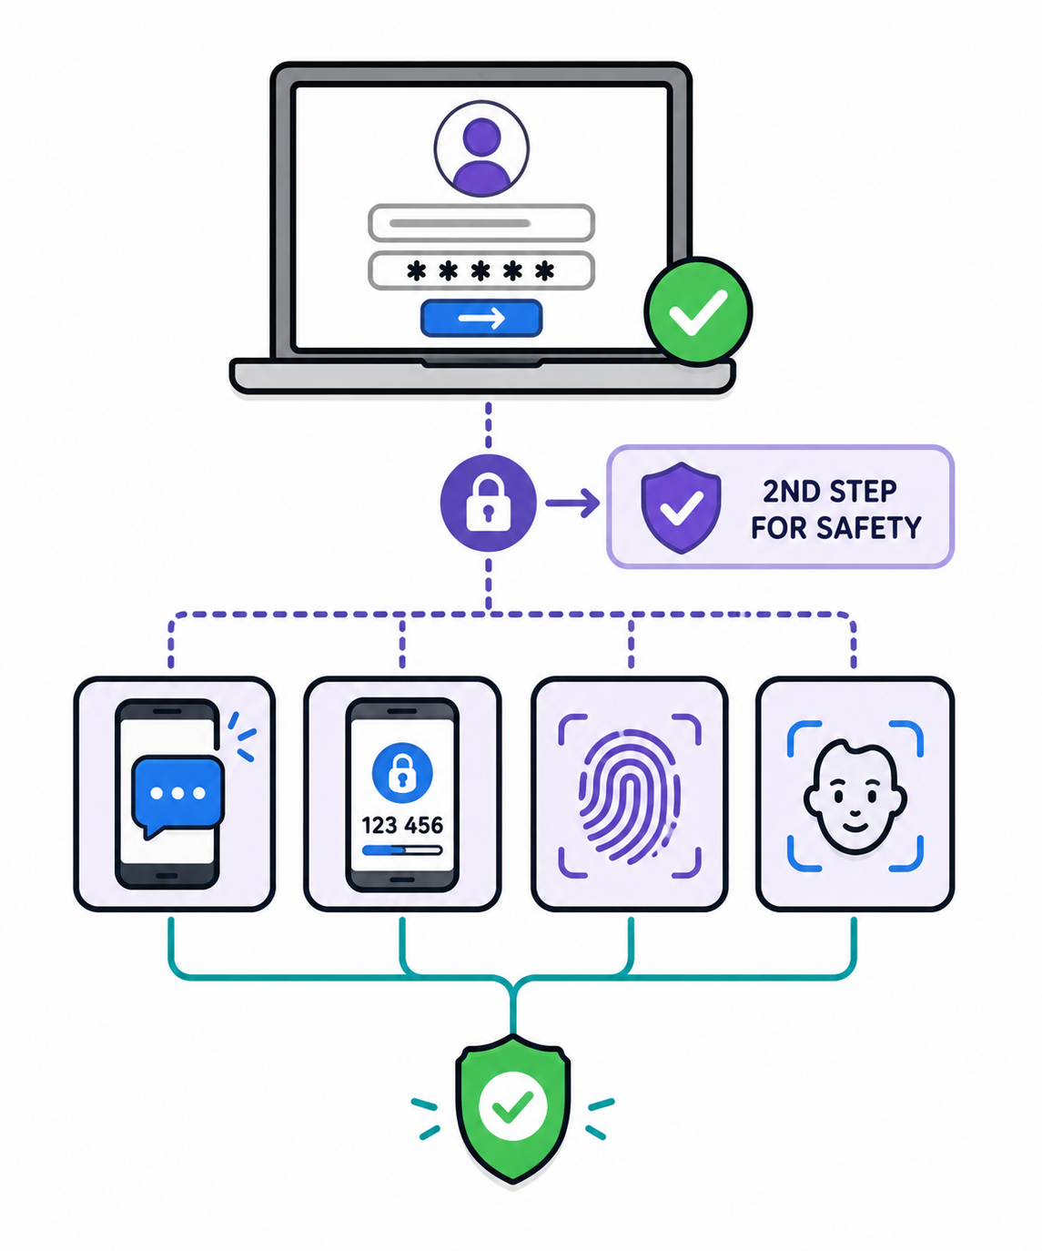
Two-Factor Authentication
Adds an extra login step for safety
Needs a password PLUS something else:
  A code sent to your phone
  A prompt in an app
  A fingerprint or face scan

Slide 8
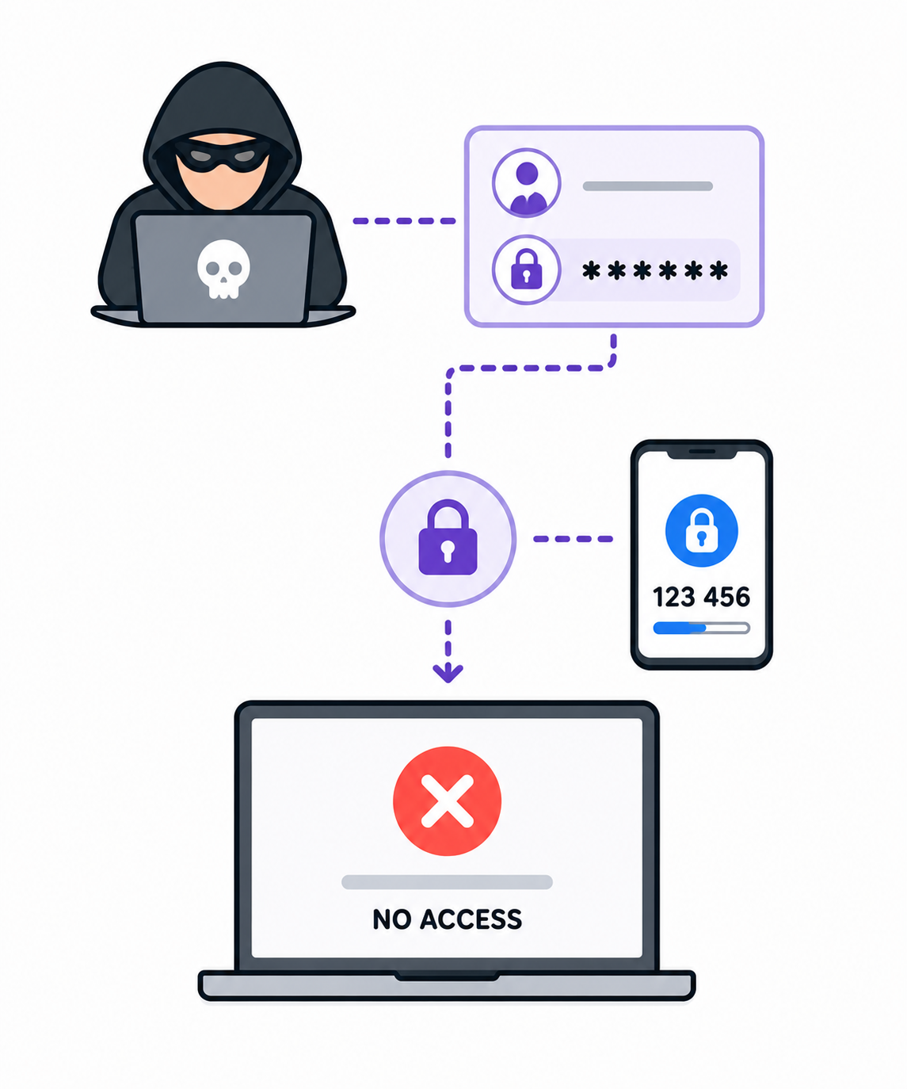
Why use 2FA?
If your username and password is stolen, hackers still can’t login without the second step!

Slide 9

Targets
Tasks
I can state the purpose of network security.
I can state two methods of network security.
Network Security Workbook
Superstudyparty.com
  NPA Computing Technologies
  Level 4
  Computing Foundations
  Network Security

