Slide 1



Starter Revision
Subject: Computing Technologies
Level: 4
Computing Foundations
Networks in Daily Life
Types of Networks
Network Security

Slide 2
The Internet
NPA Computing Technologies
Level 4

Slide 3

Learning Targets
I can describe the purpose of the internet.
I can describe the purpose of routers and cables.
I can describe the purpose of an internet service provider (ISP).

Slide 4
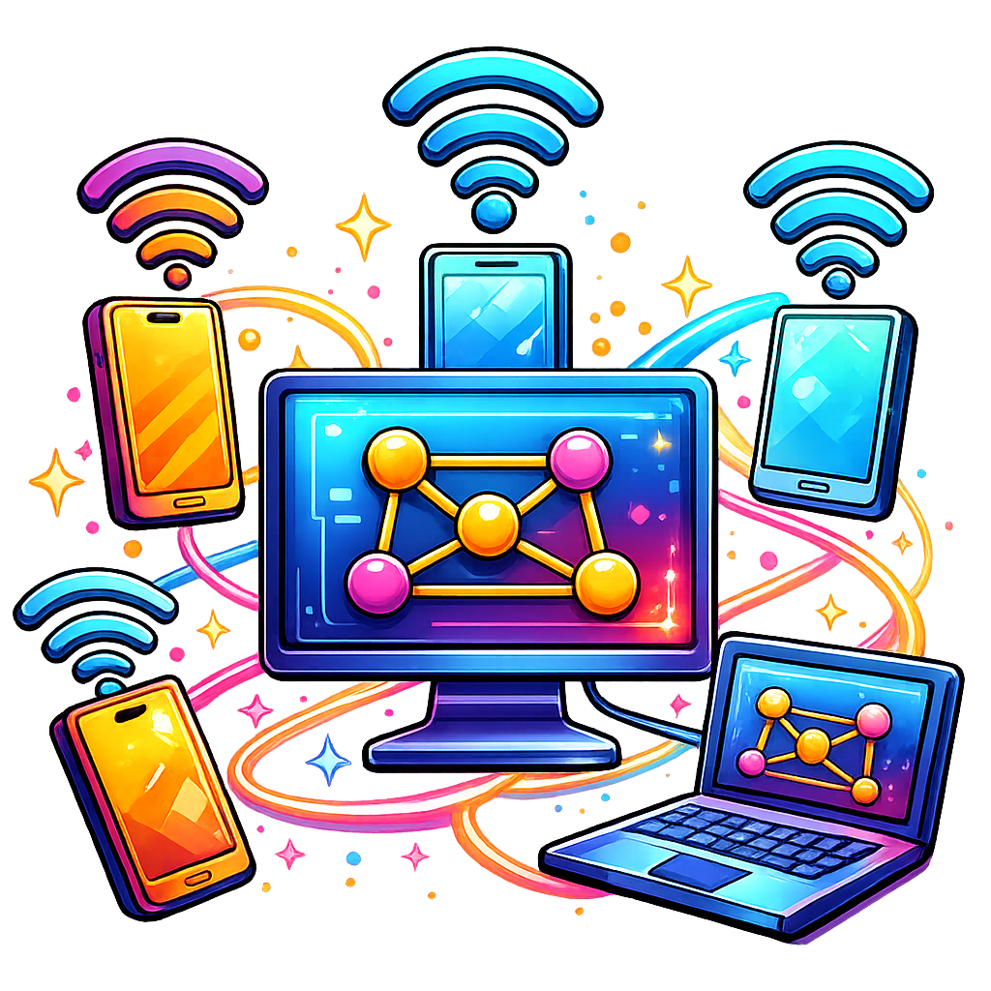
What is The Internet?
The internet connects devices worldwide, enabling communication and information sharing.
Information is broken into small chunks of data and sent from one device to another over a network.

Slide 5
Connecting to the Internet…
There are three requirements needed to connect to the internet.
  Internet Service Provider
  Router
  Cables

Slide 6
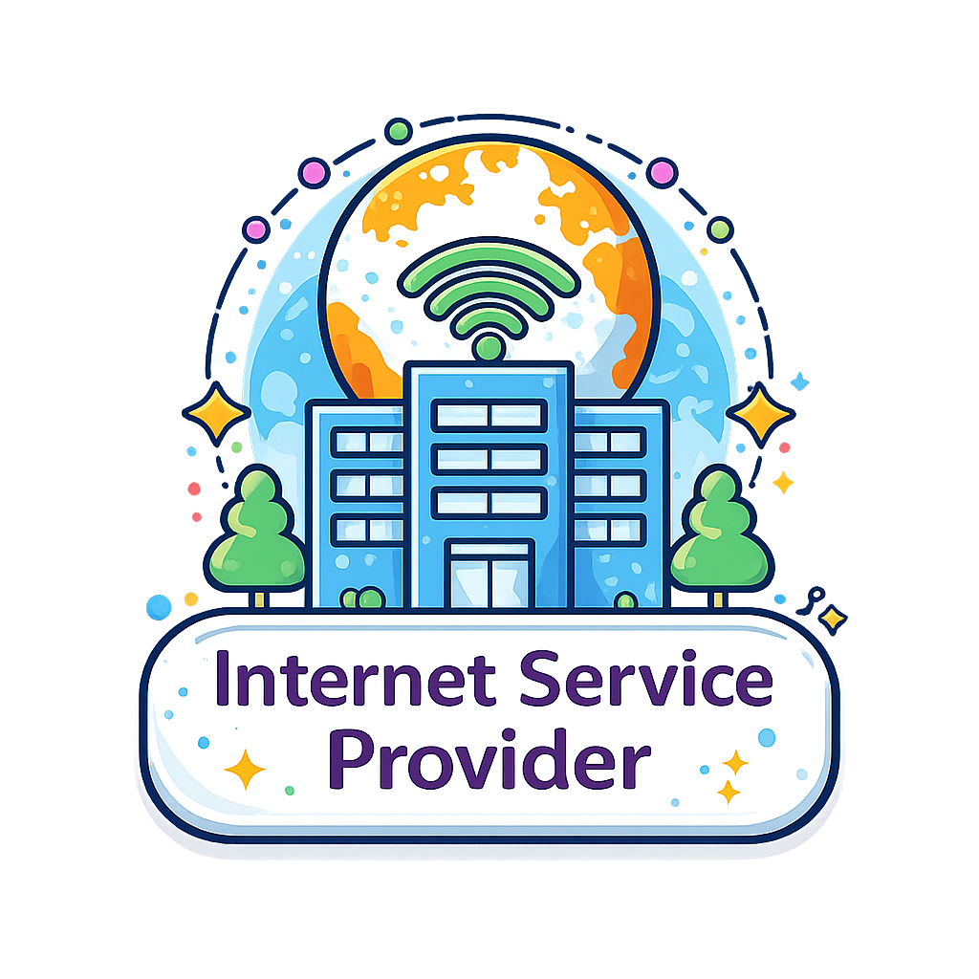
Internet Service Providers
Otherwise known as ISPs, they provide access to the internet.
They connect your home or business to their network, allowing you to use the internet.
Different ISPs have different prices and speeds.

Slide 7

Routers
A router is a device in a home or business that transfers data to and from the ISP.
Any devices that connects to the router then has Internet access!

Slide 8

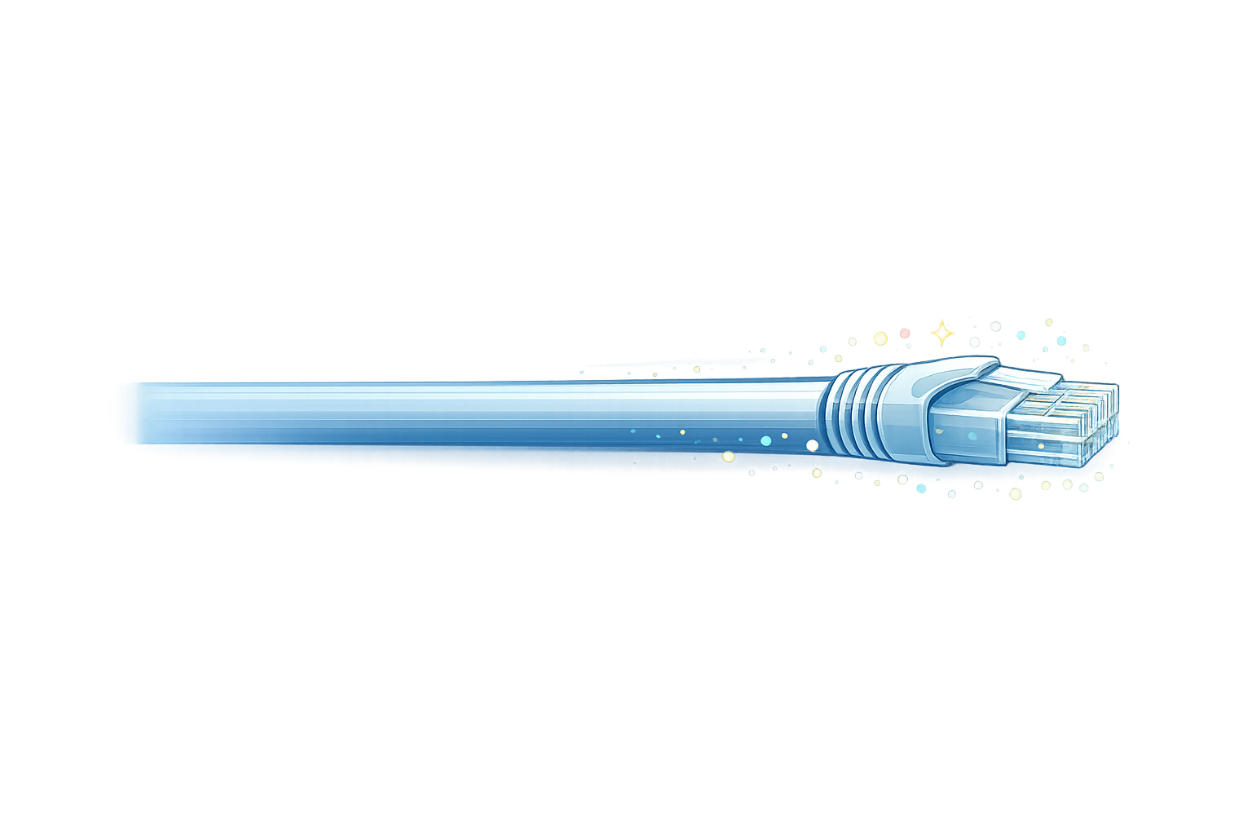
Cables
Almost all connections to the internet require the same cables.
A fibreoptic cable that transfers data between the router and the ISP.
Ethernet cables that connect the router to devices in the same building.

Slide 9



What Internet Access looks like
Data travels both ways between the Internet Service Provider and our devices. Everything goes through the router.

Slide 10

Targets
Tasks
I can describe the purpose of the internet.
I can describe the purpose of routers and cables.
I can describe the purpose of an internet service provider (ISP).
The Internet Workbook
Superstudyparty.com
  NPA Computing Technologies
  Level 4
  Computing Foundations
  The Internet

