Slide 1



Starter Revision
Subject: Computing Technologies
Level: 4
Computing Foundations
Networks in Daily Life
Types of Networks
Network Security
The Internet

Slide 2
Data in Society
Computing Foundations

Slide 3

Learning Targets
I can state the role of data in society.

Slide 4
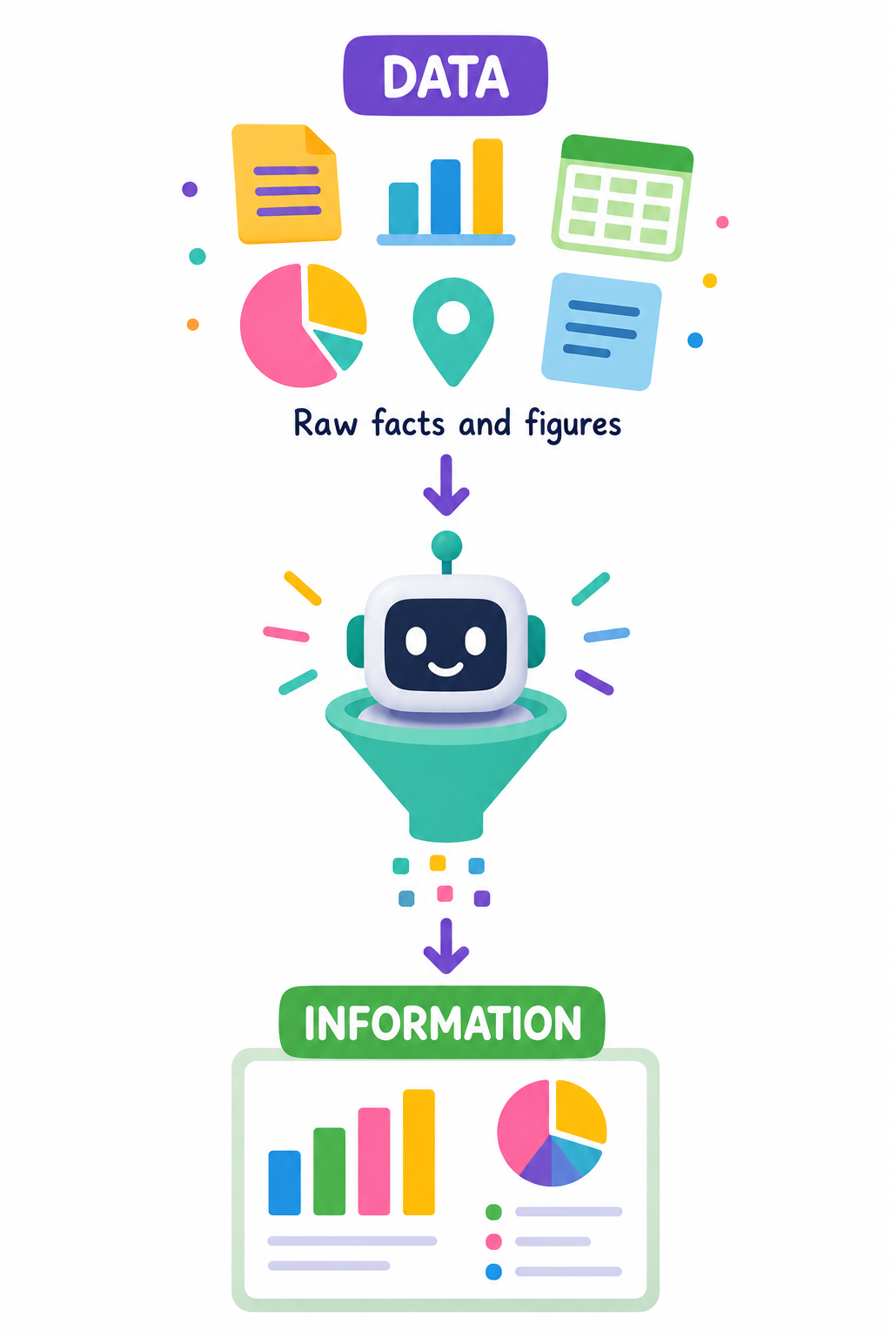
What is Data?
Data is raw facts and figures that can be processed into information.

Slide 5
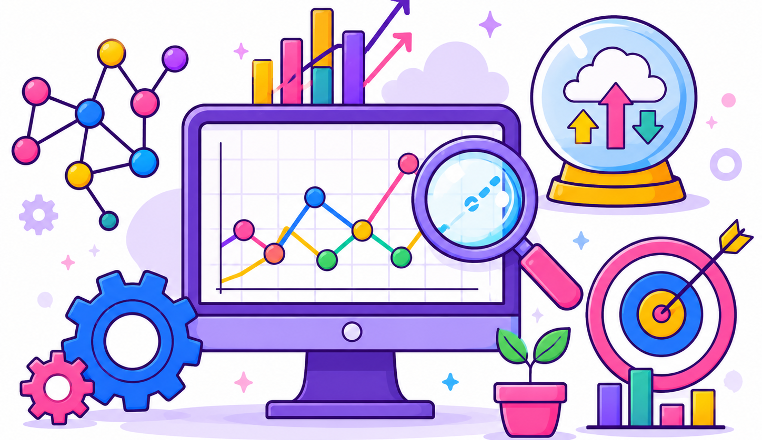
What is Data Science?
Data science is the field of using data to:
  Find patterns
  Make predictions
  Help solve problems
  Support Decision Making

Slide 6
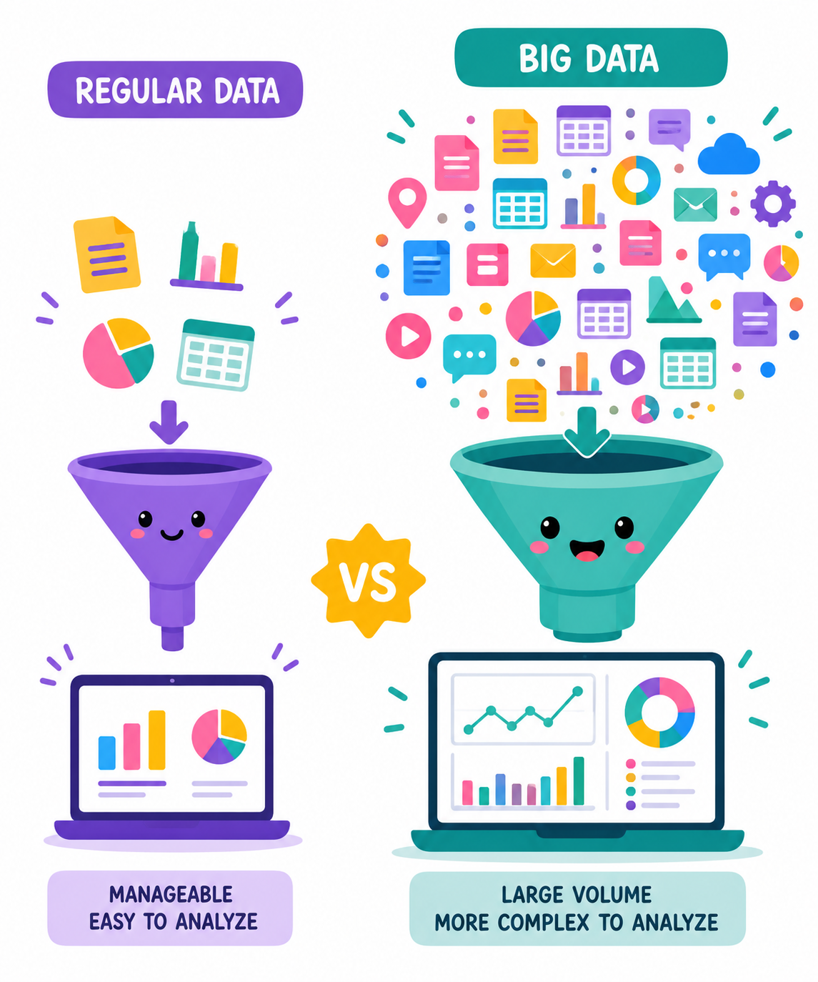
What is Big Data?
Big Data refers to extremely large data sets of data.
Having more data helps identify complex patterns which can solve more complicated problems or improve decision making.

Slide 7

Data in Society
In our everyday life, data is
used in a number of ways to help improve our lives, keep us safe and allow us to make better decisions.

Slide 8
Healthcare
Data is used to track patient records and predict disease outbreaks.
This way, illnesses can be spotted earlier or even prevented.

Slide 9
Education
Data is used to help schools understand progress and behaviour of pupils.
It also allows teachers to plan support for pupils who need it.

Slide 10
Transport
Data is used to plan journies, reduce traffic jams and ensure the most efficient route is taken.
Using data, sat navs can update mid journey to avoid areas that have become busy.

Slide 11
Shopping & Advertising
Data is used to show what products are popular and to personalise advertisements to specific people.

Slide 12
Social Media
Data is used to suggest content based on what users have shown interest in.
If you have liked or shared funny cat videos, it is likely you will see more cat videos going forward.

Slide 13

Targets
Tasks
I can state the role of data in society.
Data in Society Workbook
Superstudyparty.com
  NPA Computing Technologies
  Level 4
  Computing Foundations
  Data in Society

