Slide 1



Starter Revision
Subject: Computing Technologies
Level: 4
Computing Foundations
Data in Society
Data Advantages and Challenges

Slide 2
Data Ethics
NPA Computing Foundations
Level 4

Slide 3
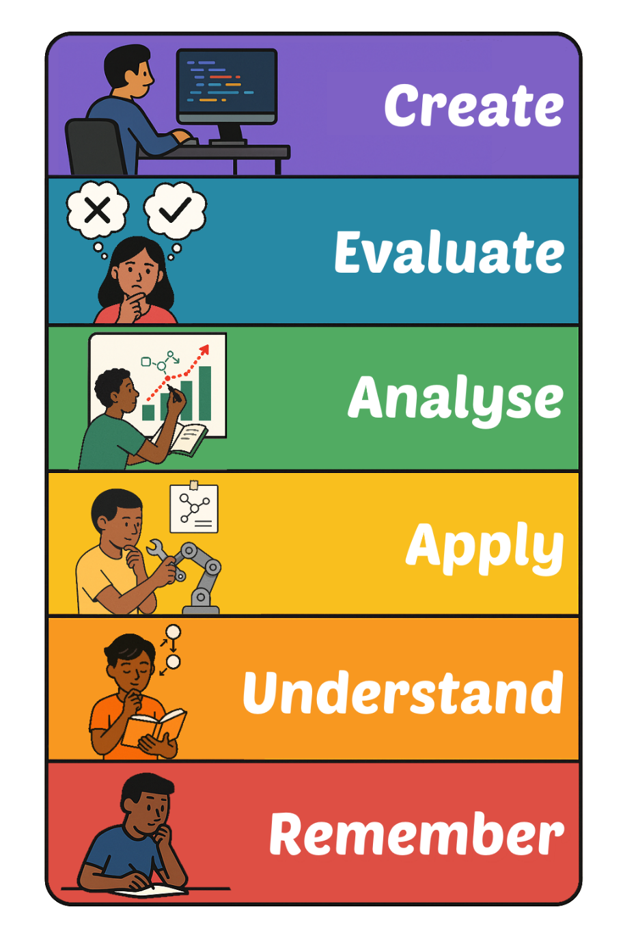
Learning Targets
I can state ethical considerations when sharing data.

Slide 4

What is Data Ethics?
Data Ethics are moral rules around the use of data.
Data should be used responsibly, fairly and with respect for people’s privacy.

Slide 5

Data Ethics
There are four key areas of
Data Ethics.
Privacy
Anonymisation
Consent
Fair Use

Slide 6

Data Privacy
Data Privacy aims to protect a person’s information.
This ensures only people with the right permissions can see your data, if anyone.

Slide 7

Data Anonymisation
Data Anonymisation removes personal details from data.
This ensures that data can’t be easily identified as your data.

Slide 8

Data Consent
Consent ensures that before taking and using your data, you have agreed to give it.
If consent isn’t given, this may break the law.

Slide 9

Fair Use of Data
Fair Use of Data ensures that the use of data is honest and will not cause harm.
It ensures that data is used for the purpose it was collected.

Slide 10

Targets
Tasks
I can state ethical considerations when sharing data.
Data Ethics Workbook
Superstudyparty.com
  NPA Computing Technologies
  Level 4
  Computing Foundations
  Data Ethics

