Slide 1



Starter Revision
Subject: Computing Technologies
Level: 4
Computing Foundations
CPU

Slide 2
Backing Storage
NPA Computing Technologies
Level 4

Slide 3
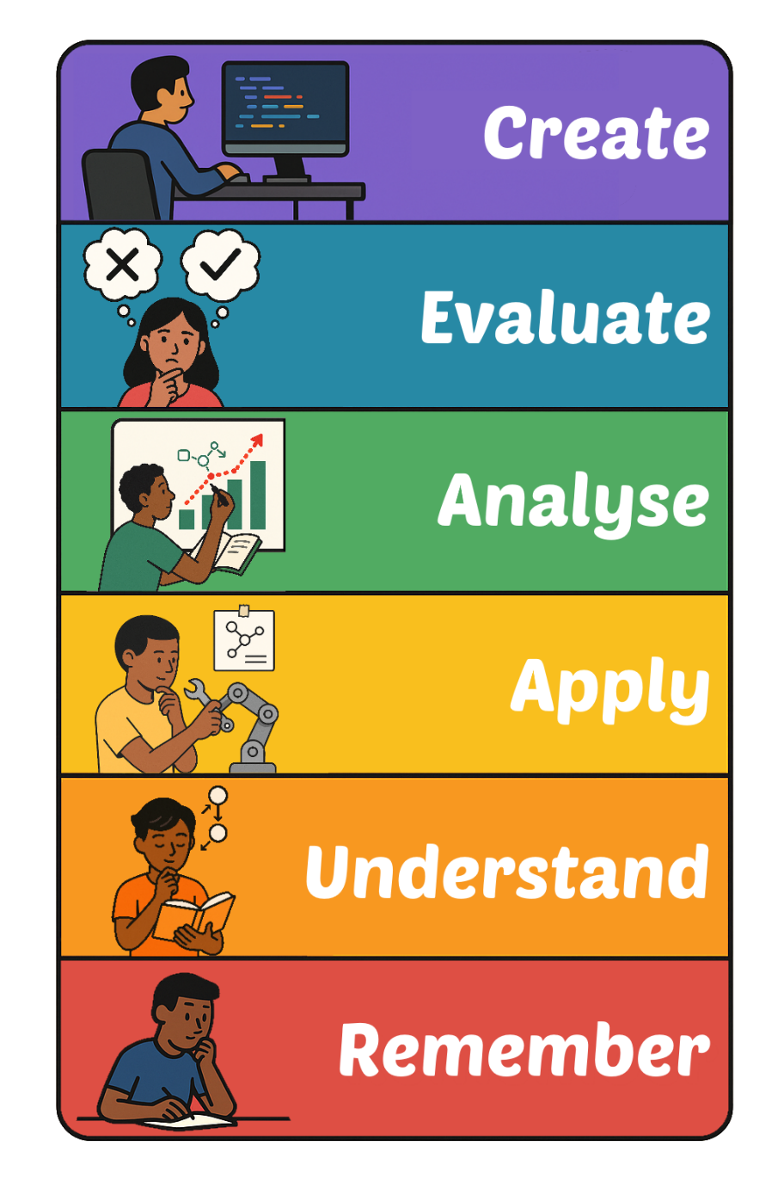
Learning Targets
I can state the purpose of backing storage.
I can describe how capacity affects backing storage.

Slide 4

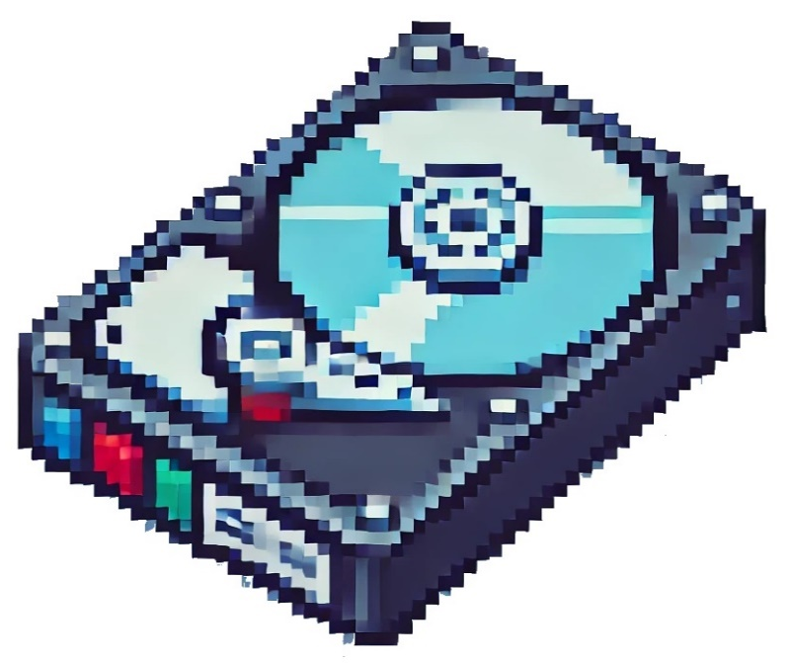
What is Backing Storage?
Backing storage provides long-term data storage
It keeps files and programs safe even when the computer is turned off

Slide 5
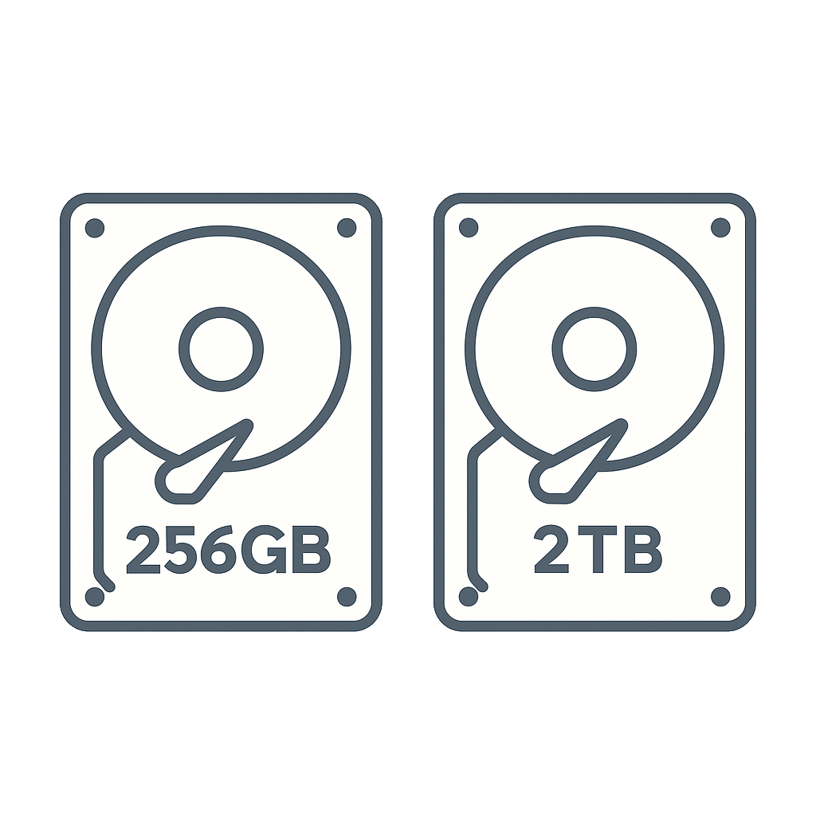
Capacity
Capacity is the amount of data that can be stored
Backing storage capacity is typically measured in gigabytes (GB) or terabytes (TB)
Typical capacities range from 256 GB to 2 TB

Slide 6
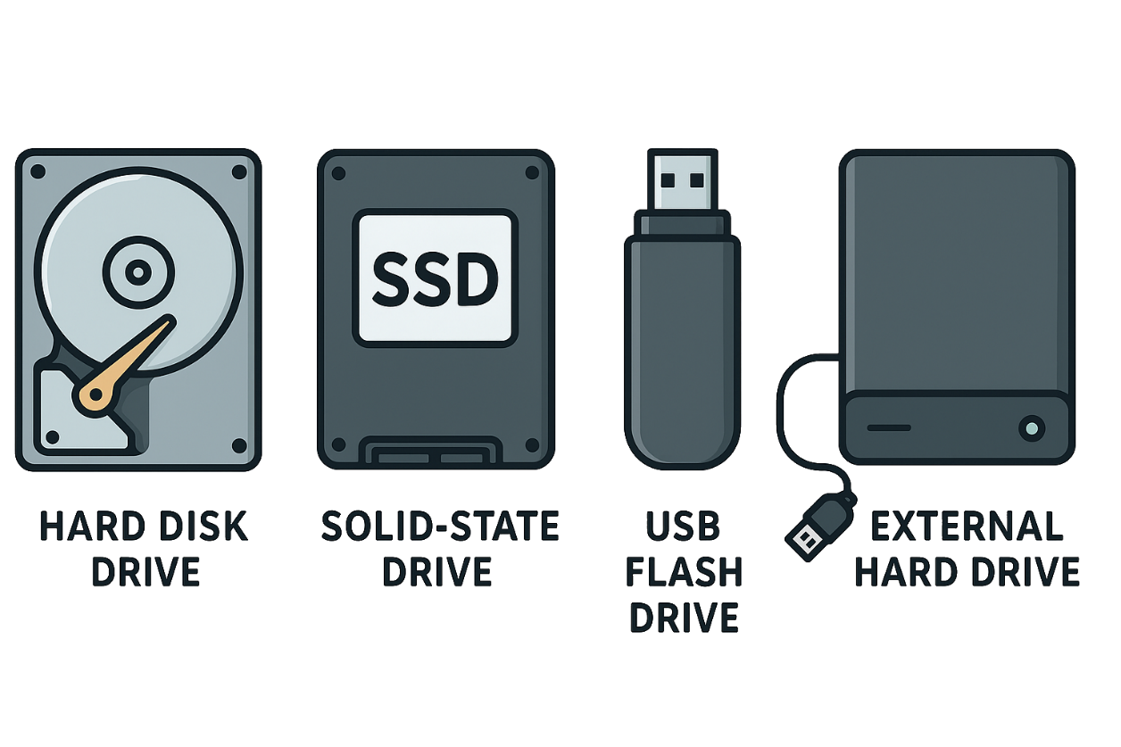
Types of Backing Storage
There are two main types of backing storage
Internal
  Found inside the computer
    Hard Disk Drive (HDD)
    Solid-State Drive (SDD)
External
  Portable devices
    USB Flash Drive
    External Hard Drive

Slide 7
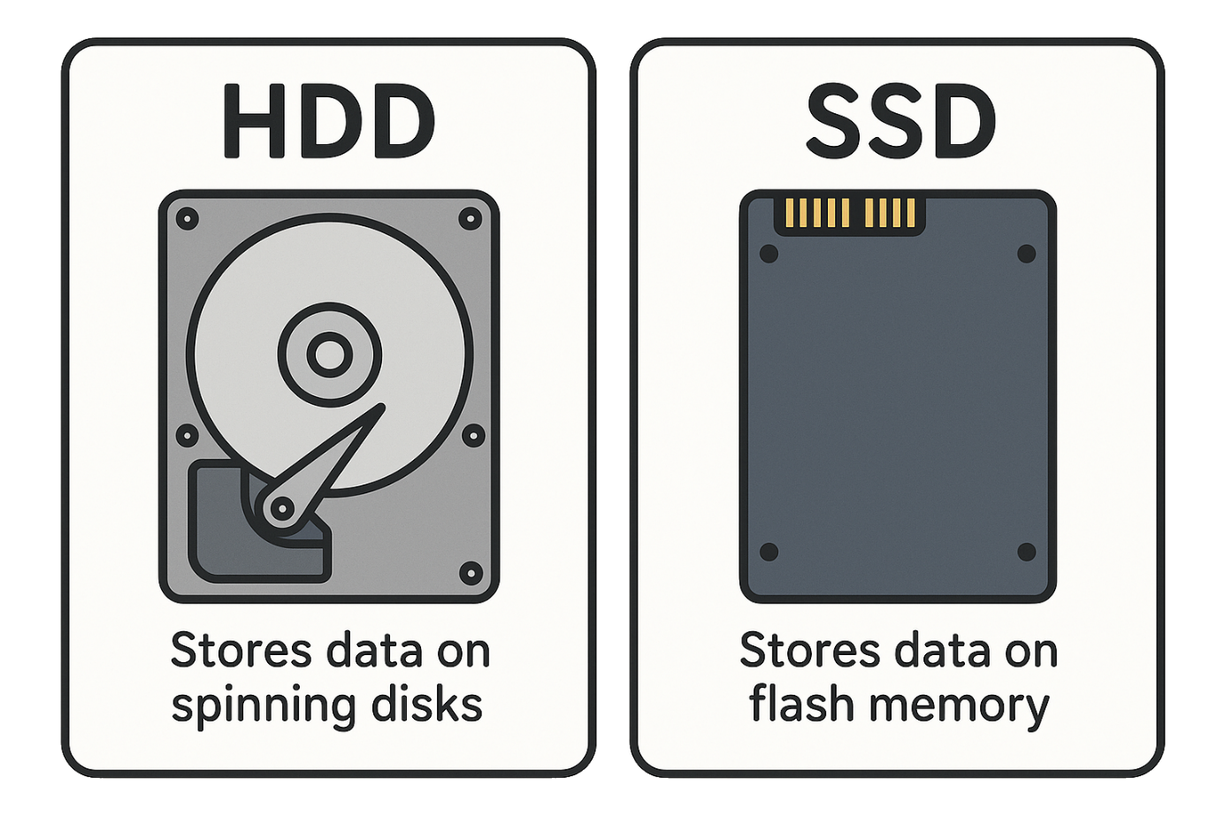
HDD vs SDD
Hard Disk Drive (HDD)
  Stores data on spinning disks
  Offers high capacity
  Slower speeds than SSD
Solid-State Drive (SSD)
  Stores data on flash memory chips
    Flash memory is electronic and has no moving parts.
  More durable because no moving parts
  Faster than HDD

Slide 8

Targets
Tasks
I can state the purpose of backing storage.
I can describe how capacity affects backing storage.
Backing Storage Workbook
Superstudyparty.com
  NPA Computing Technologies
  Level 4
  Computing Foundations
  Backing Storage

