Slide 1



Starter Revision
Subject: Computing Technologies
Level: 4
Computing Foundations
Data in Society
Data Advantages and Challenges
Data Ethics

Slide 2
Data Security
NPA Computing Technologies
Level 4

Slide 3
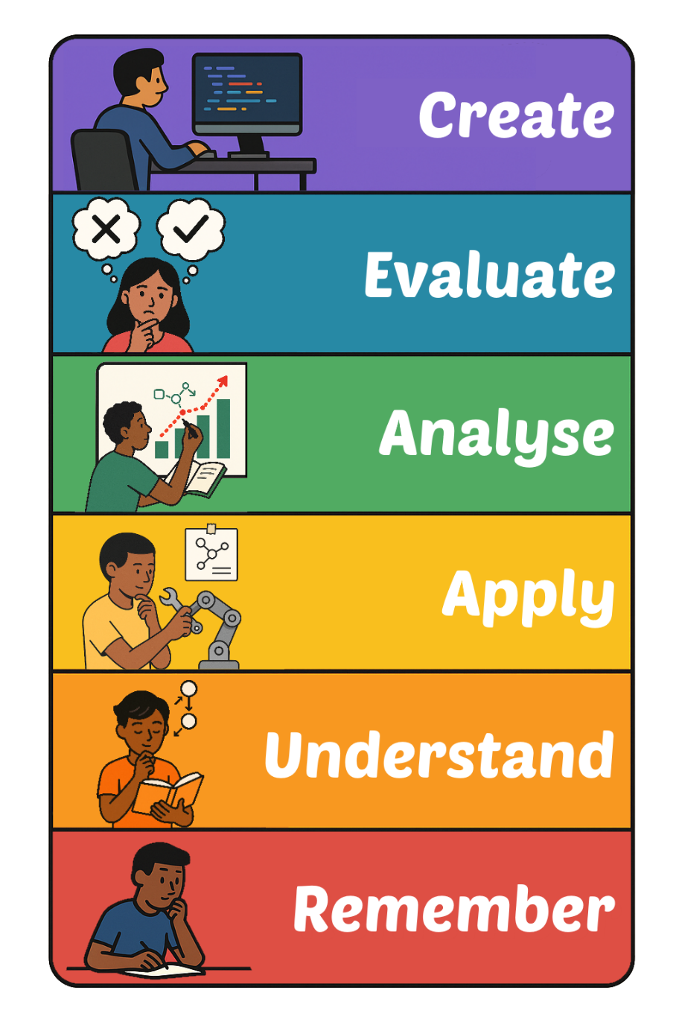
Learning Targets
I can state two ways to keep data secure.

Slide 4
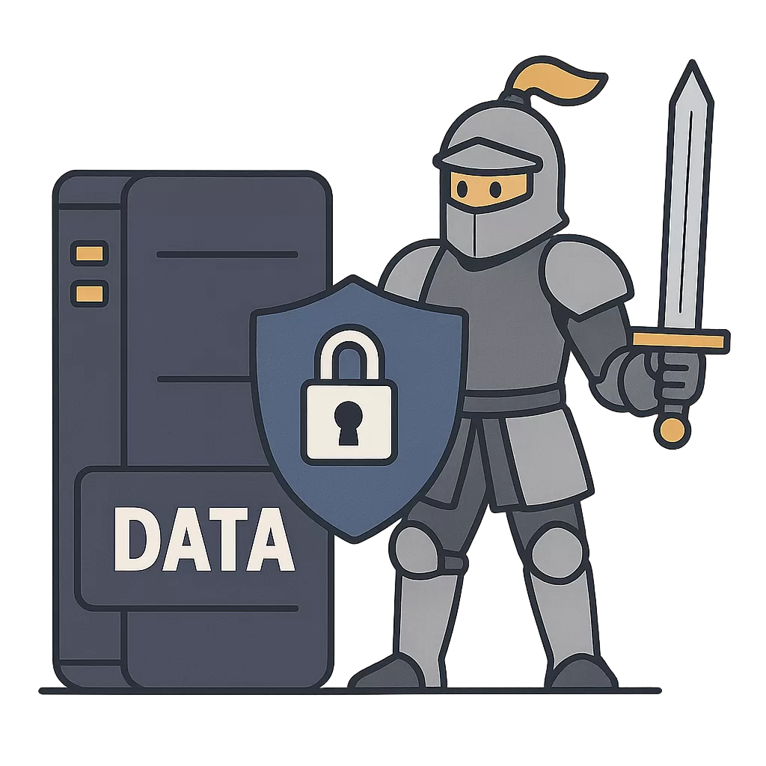
What is Data Security?
Data Security is the act of keeping data safe, which then protects people’s privacy.

Slide 5
Keeping Data Secure
There are lots of ways to keep data secure. Two methods that we will look at are:
Strong Passwords
Encryption

Slide 6
Strong Passwords
Strong passwords mean unauthorised users can’t access your account or data.
Strong passwords are the first line of security in all areas of technology.
Tips for Strong Passwords
8–12 characters
Use UPPER and lower case
Add numbers (e.g., 3, 9)
Use symbols (e.g., @, !)
Don’t use easy words or reuse passwords

Slide 7
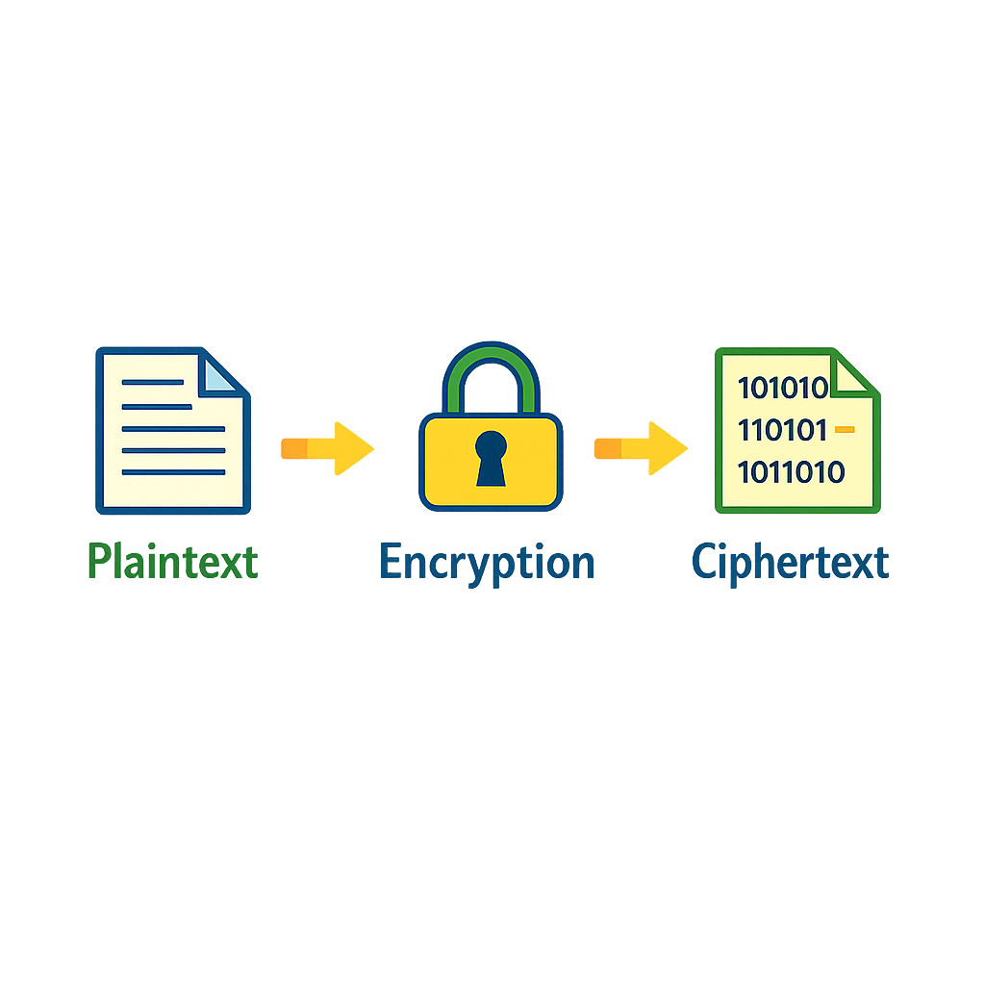
Encryption
Encryption ensures that data is unreadable even if it is stolen.
Encryption changes each character to a different character.
It can no longer be read by someone without access.

Slide 8

Targets
Tasks
I can state two ways to keep data secure.
Data Security Workbook
Superstudyparty.com
  NPA Computing Technologies
  Level 4
  Computing Foundations
  Data Security

