Slide 1


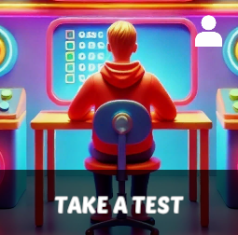
Starter Revision
Subject: Computing Technologies
Level: 4
Computing Foundations
Networks in Daily Life
Types of Networks
Network Security
The Internet

Slide 2
Artificial Intelligence (AI)
NPA Computing Technologies
Level 4

Slide 3
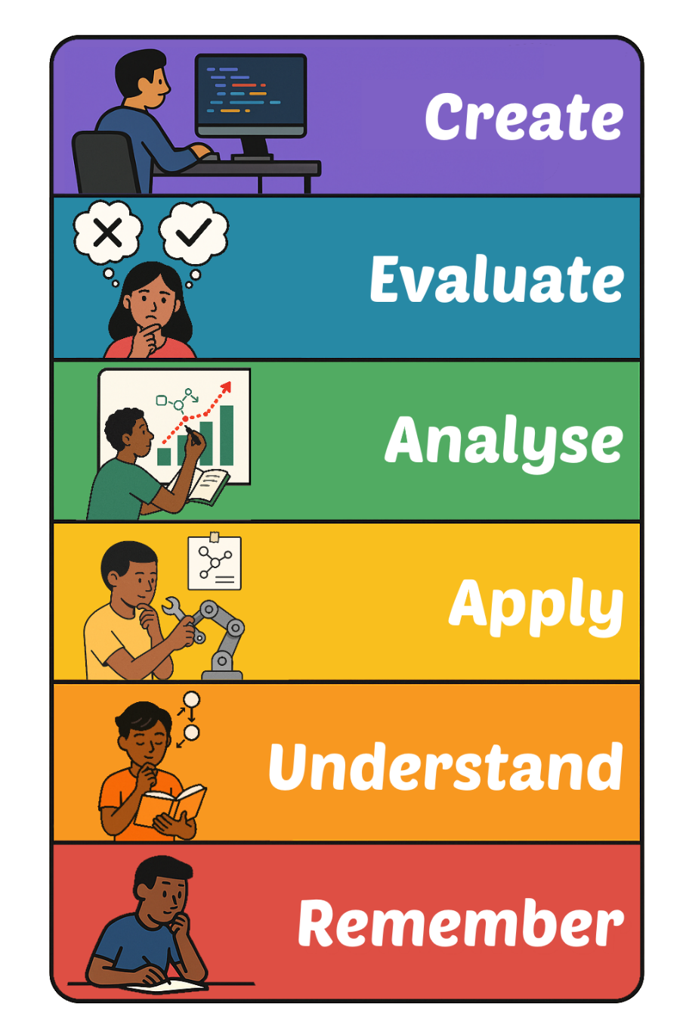
Learning Targets
I can describe what Artificial Intelligence is.
I can state three uses of AI.
I can state two potential risks of using AI.

Slide 4
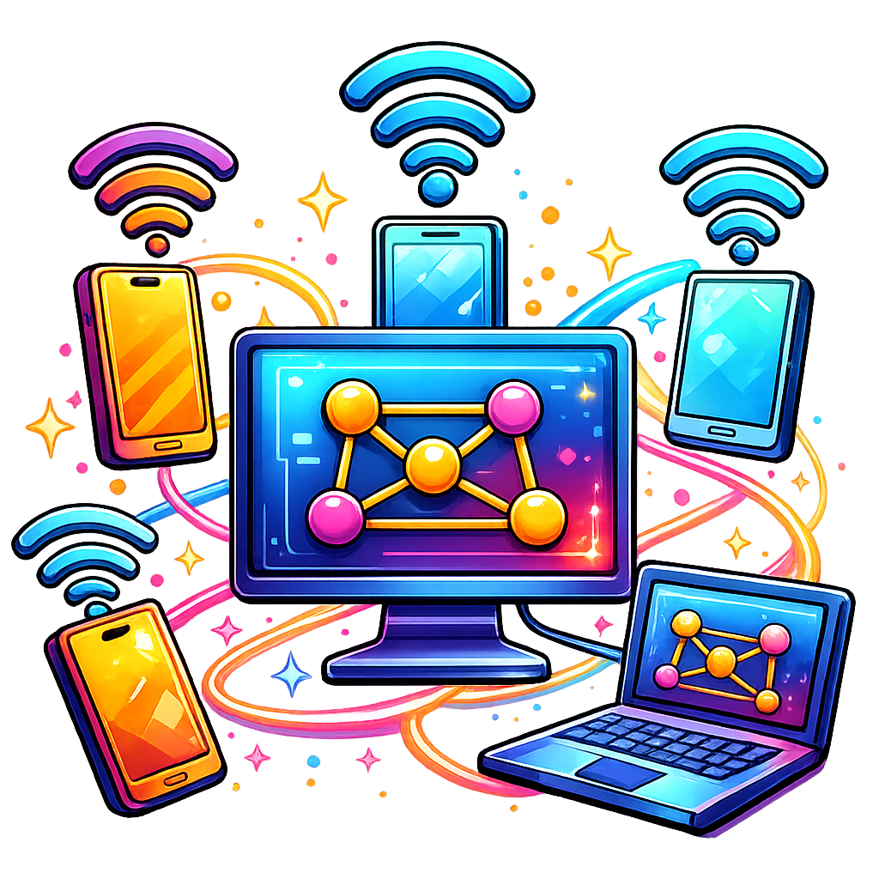
Emerging Digital Technologies
Emerging digital technologies are new tools and systems still being developed and improved.
While the technology does exist, it is new, and as a result it is still ‘emerging’.

Slide 5
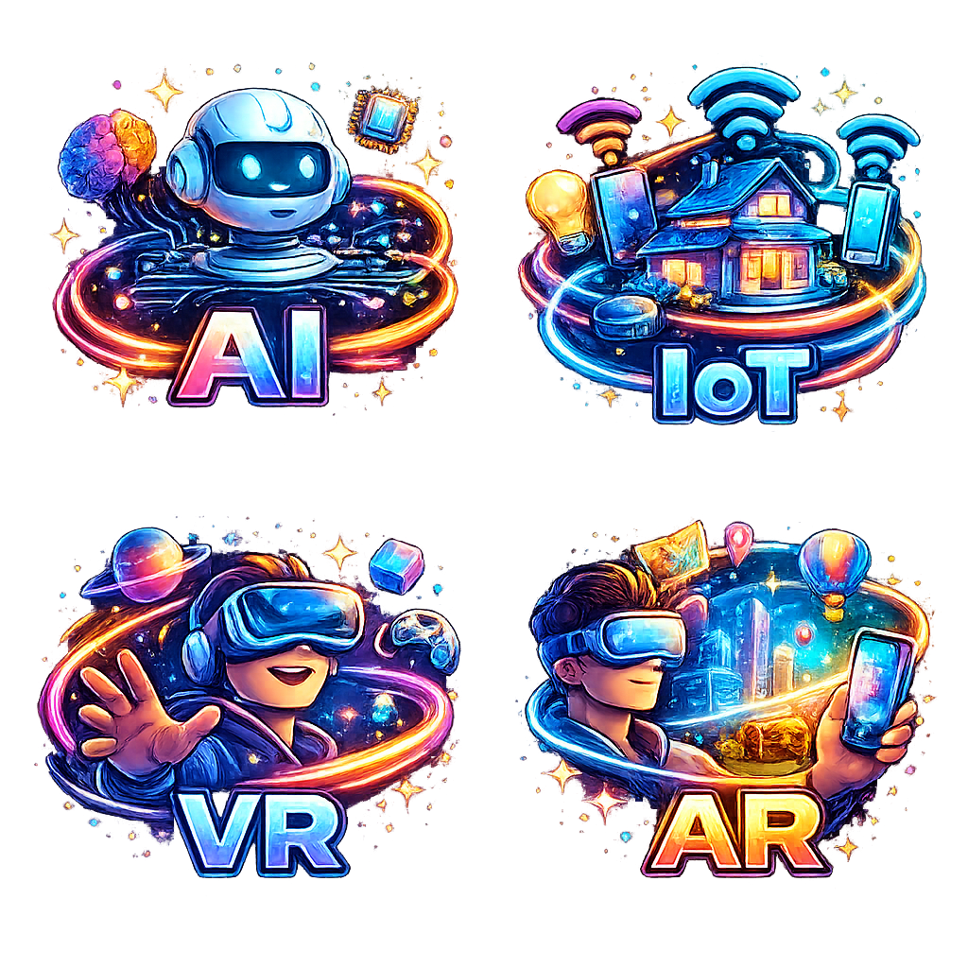
Examples of Emerging Digital Technologies
Artificial Intelligence (AI)
Internet of Things (IoT)
Virtual Reality (VR)
Augmented Reality (AR)

Slide 6
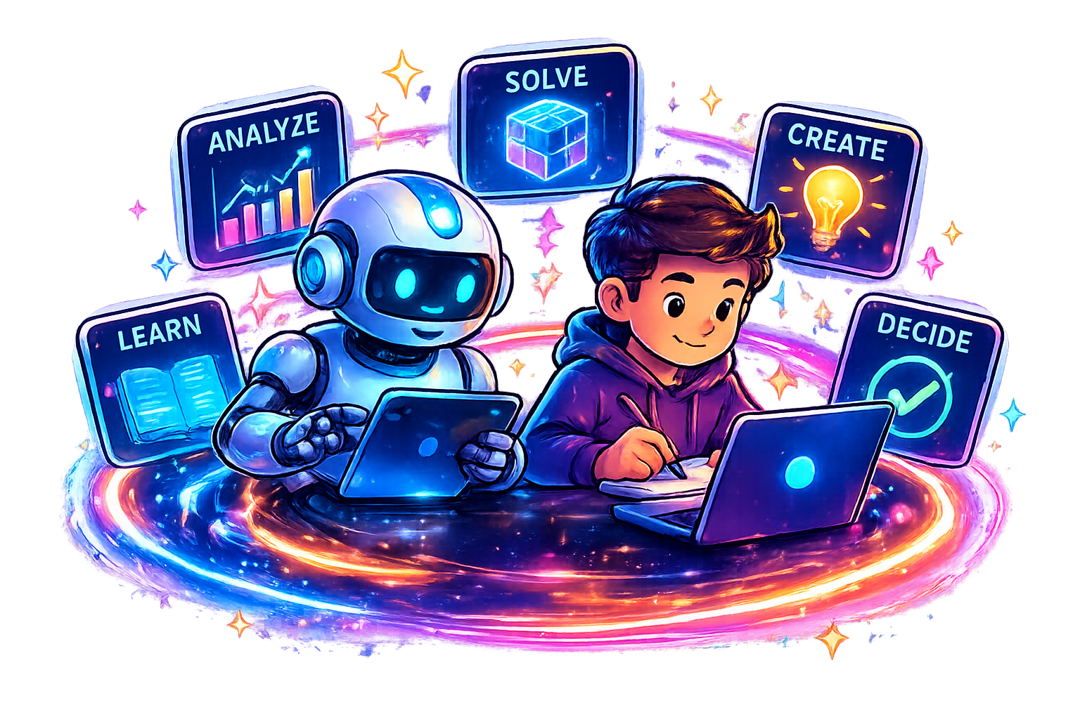
What is Artificial Intelligence?
Artificial Intelligence (AI) is a technology that enables computers to simulate human intelligence.
AI can do a lot of the same tasks as humans but quicker and better.

Slide 7
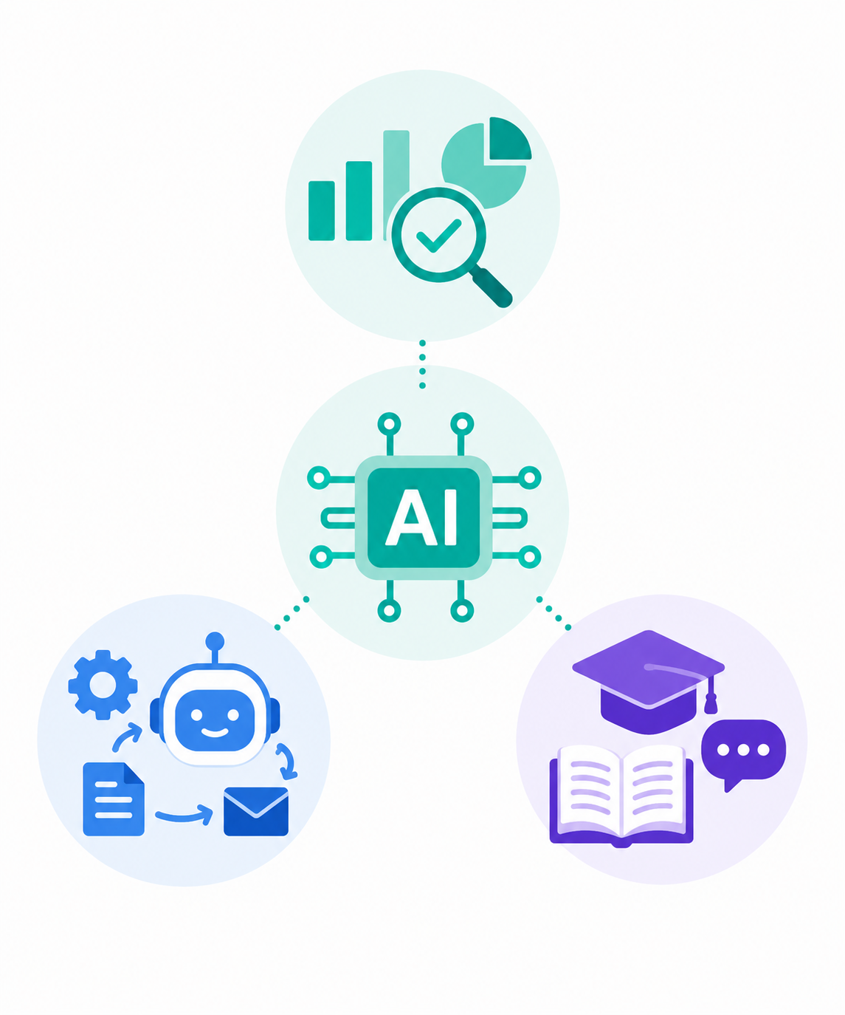
Uses of AI
There are three main uses of AI that:
Help with Decision Making
Automate Tasks
Support Learning

Slide 8
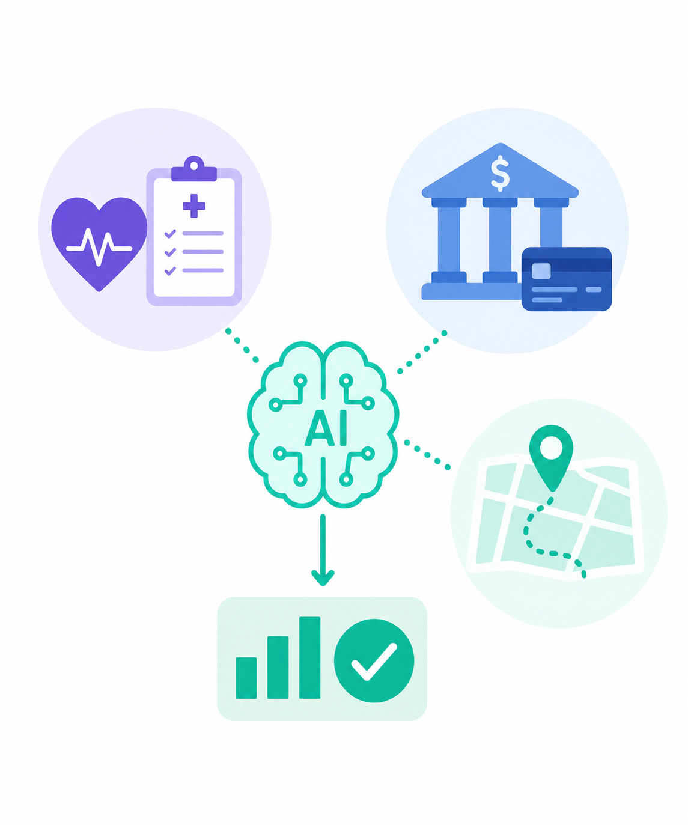
Using AI to help with Decision Making
AI can analyse large amounts of data quickly to help people make better decisions.
Health – Can identify illnesses
Banks – Helps detect fraud
Maps – Choosing fastest route

Slide 9
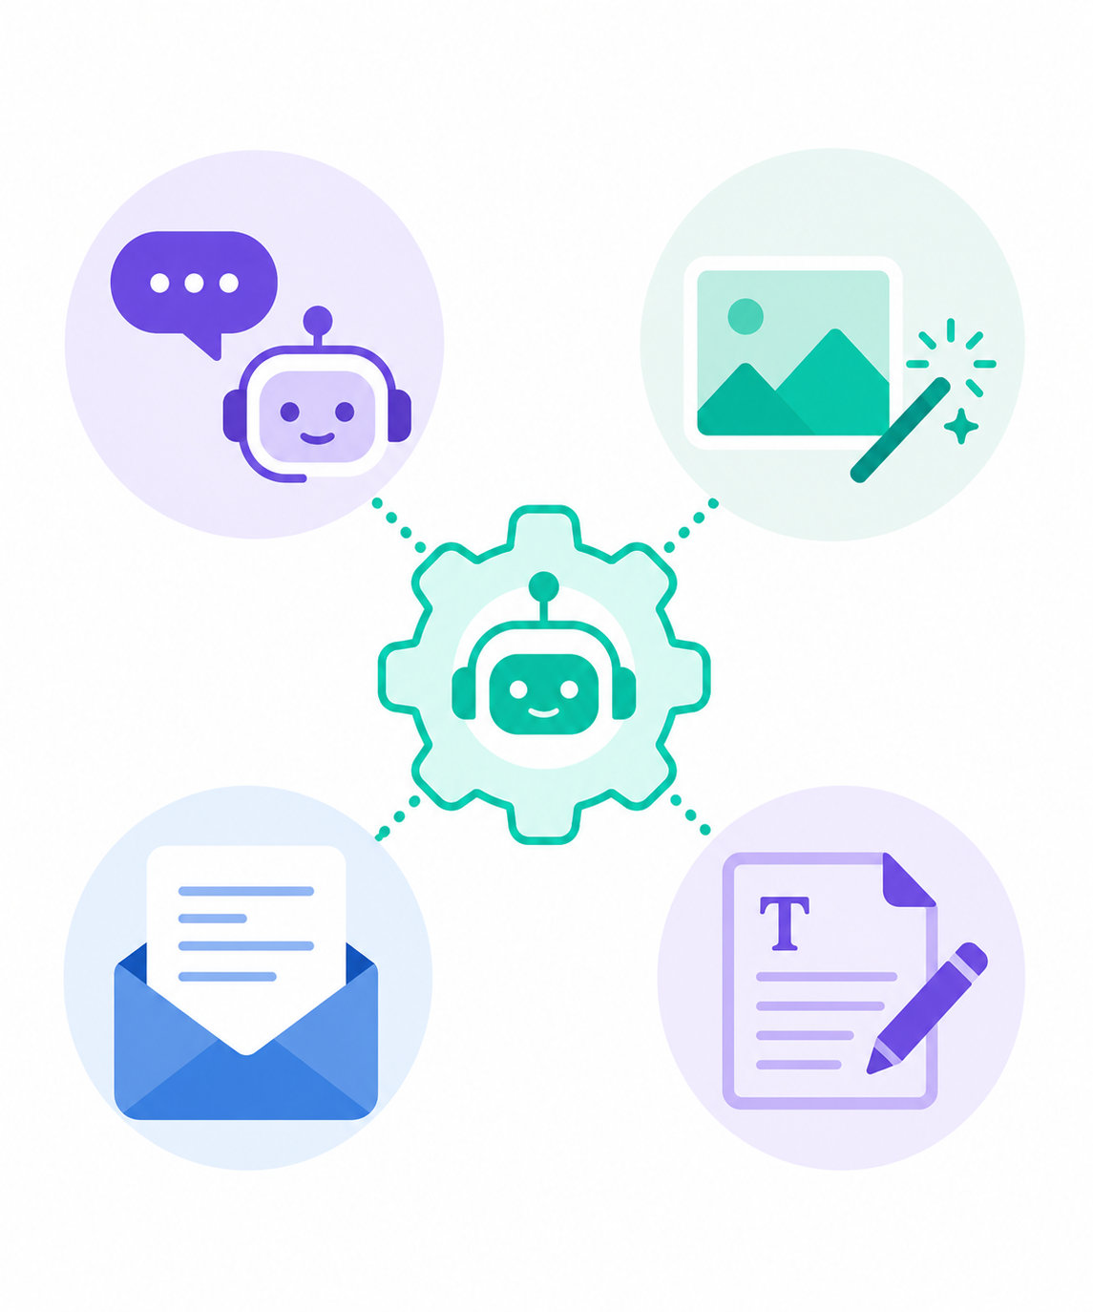
Using AI to Automate Tasks
AI can complete tasks automatically without needing constant human input.
Talking to customers
Writing emails and blog posts
Creating images and posters

Slide 10
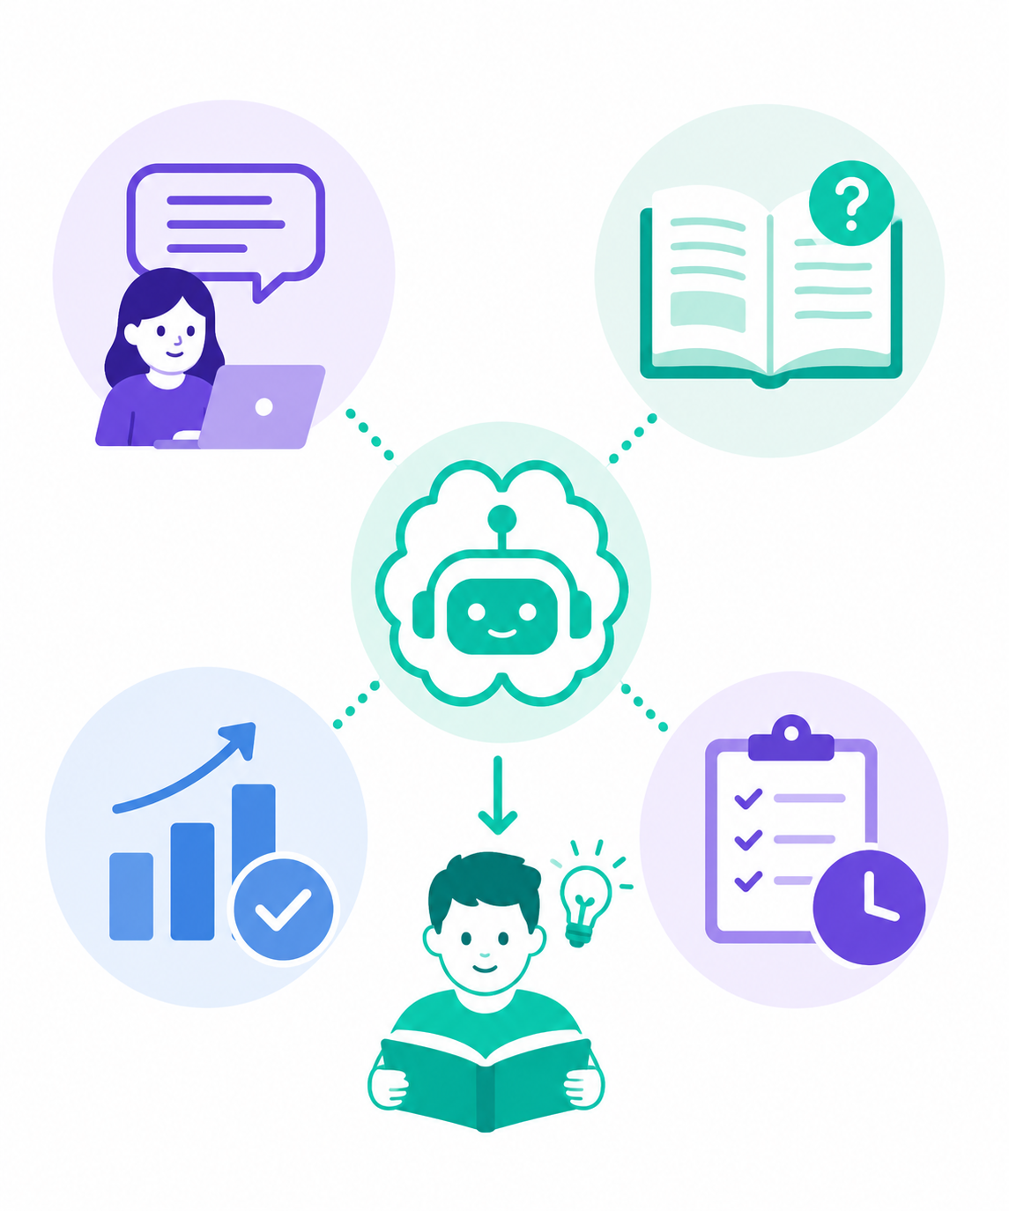
Using AI to Support Learning
AI can support learning by providing information on a topic at a specific level.
Explains topics differently
Generates practice questions
Checks spelling and grammar
Provides instant feedback

Slide 11
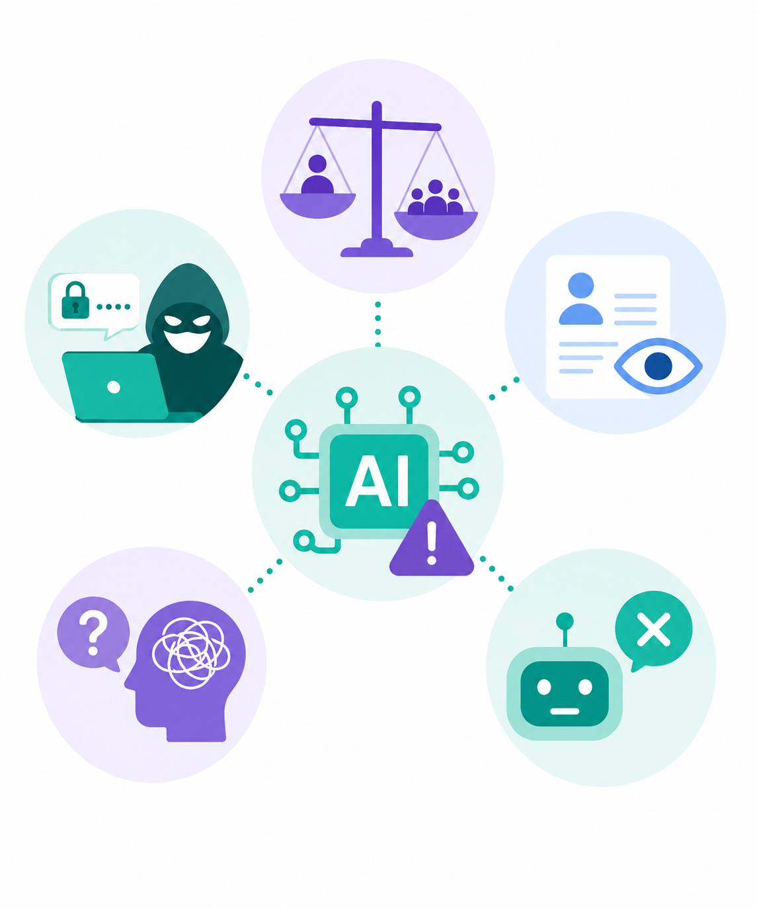
Risks of using AI
There are two main risks associated with using AI:
Loss of Jobs
Data Breaches

Slide 12
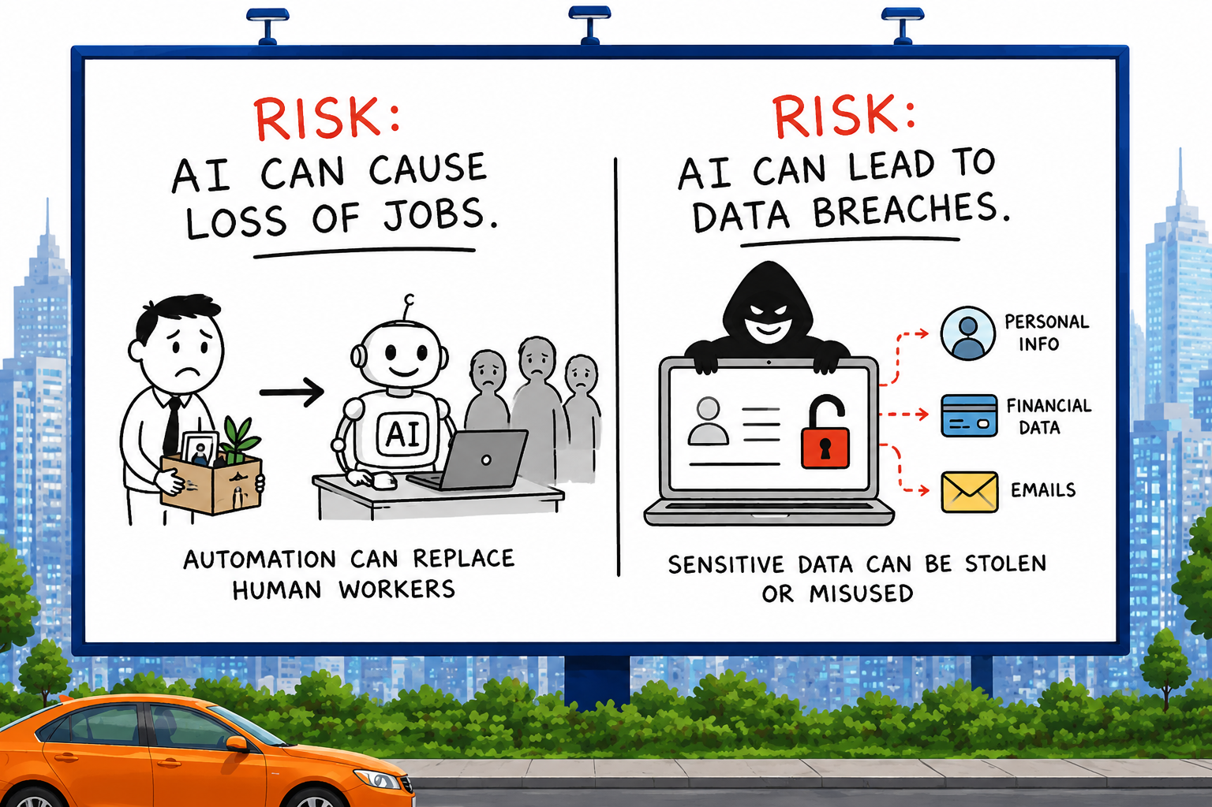
Job Losses
AI can perform some tasks faster and cheaper than humans. This may reduce the number of workers needed in some jobs.
Why hire someone to make you an image when AI can do it?

Slide 13
Data Breaches
AI systems require lots of personal data. If stolen or accessed without permission, it can cause serious problems.
Personal details being leaked
Financial information stolen

Slide 14

Targets
Tasks
I can describe what AI is.
I can state three uses of AI.
I can state two potential risks of using AI.
Artificial Intelligence Workbook
Superstudyparty.com
  NPA Computing Technologies
  Level 4
  Computing Foundations
  Artificial Intelligence (AI)

