Slide 1



Starter Revision
Subject: Computing Technologies
Level: 4
Computing Foundations
Artificial Intelligence (AI)

Slide 2
Internet of Things
NPA Computing Technologies
Level 4

Slide 3

Learning Targets
I can describe what Internet of Things (IoT) is.
I can state the impact of IoT on our lives.
I can state the advantage of using IoT.

Slide 4
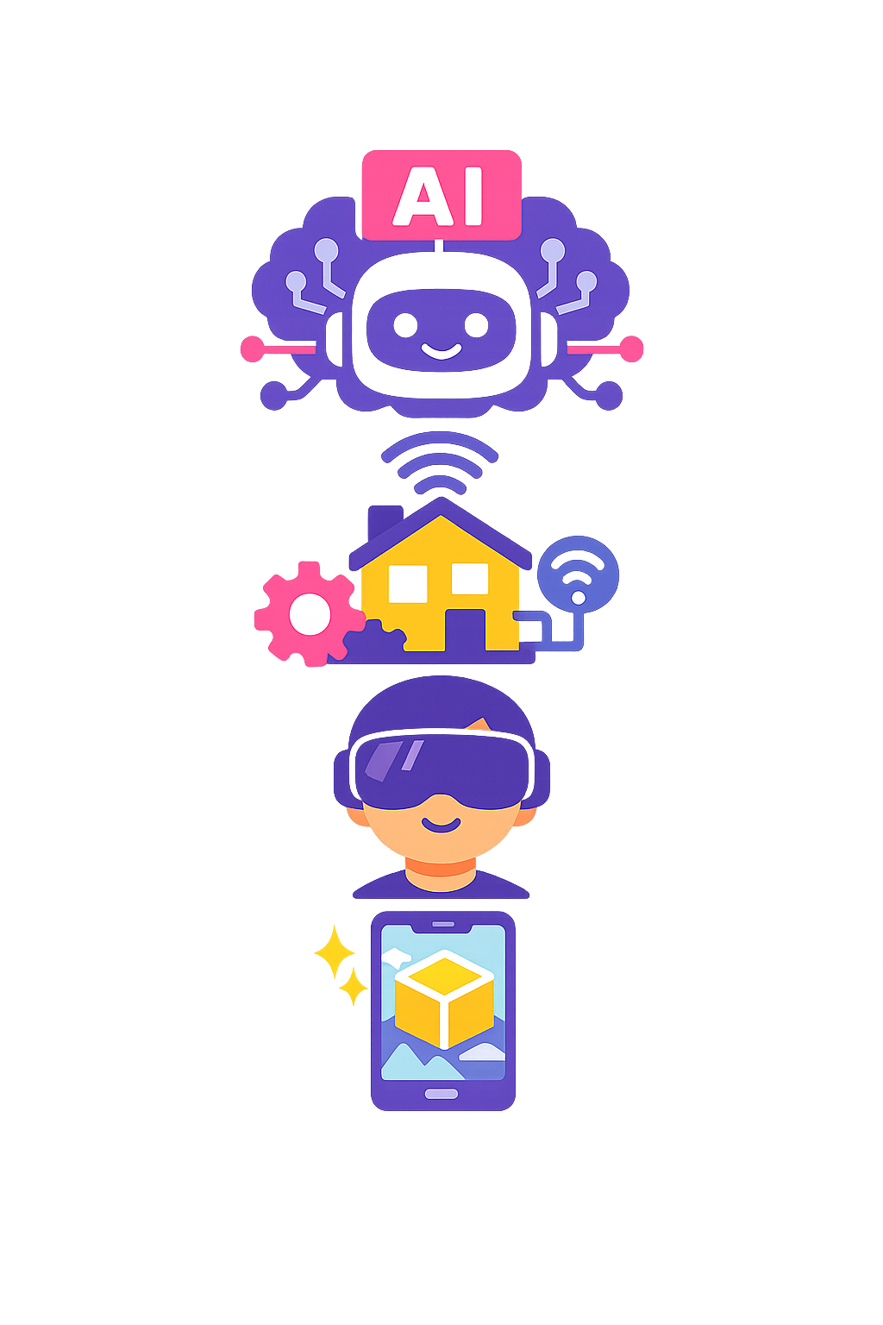
Emerging Digital Technologies
Emerging digital technologies are new tools and systems still being developed and improved.
While the technology does exist, it is new, and as a result it is still ‘emerging’.

Slide 5
Examples of Emerging Digital Technologies
Artificial Intelligence (AI)
Internet of Things (IoT)
Virtual Reality (VR)
Augmented Reality (AR)

Slide 6
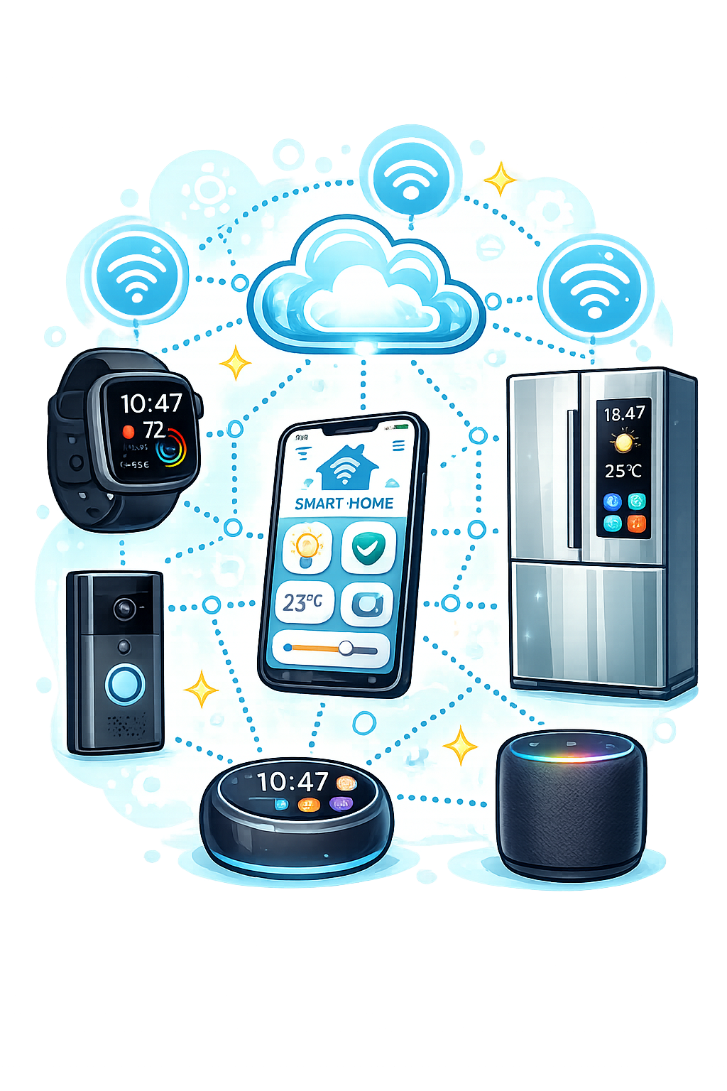
What is the Internet of Things?
Internet of Things is a network of everyday physical devices connected to the internet that share data and perform tasks.
IoT aims to make our lives easier, safer and more efficient by using data.

Slide 7

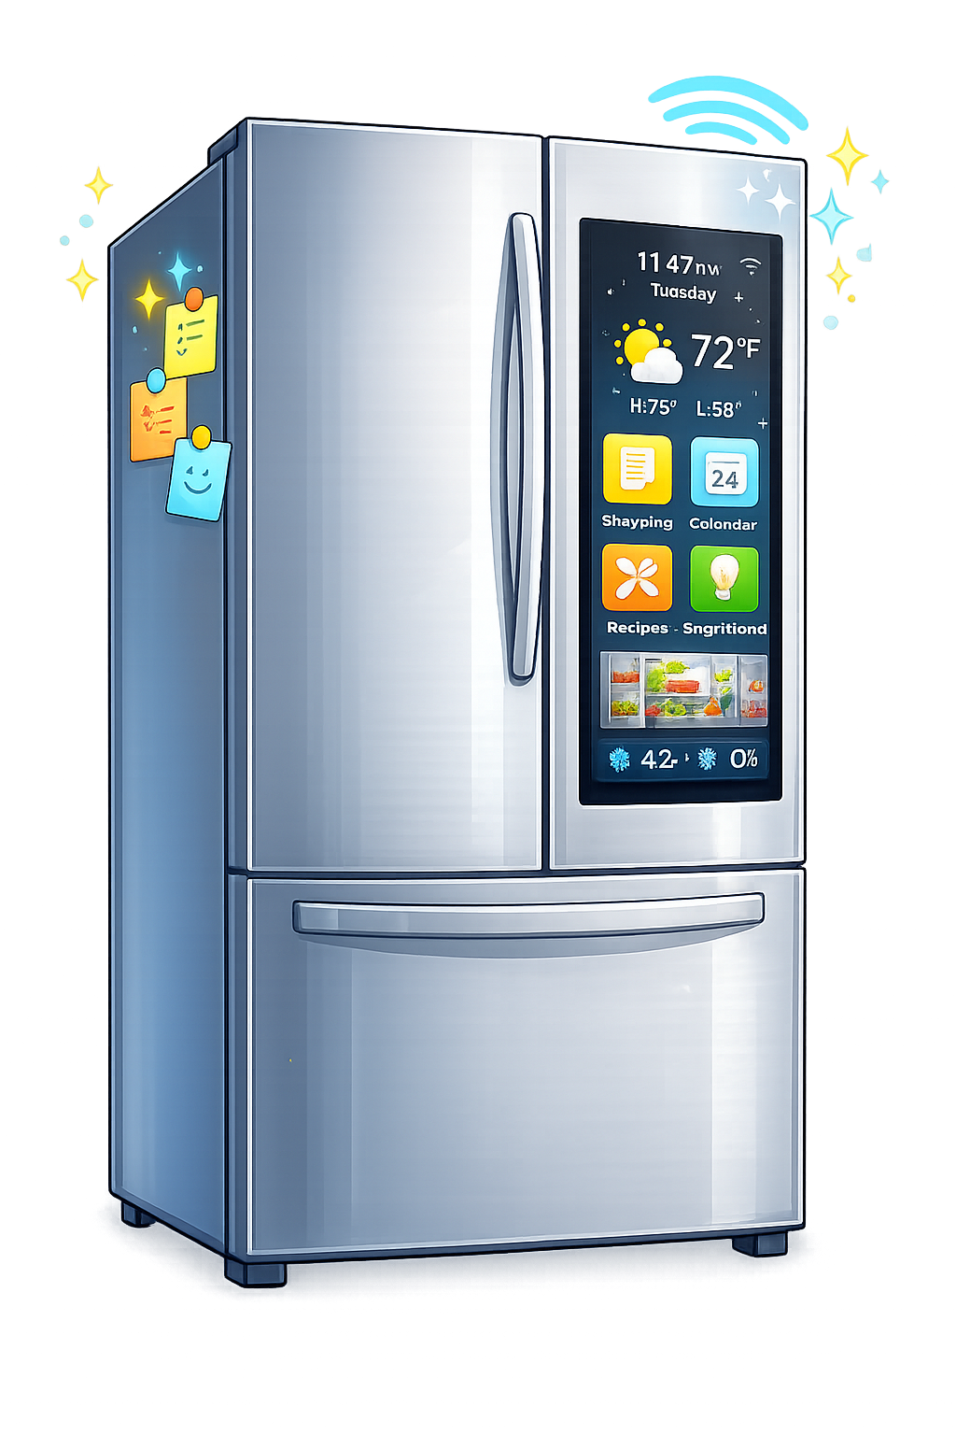

Examples of IoT
Smart Watches/Fitness Trackers
Smart Speakers (Alexa)
Smart Doorbells (Ring)
Smart Fridges
Baby Monitors
Security Lights and Cameras
Pet Trackers

Slide 8
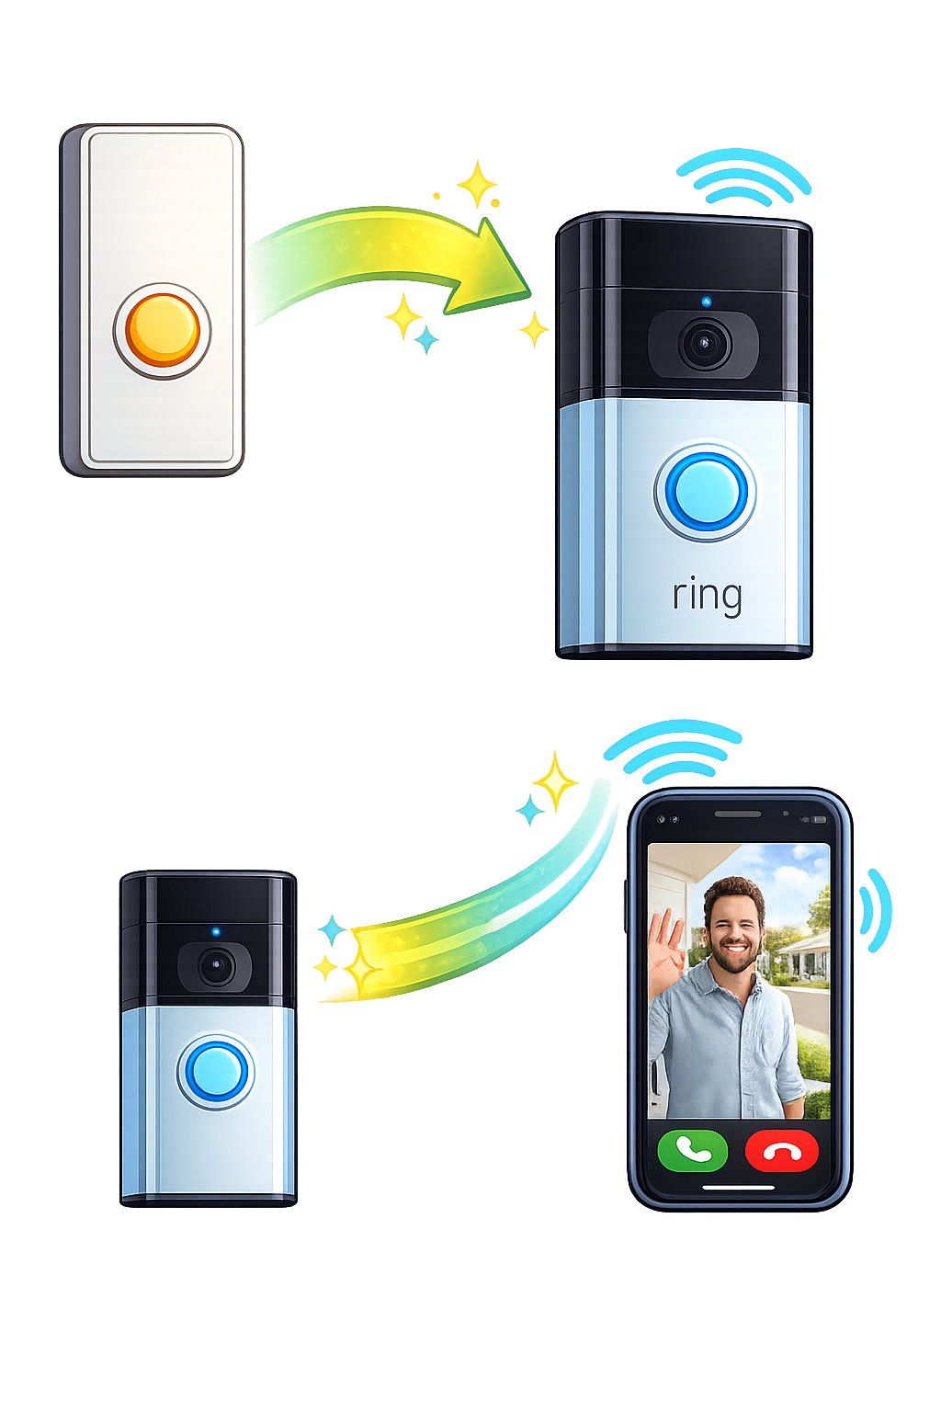
Advantages of IoT
The main advantage of IoT is that devices can be connected together to perform bigger, better tasks.
Those devices go from typically doing just one job, to doing multiple.

Slide 9

Targets
Tasks
I can describe what IoT is.
I can state the impact of IoT on our lives.
I can state the advantage of using IoT.
Internet of Things Workbook
Superstudyparty.com
  NPA Computing Technologies
  Level 4
  Computing Foundations
  Internet of Things (IoT)

