Slide 1



Starter Revision
Subject: Computing Technologies
Level: 4
Computing Foundations
CPU
Backing Storage

Slide 2
Main Memory
NPA Computing Technologies
Level 4

Slide 3

Learning Targets
I can state the purpose of main memory.
I can describe how capacity affects main memory.

Slide 4
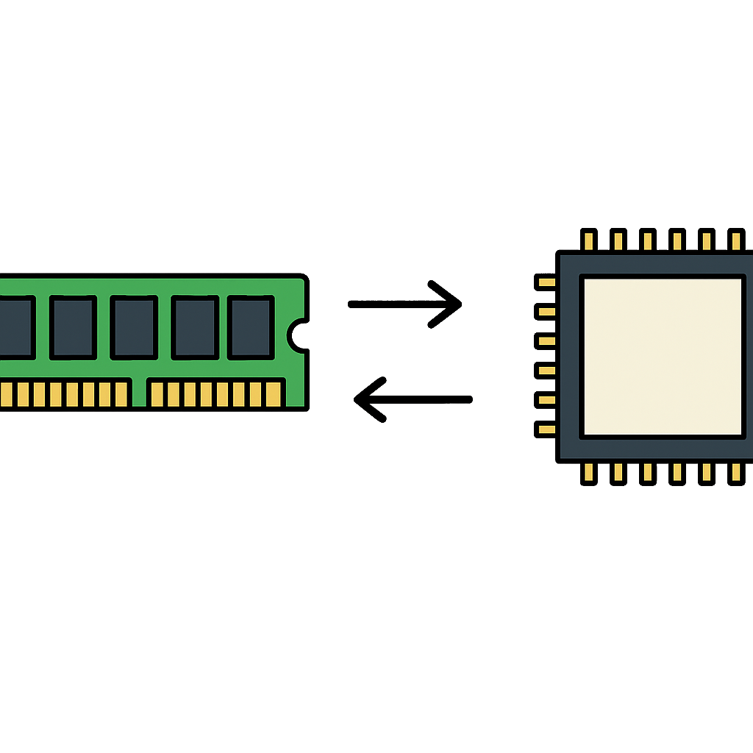
What is Main Memory (RAM)?
Main memory temporarily stores data and instructions while they are being used by the CPU
It provides fast access, allowing the CPU to quickly retrieve the information needed to run a program

Slide 5
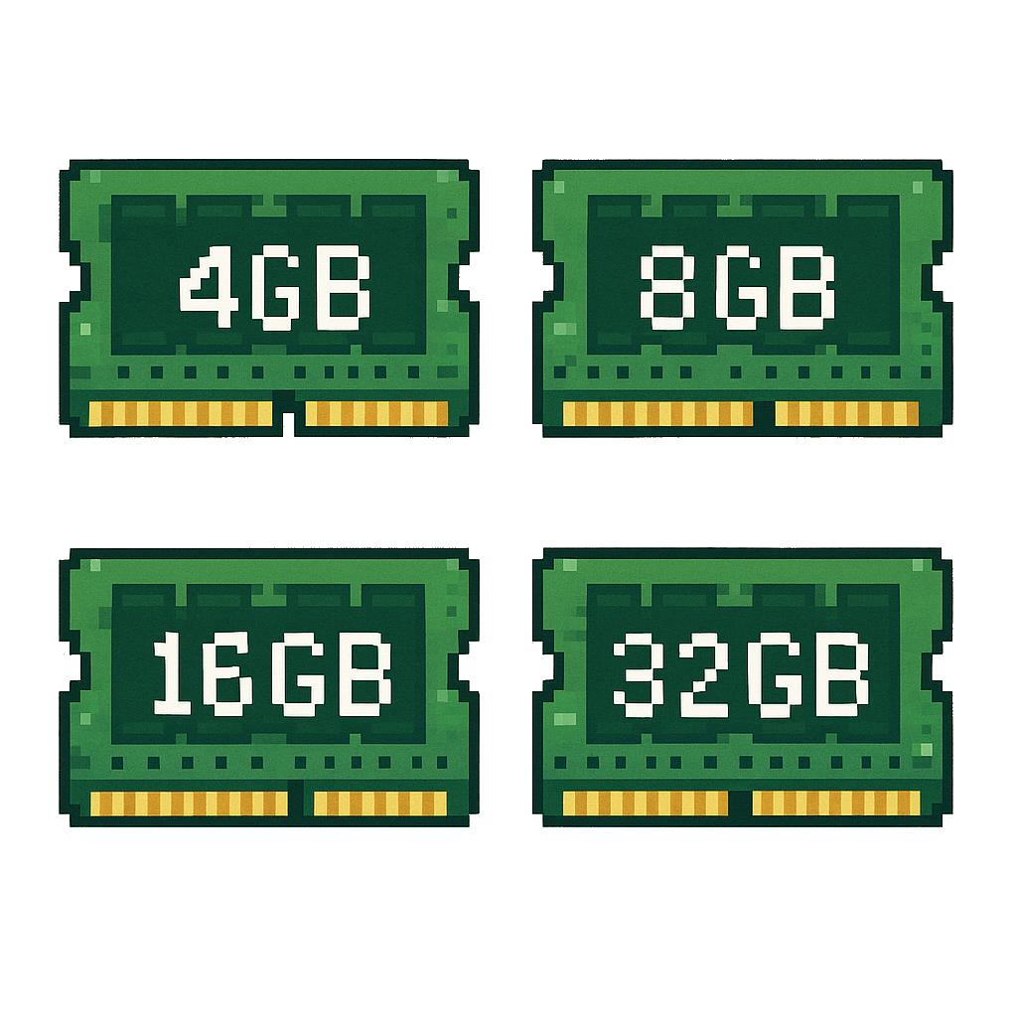
Capacity
Capacity is the amount of data that can be stored
The capacity of RAM is measured in gigabytes (GB)
Typical sizes range from 4GB to 32GB

Slide 6
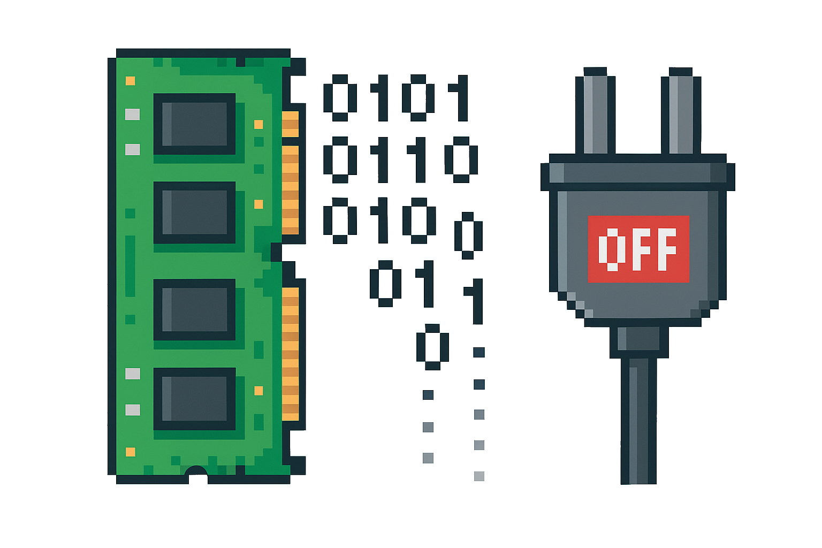
Volatile Memory
RAM is volatile memory
This means that data is lost when the power is turned off

Slide 7
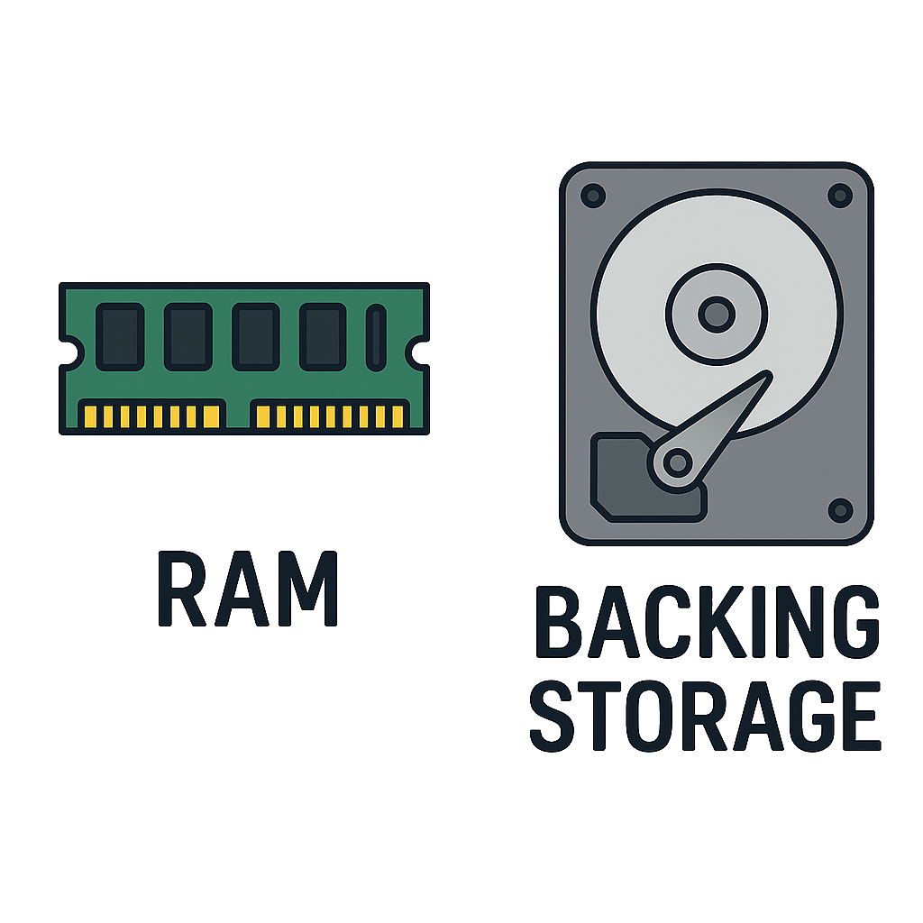
Main Memory VS Backing Storage
Main memory is temporary (data is erased when the computer is turned off), while backing storage is permanent
Main memory is faster than backing storage, making it suitable for tasks currently being processed

Slide 8
Main Memory VS Backing Storage
Memory | Temporary (Data cannot be held without power) | Permanent
Speed | Faster | Slower

Slide 9

Targets
Tasks
I can state the purpose of main memory.
I can describe how capacity affects main memory.
Main Memory Workbook
Superstudyparty.com
  NPA Computing Technologies
  Level 4
  Computing Foundations
  Main Memory

