Slide 1



Starter Revision
Subject: Computing Technologies
Level: 4
Computing Foundations
CPU
Backing Storage
Main Memory
Logical Operators

Slide 2
Units of Storage
NPA Computing Technologies
Level 4

Slide 3
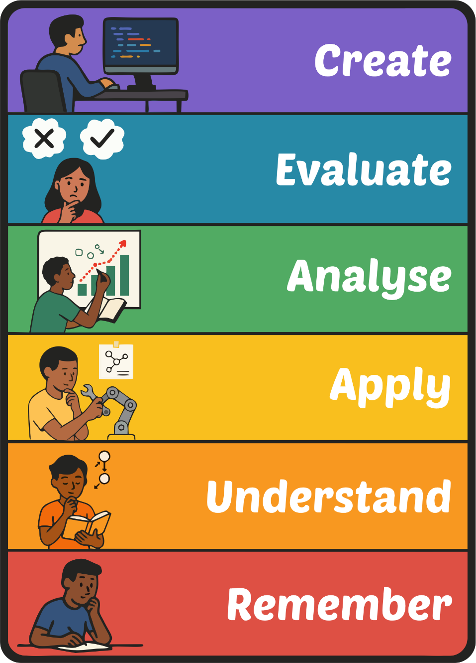
Learning Targets
I can state the data storage units
I can order the data storage units
I can state the conversion between data storage units
I can describe the purpose of data storage units

Slide 4
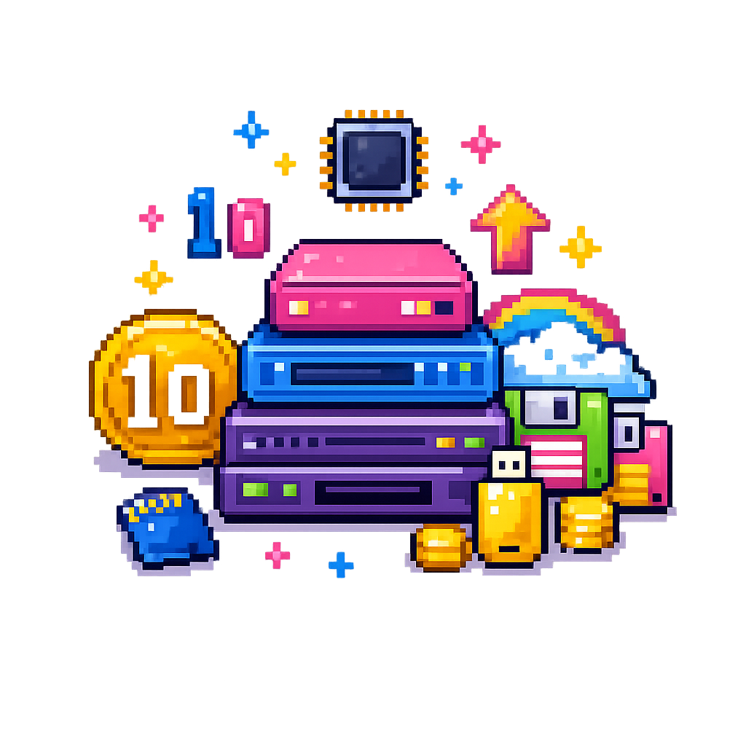
What is a Unit of Storage?
A Unit of Storage measures how much data a computer can hold.
Every file on a computer has a unit of measurement associated with it.
Units of Storage ranges from bits to terabytes.

Slide 5
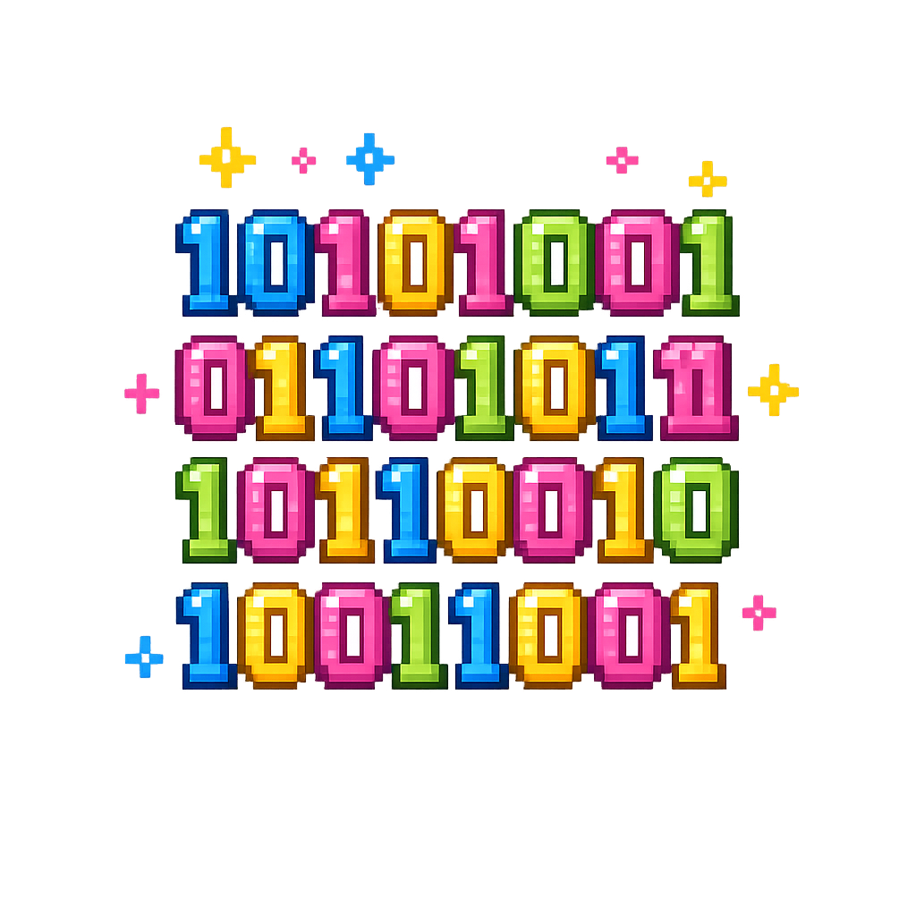
Bits
Bits are the smallest unit of measurement.
A bit is either a 1 or 0
Used for storing binary data.
Bit
Terabyte
Byte
Megabyte
Gigabyte
Kilobyte

Slide 6
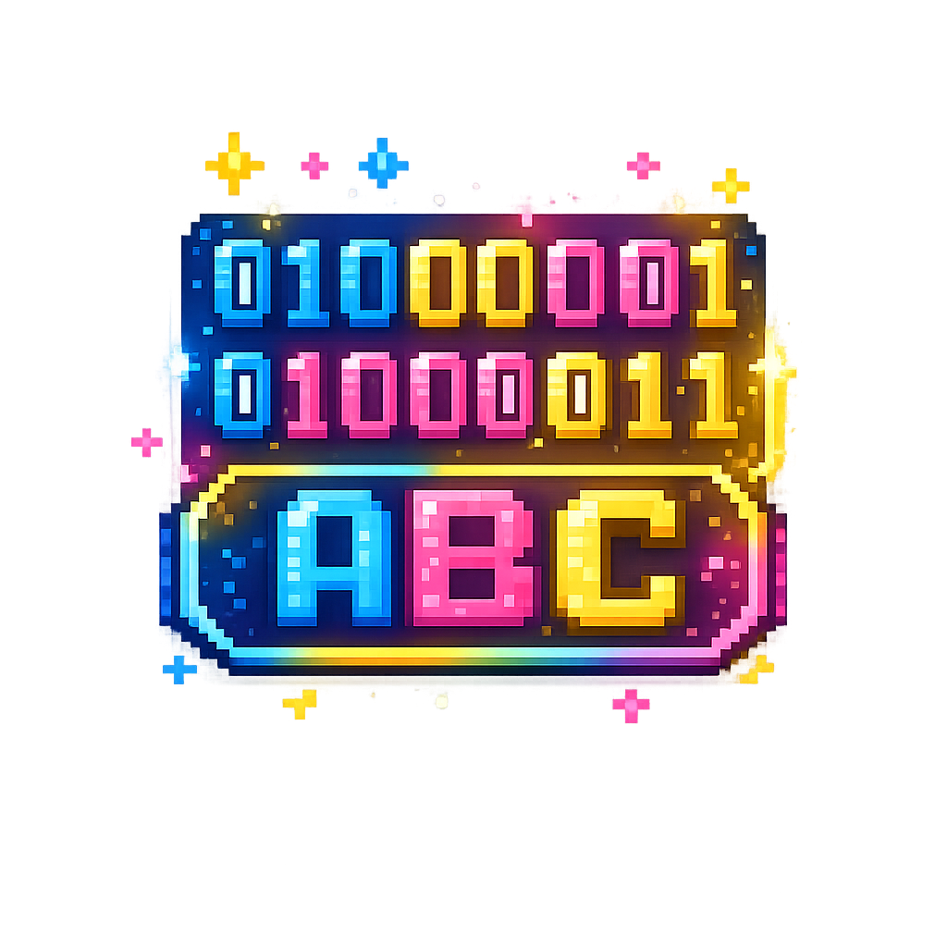
Bytes
A group of 8 bits is known as a byte
10101010 = 1 byte
A byte can store
  A character
  A number
Bit
Byte
Kilobyte
Megabyte
Gigabyte
Terabyte

Slide 7

Kilobytes
1 Kilobyte = 1024 bytes
A kilobyte can store
  A text file
Bit
Byte
Kilobyte
Megabyte
Gigabyte
Terabyte

Slide 8
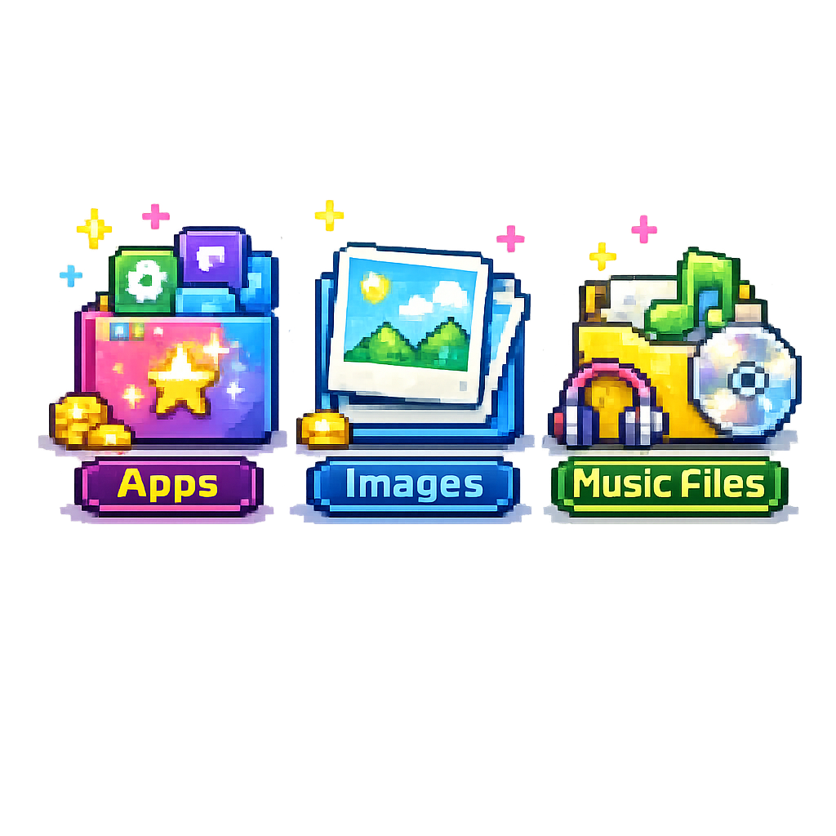
Megabyte
1 Megabyte = 1024 Kilobytes
A megabyte can store
  music
  images
Bit
Byte
Kilobyte
Megabyte
Gigabyte
Terabyte

Slide 9

Gigabyte
1 Gigabyte = 1024 Megabytes
A gigabyte can store
  Computer games
Bit
Byte
Kilobyte
Megabyte
Gigabyte
Terabyte

Slide 10

Terabyte
1 Terabyte = 1024 Gigabytes
Backing storage is commonly measured in terabytes
Bit
Byte
Kilobyte
Megabyte
Gigabyte
Terabyte

Slide 11
Units of Storage Overview
Bit
Byte
Kilobyte
Megabyte
Gigabyte
Terabyte
÷ 8
÷ 1024
÷ 1024
÷ 1024
÷ 1024
x 8
x 1024
x 1024
x 1024
x 1024

Slide 12

Targets
Tasks
I can state the data storage units
I can order the data storage units
I can state the conversion between data storage units
I can describe the purpose of data storage units
Units of Storage Workbook
Superstudyparty.com
  NPA Computing Technologies
  Level 4
  Computing Foundations
  Units of Storage

