Slide 1


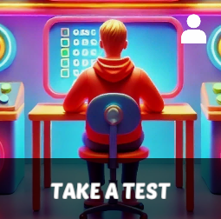
Starter Revision
Subject: Computing Technologies
Level: 4
Computing Foundations
Units of Storage

Slide 2
Binary
NPA Computing Technologies
Level 4

Slide 3
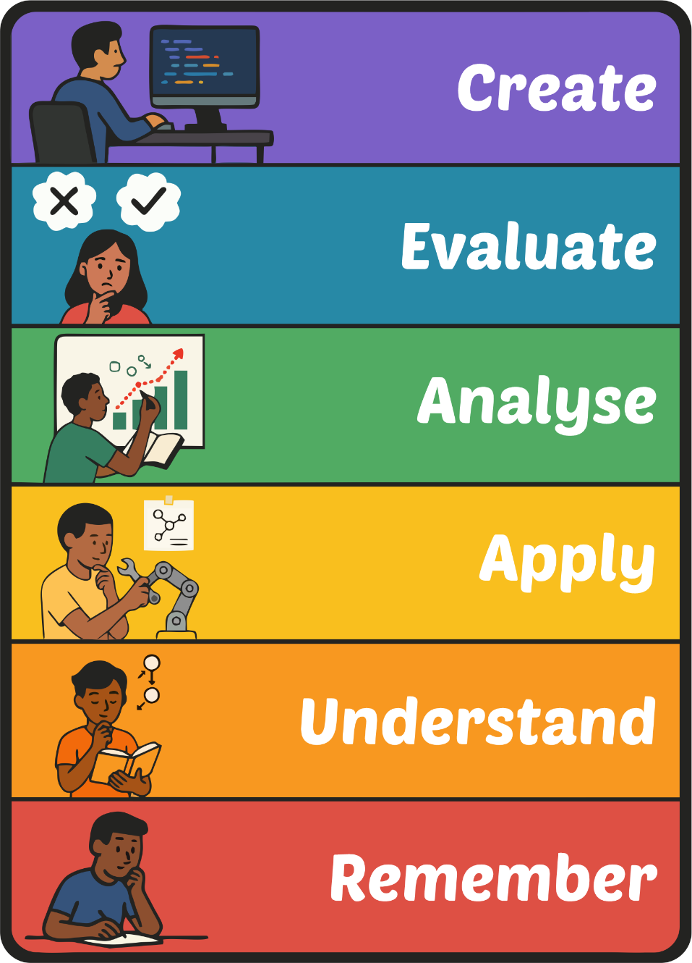
Learning Targets
I can explain what binary is.
I can convert binary to denary.
I can convert denary to binary.

Slide 4
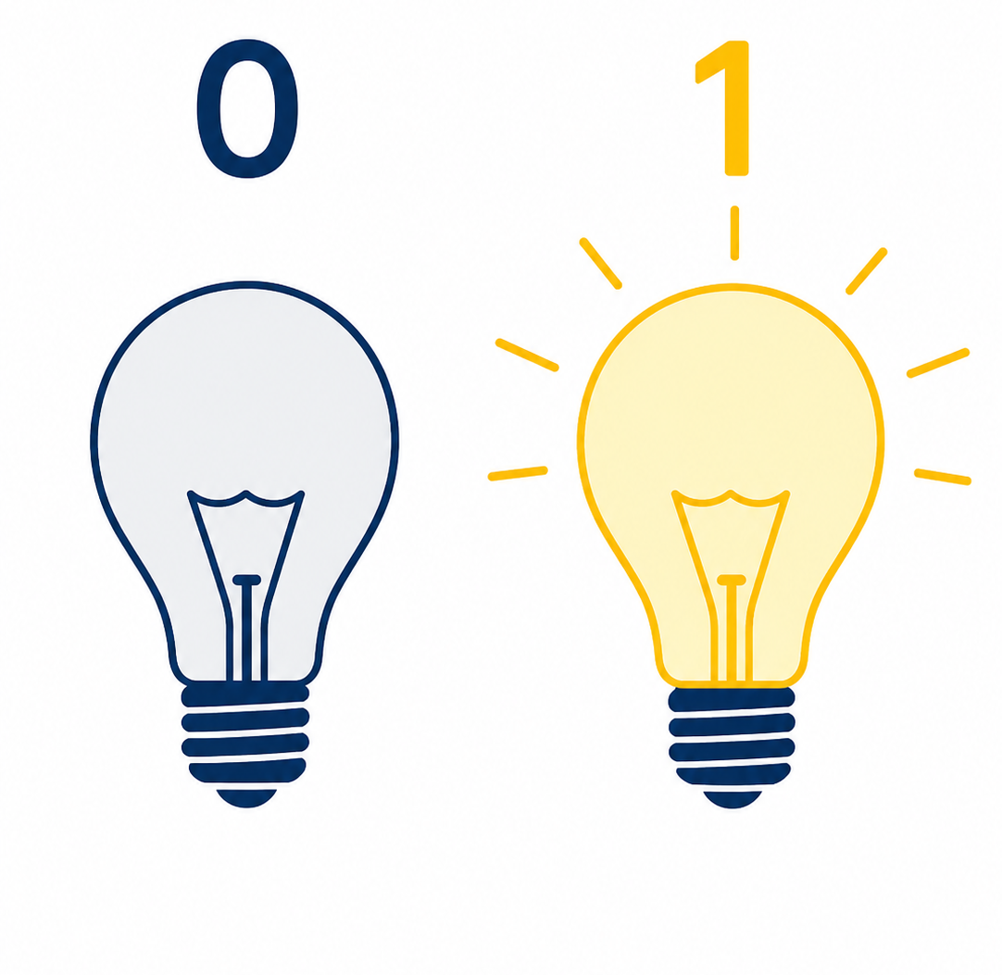
What is Binary?
Binary is a 'Machine Language' that all devices use to function.
Everything from turning on a computer to displaying images is done using binary.
In 4-bit binary, the smallest number is 0 and the largest is 15.

Slide 5
How Binary Works
Binary is made up of 1’s and 0’s.
As the binary number gets larger, values get added to the left.
101010110
10
Binary can only be in two states:
ON or OFF
The first value is 1.
This is ‘ON’.
The second value is 0.
This is ‘OFF’.

Slide 6
Converting 4-bit Binary to Denary
Each digit within a binary number has a 'value'.
For each digit we move to the left, the value doubles.
The value of a binary number starts at 1.
Value | 8 | 4 | 2 | 1
Binary | 1 | 0 | 1 | 1
We now know that 1011 in binary is equal to 11 in denary.
For each value where the binary is 1, we add the values together.
8
+
2
+
1
=
11
Notes:
Explain that in its most basic form, we start from the right, and each number doubles as we move left.

Slide 7
Converting 4-bit Binary to Denary
Now let’s convert 1100 to Denary
Value | 8 | 4 | 2 | 1
Binary | 1 | 1 | 0 | 0
Write the Binary number into the grid.
8
+
4
=
12
For every binary value that is 1, pull out the value.
Now add the values together to get the Denary value.
Notes:
Explain that in its most basic form, we start from the right, and each number doubles as we move left.

Slide 8
Converting 4-bit Denary to Binary
Now let’s convert the number 11 into Binary.
Value | 8 | 4 | 2 | 1
Binary | 1 | 0 | 1 | 1
We now know that 11 in binary is 1011!
The first number that fits into 11 is 8.
The first number that fits into 3 is 2.
The first number that fits into 1 is 1.
Where there are empty binary values, write in a 0.
Now repeat the same steps until we have 0.
Write a 1 under 8.
Write a 1 under 2.
Write a 1 under 1.
3 is now the number we are working with.
1 is now the number we are working with.
We have now reached 0 so the conversion is complete.
11 – 8 = 3
3 – 2 = 1
1 – 1 = 0
Notes:
Explain that in its most basic form, we start from the right, and each number doubles as we move left.

Slide 9
Converting 4-bit Denary to Binary
Now let’s convert the number 7 into Binary.
Value | 8 | 4 | 2 | 1
Binary | 0 | 1 | 1 | 1
7 converted to Binary is 0111!
What is the lowest value that fits into 7?
What is the lowest value that fits into 3?
What is the lowest value that fits into 1?
7 – 4 = 3
3 – 2 = 1
1 – 1 = 0
Now, fill in any blanks with a 0.
Notes:
Explain that in its most basic form, we start from the right, and each number doubles as we move left.

Slide 10

Targets
Tasks
I can explain what binary is.
I can convert binary to denary.
I can convert denary to binary.
Binary Workbook
Superstudyparty.com
  NPA Computing Technologies
  Level 4
  Computing Foundations
  Units of Storage

