Slide 1


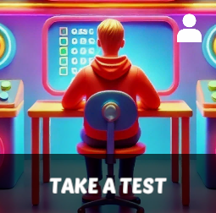
Starter Revision
Subject: Computing Technologies
Level: 4
Computing Foundations
Units of Storage
4-Bit Binary

Slide 2
Storing Text (ASCII)
NPA Computing Technologies
Level 4

Slide 3
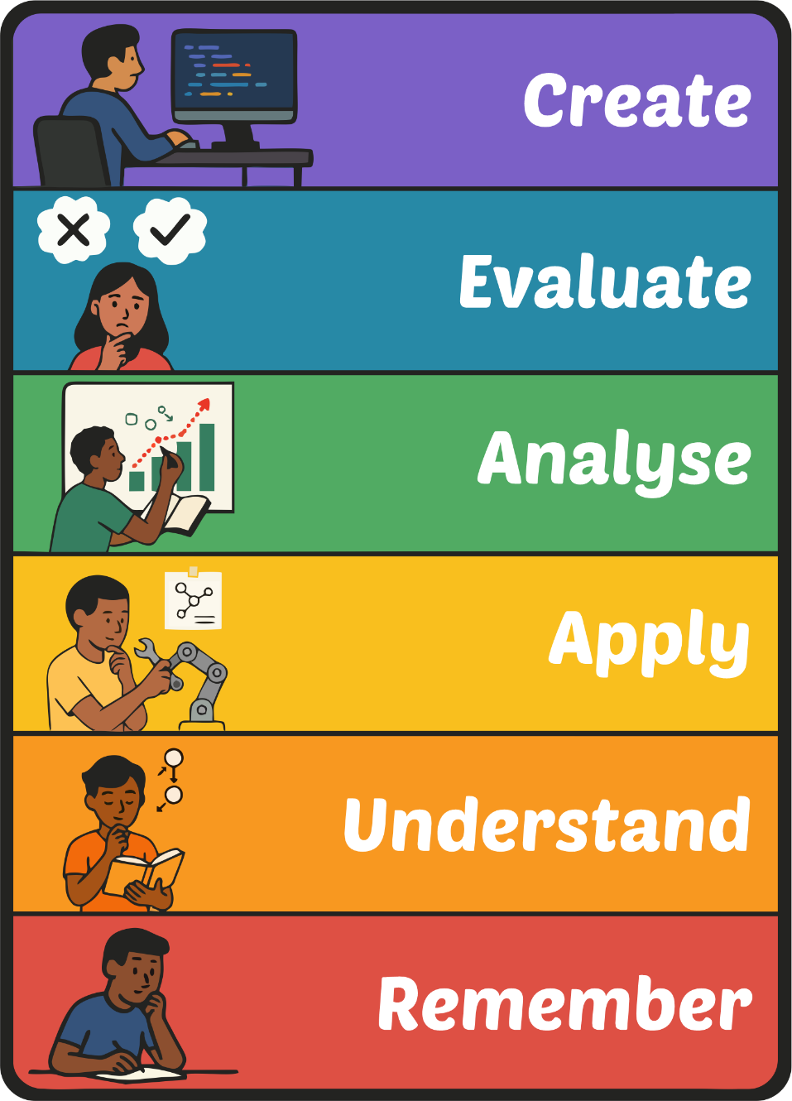
Learning Targets
I can explain the purpose of ASCII.
I can describe how binary uses ASCII to display characters.

Slide 4
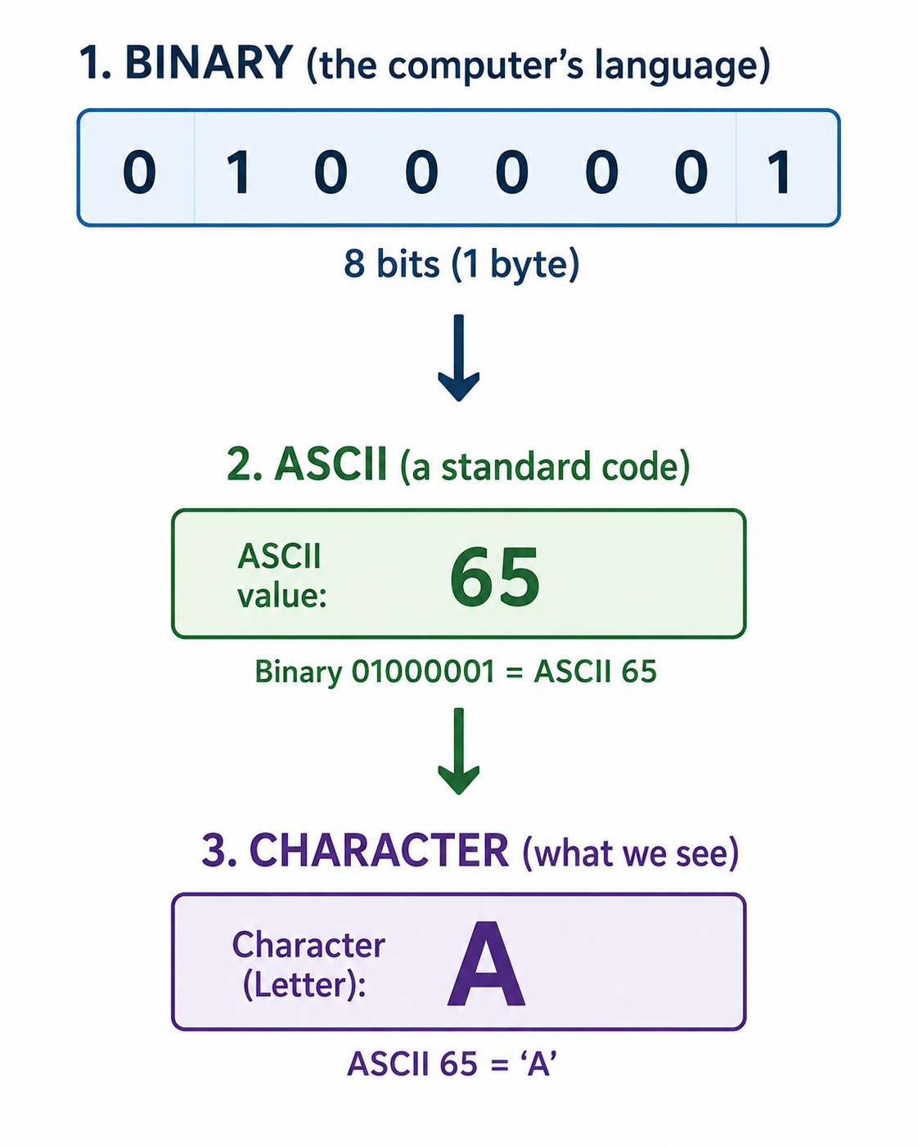
What is ASCII?
ASCII stands for:
“American Standard Code for Information Interchange”
ASCII converts binary into characters we can use and understand.

Slide 5
Why do we need ASCII?
Computers only understand 1s and 0s.
But people read letters and symbols.
ASCII is the way to convert binary into characters that humans can understand.
Binary | ASCII | Character
01000001 | 65 | A
01000010 | 66 | B
01000011 | 67 | C
01000101 | 68 | D
01000110 | 69 | E
01000111 | 70 | F
01001000 | 71 | G
01001001 | 72 | H

Slide 6
Using ASCII
Every word is made up of a collection of ASCII codes but displayed as characters.
Can you decode the below word?
A | 65
B | 66
C | 67
D | 68
E | 69
F | 70
G | 71
H | 72
I | 73
J | 74
K | 75
L | 76
M | 77
N | 78
O | 79
P | 80
Q | 81
R | 82
S | 83
T | 84
U | 85
V | 86
W | 87
X | 88
Y | 89
Z | 90
67 | 79 | 77 | 80 | 85 | 84 | 69 | 82
C | O | M | P | U | T | E | R

Slide 7

Targets
Tasks
I can explain the purpose of ASCII.
I can describe how binary uses ASCII to display characters.
Binary Workbook
Superstudyparty.com
  NPA Computing Technologies
  Level 4
  Computing Foundations
  Units of Storage

