Slide 1



Starter Revision
Subject: Computing Technologies
Level: 4
Computing Foundations
4-Bit Binary
Storing Text

Slide 2
Operating Systems
NPA Computing Technologies
Level 4

Slide 3
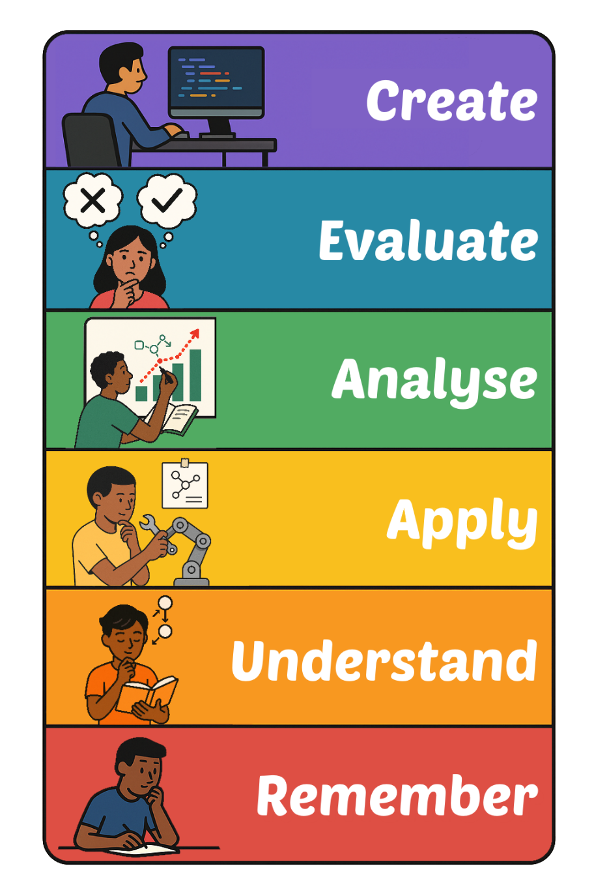
Learning Targets
I can state the roles of operating systems
I can describe how an operating system manages hardware and resources

Slide 4
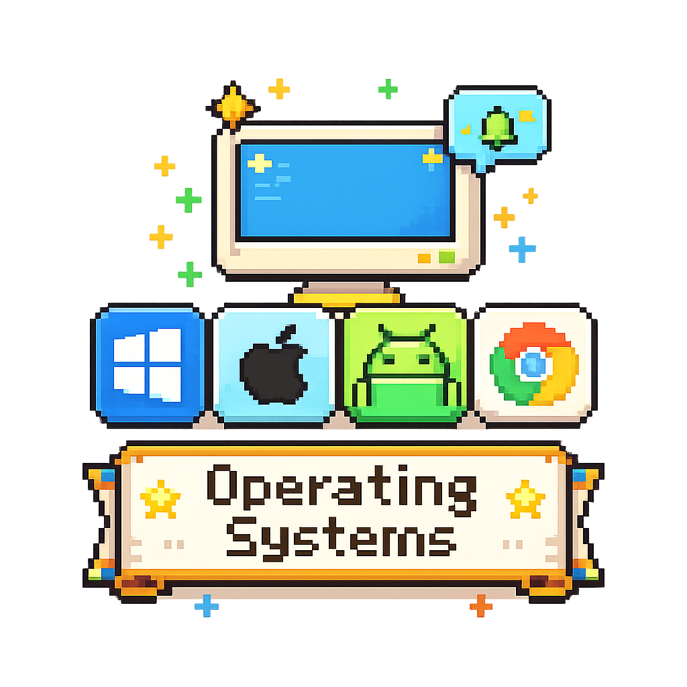
What is an Operating System?
An operating system (OS) is the software that manages a computer’s hardware and resources
It acts as a bridge between the user, applications, and the hardware

Slide 5
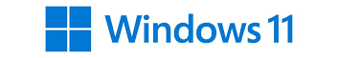

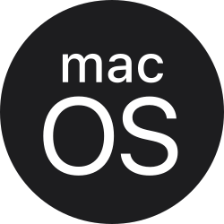
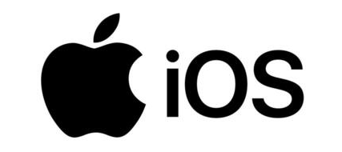

Examples of Operating Systems
Every device you use will use an Operating System to control its hardware.
Here are five of the most common that you may use in school and at home.

Slide 6
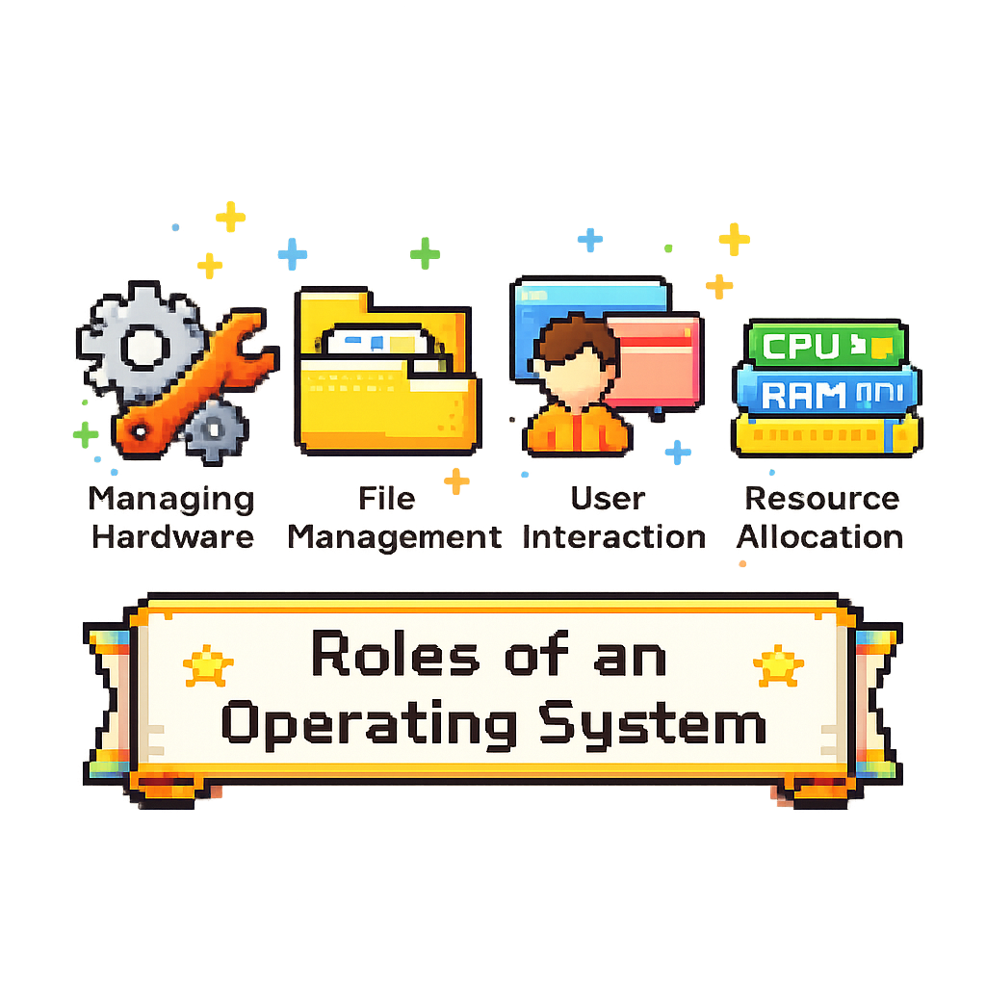
Roles of an Operating System
An Operating Systems main role is to manage a computers hardware and resources.
But how does it do this?

Slide 7
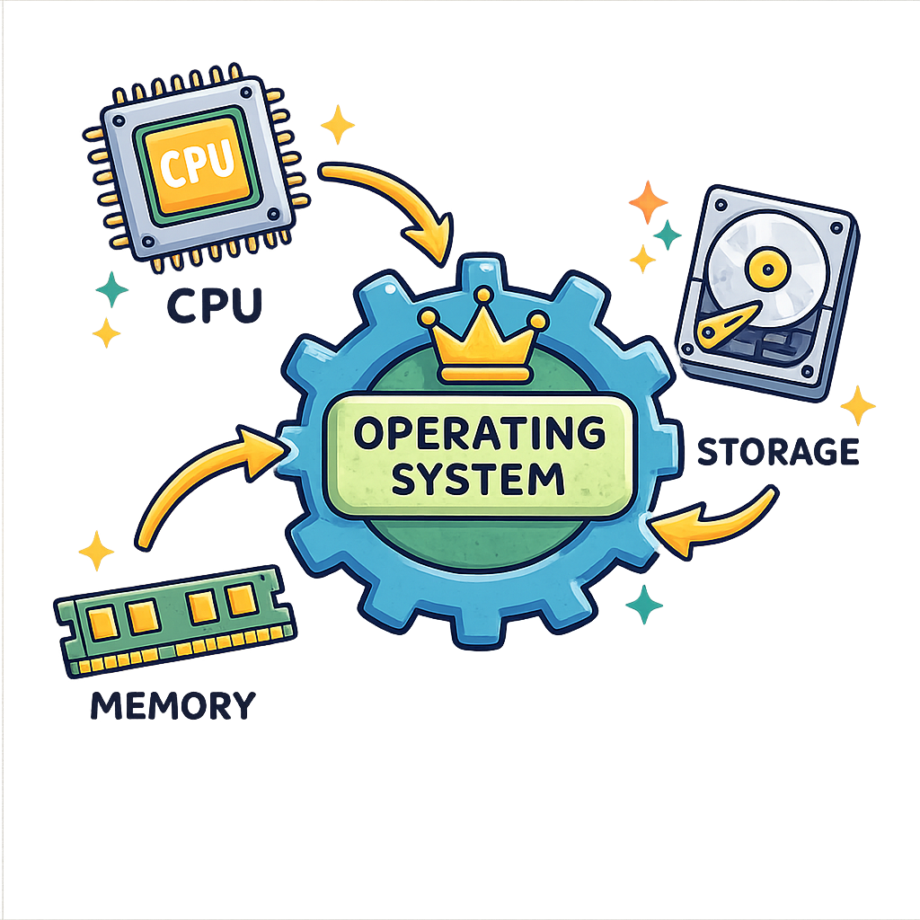
Managing Hardware
Controls devices like the CPU, memory, and storage to ensure they work efficiently.

Slide 8
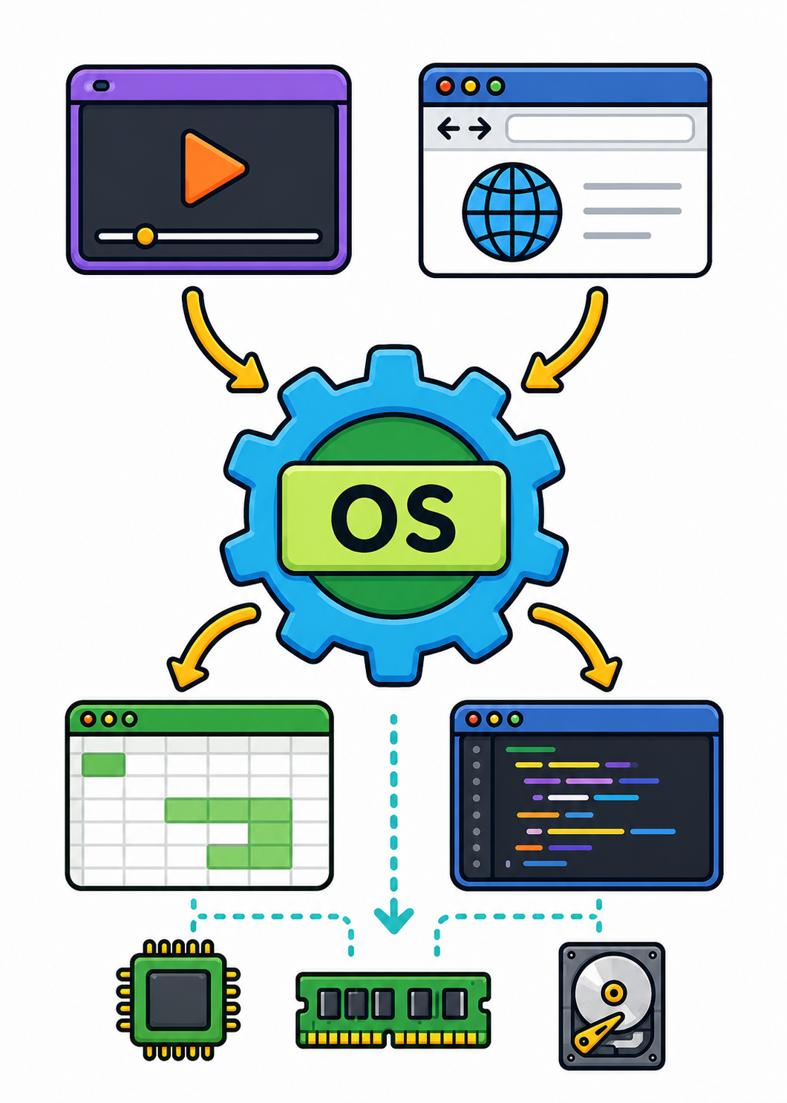
Resource Allocation
Distributes the computer’s resources to different programs and tasks.

Slide 9
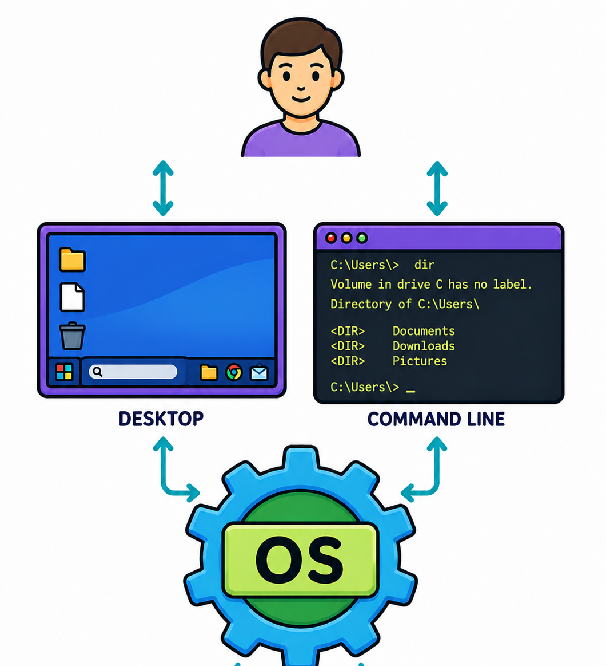
Provides a User Interface
Provides a way for users to interact with the computer, such as through a desktop or command line

Slide 10
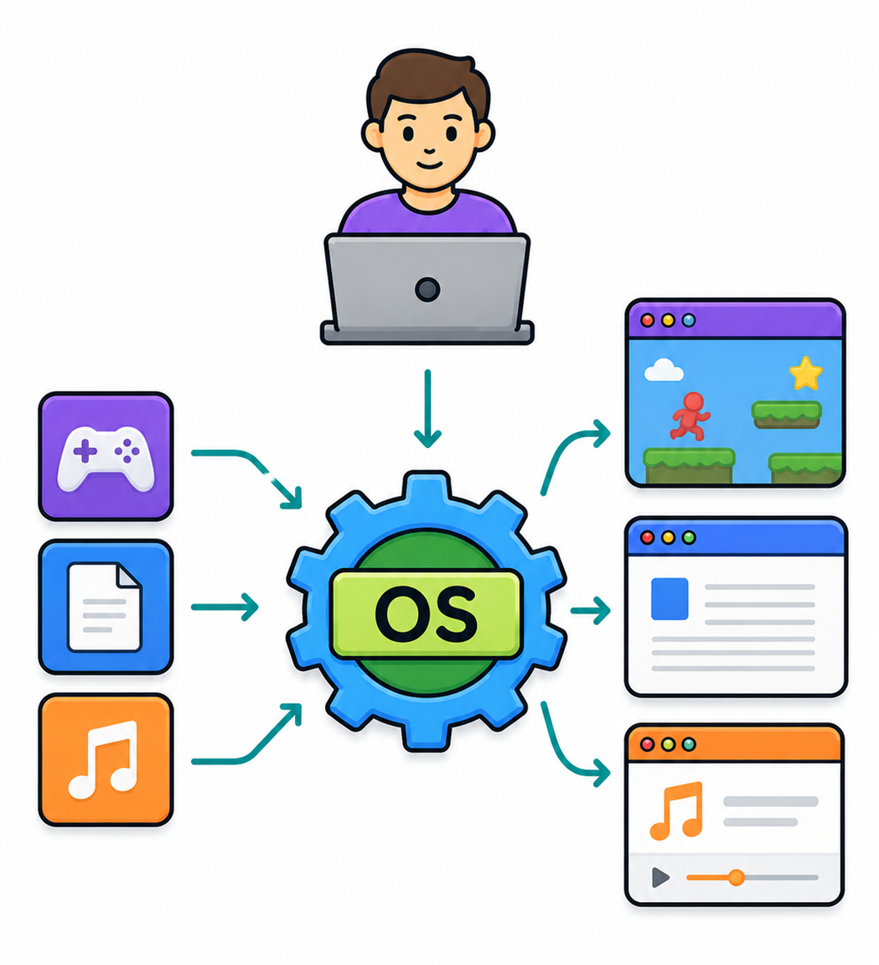
Running Applications
Loads and runs programs so the user can perform tasks

Slide 11
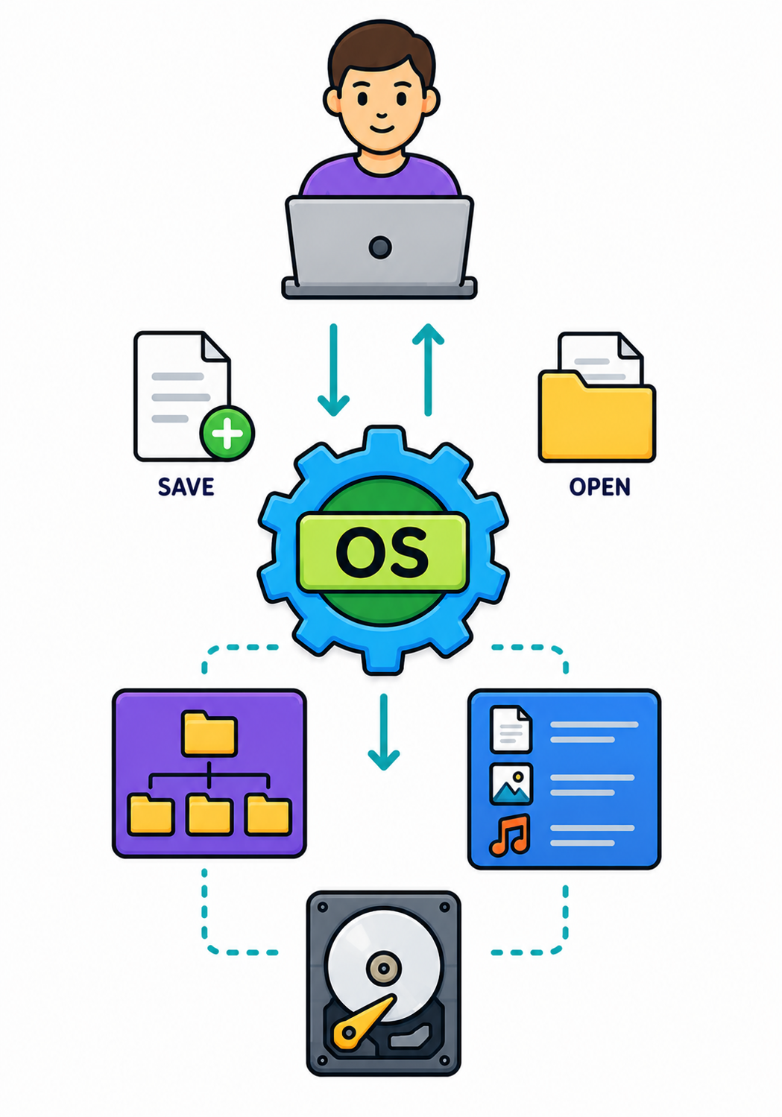
File Management
Helps organise, save, and retrieve files on the computer

Slide 12

Targets
Tasks
I can state the roles of operating systems
I can describe how an operating system manages hardware and resources
Operating Systems Workbook
Superstudyparty.com
  NPA Computing Technologies
  Level 4
  Computing Foundations
  Operating Systems

