Slide 1



Starter Revision
Subject: Computing Technologies
Level: 4
Computing Foundations
4-Bit Binary
Storing Text
Operating Systems

Slide 2
Data Types
NPA Computing Technologies
Level 4

Slide 3

Learning Targets
I can identify the type of data being used.
I can select the best data type to use.

Slide 4

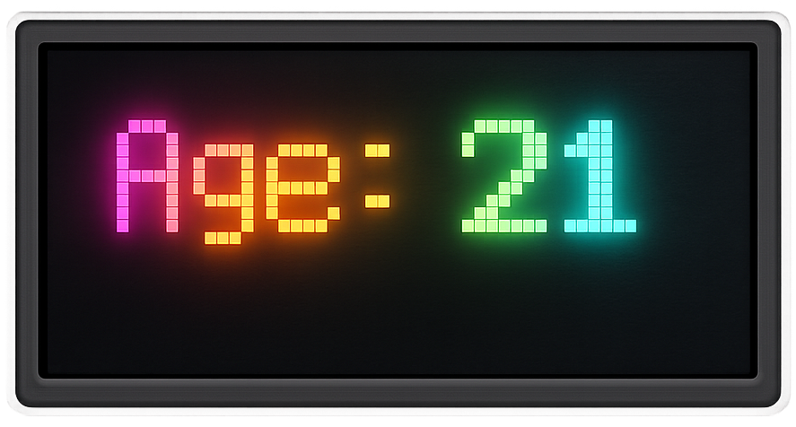

What are Data Types?
Data types define the kind of information a program can work with.
All information used within a program can be stored as different data types.

Slide 5
Float / Real
Floats / Reals store numbers that have a decimal place.
Price: 4.99
Height: 1.75
Temperature: 22.5

Slide 6
Integer
Integers store whole numbers.
Age: 21
Score: 150
Number of Pupils: 20

Slide 7
String
Strings store a mix of letters, numbers and characters.
Name: Bill
Email: hello@studyparty.com
Password: p4ssw0rd_1!

Slide 8
Identify the Data Types
Can you identify if the following information is a float/real, integer or a string?
27.99
Float / Real

Slide 9
Identify the Data Types
Can you identify if the following information is a float/real, integer or a string?
10000
Integer

Slide 10
Identify the Data Types
Can you identify if the following information is a float/real, integer or a string?
Wilma
String

Slide 11
Identify the Data Types
Can you identify if the following information is a float/real, integer or a string?
-100
Integer

Slide 12
Identify the Data Types
Can you identify if the following information is a float/real, integer or a string?
#StudyParty
String

Slide 13
Identify the Data Types
Can you identify if the following information is a float/real, integer or a string?
0
Integer

Slide 14
Identify the Data Types
Can you identify if the following information is a float/real, integer or a string?
3.14
Float / Real

Slide 15
Identify the Data Types
Can you identify if the following information is a float/real, integer or a string?
8 Study Street
String

Slide 16
Identify the Data Types
Can you identify if the following information is a float/real, integer or a string?
0.28
Float / Real

Slide 17

Using the correct data type
When writing code, it is important to use the right data type for the job.

Slide 18
Using the correct data type
If you were storing the number of pupils in a classroom, what data type would you use?
Integer

Slide 19
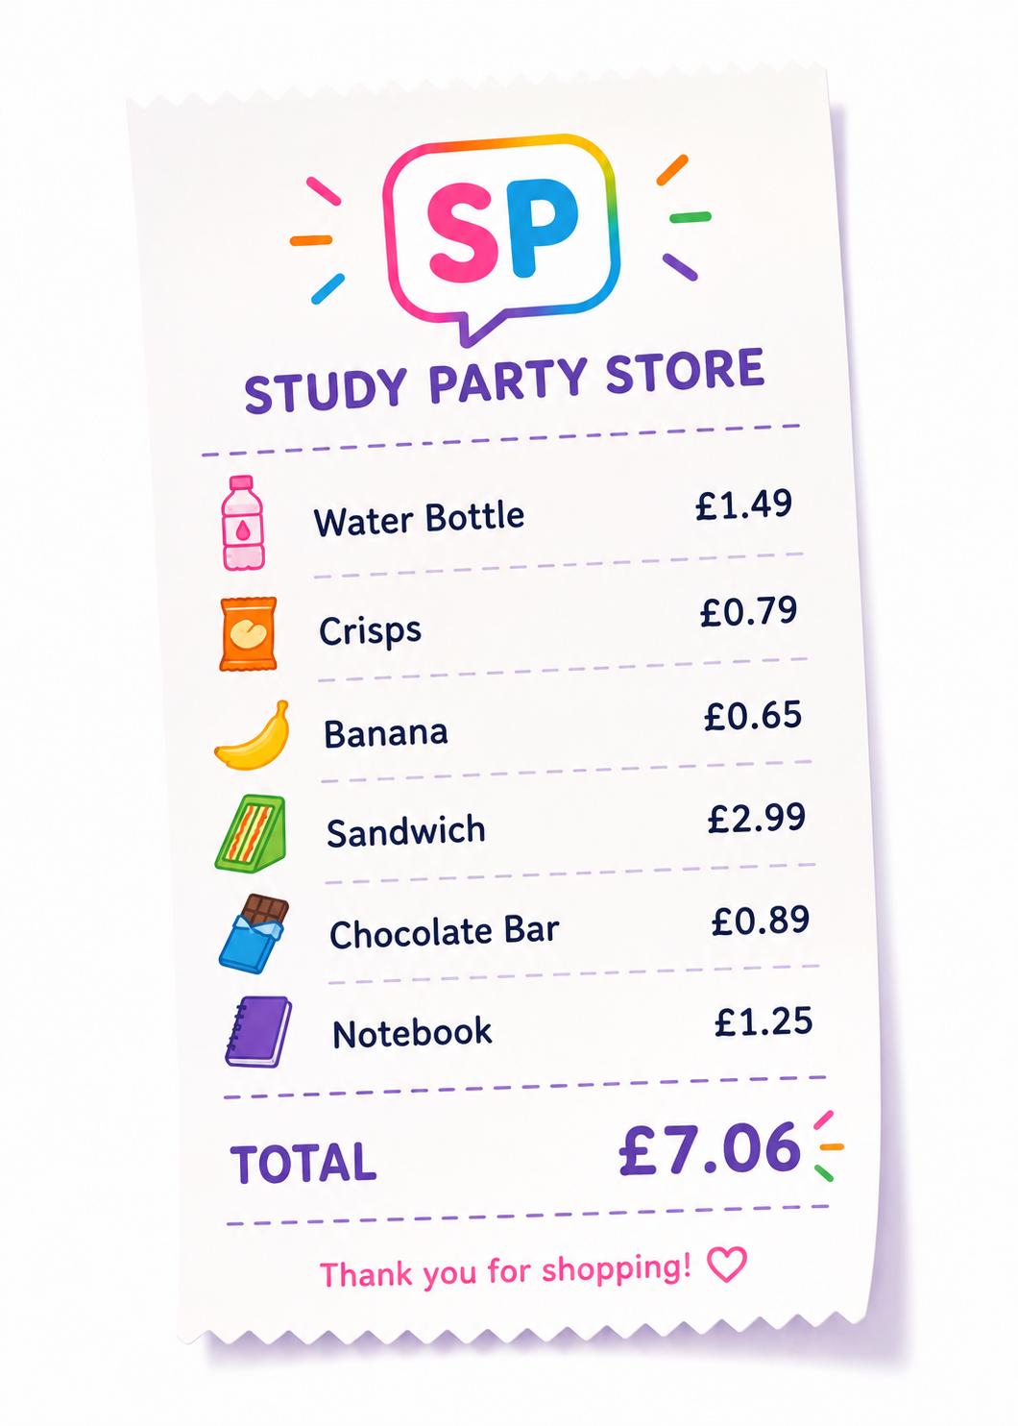
Using the correct data type
If you were calculating the total price of items bought in a shop, what data type would you use?
Float / Real

Slide 20
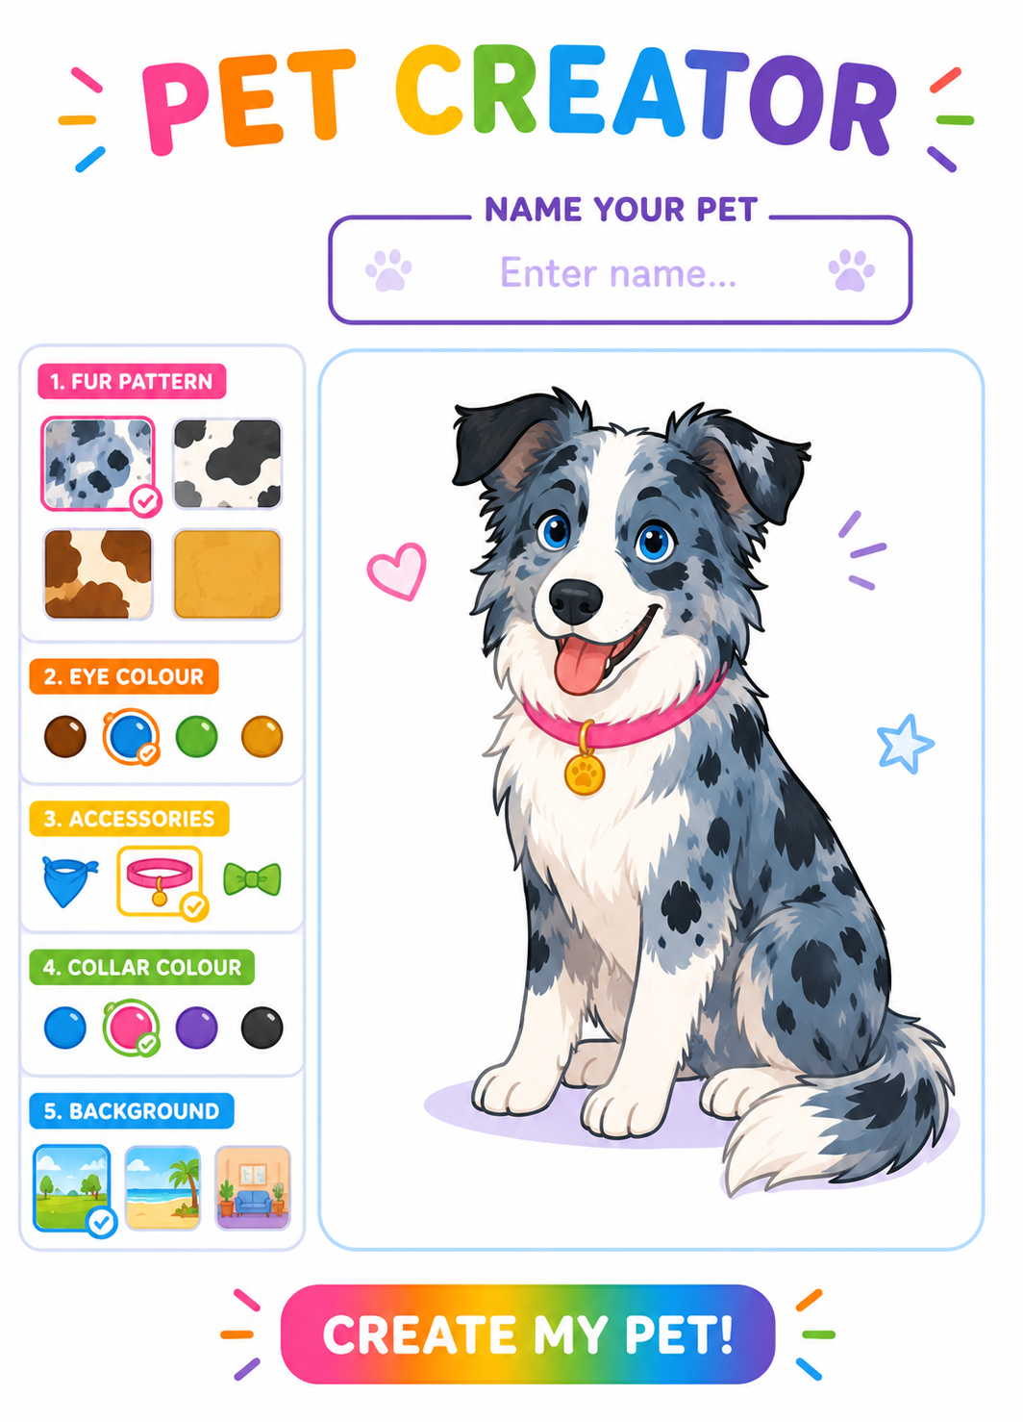
Using the correct data type
If you were creating a game where you can design your own pet, what data type would store the pets name?
String

Slide 21

Targets
Tasks
I can identify the type of data being used.
I can select the best data type to use.
Data Types Workbook
Superstudyparty.com
  NPA Computing Technologies
  Level 4
  Computing Foundations
  Data Types

